Slide 1
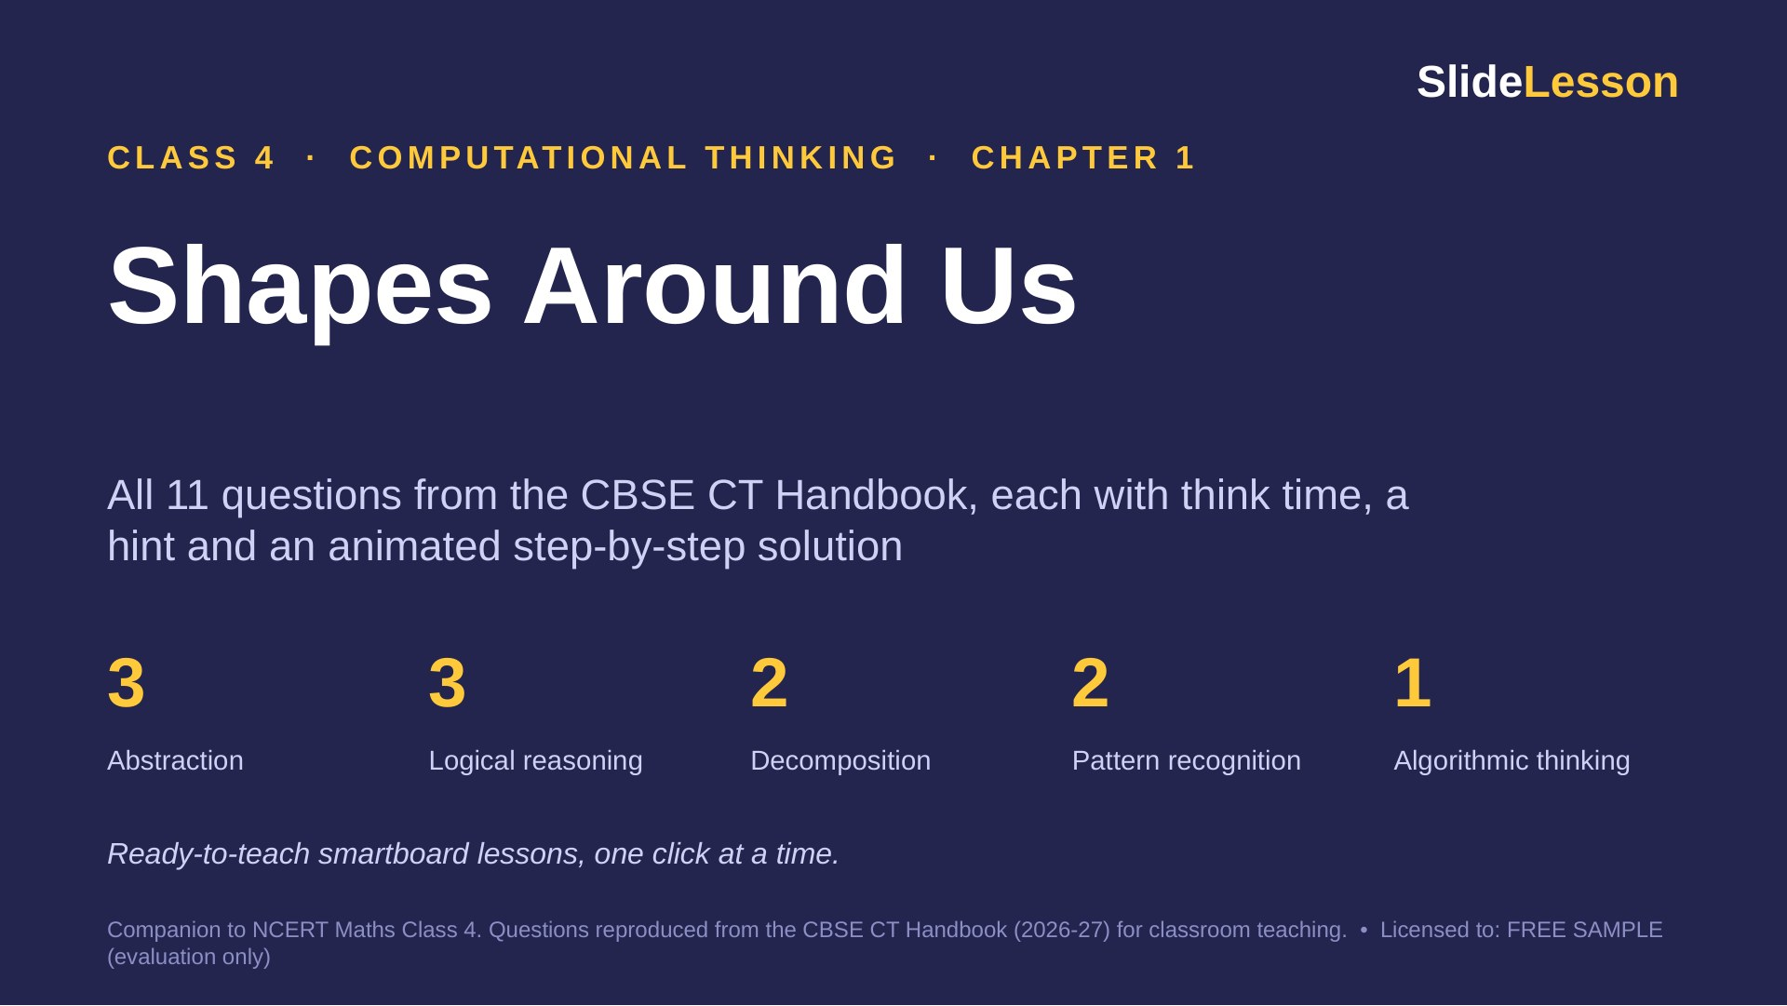
Notes:
This deck covers every question in Chapter 1 of the Class 4 CT Handbook (11 questions and The Thinking Spot). Each question has 3 slides: THINK (60 seconds alone), HINT, and SOLUTION (click to reveal one step at a time). Speaker notes give facilitation tips, common mistakes and extension questions.

Slide 2
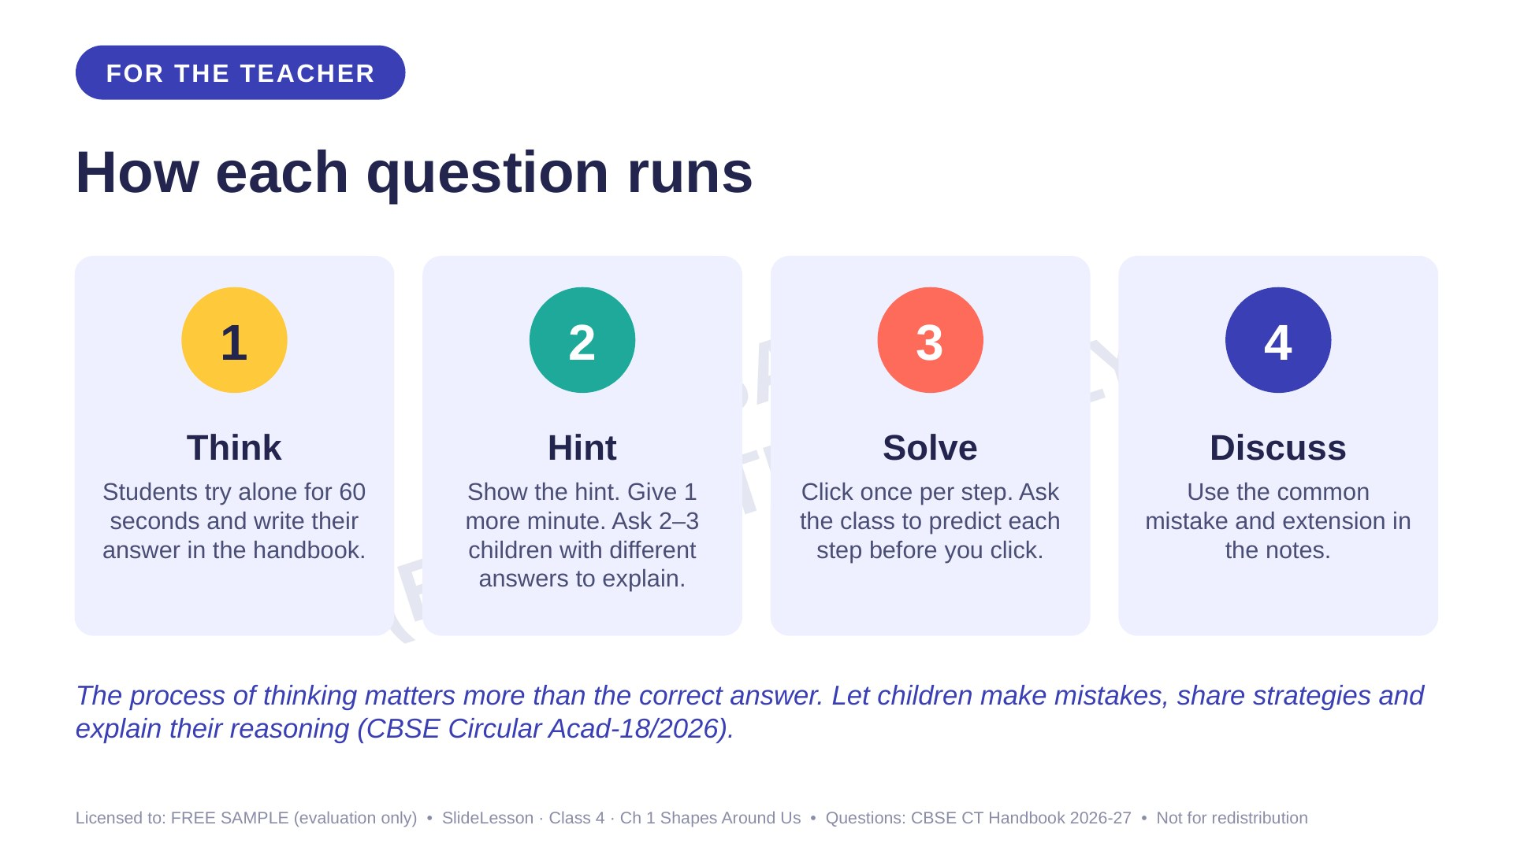

Slide 3
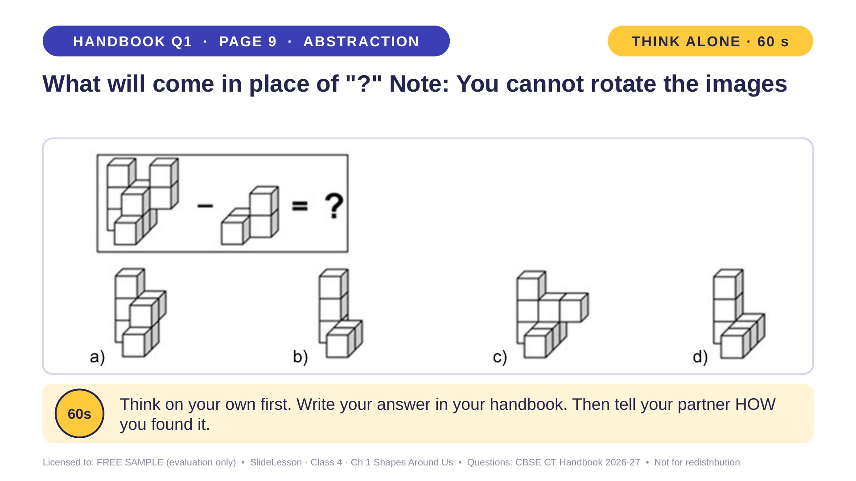
Notes:
WHILE SOLVING: build both shapes with snap cubes and physically remove the smaller one. COMMON MISTAKE: rotating the result, which is not allowed. EXTENSION: what would you get if you subtracted a single cube from the top?
ANSWER (do not tell yet): d

Slide 4
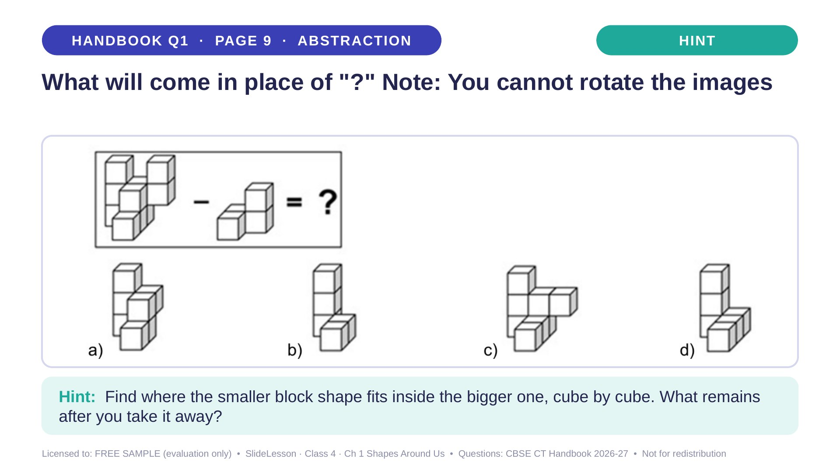
Notes:
Give the hint, then 1 more minute. Ask 2-3 children with DIFFERENT answers to explain their thinking before moving on.
WHILE SOLVING: build both shapes with snap cubes and physically remove the smaller one. COMMON MISTAKE: rotating the result, which is not allowed. EXTENSION: what would you get if you subtracted a single cube from the top?

Slide 5
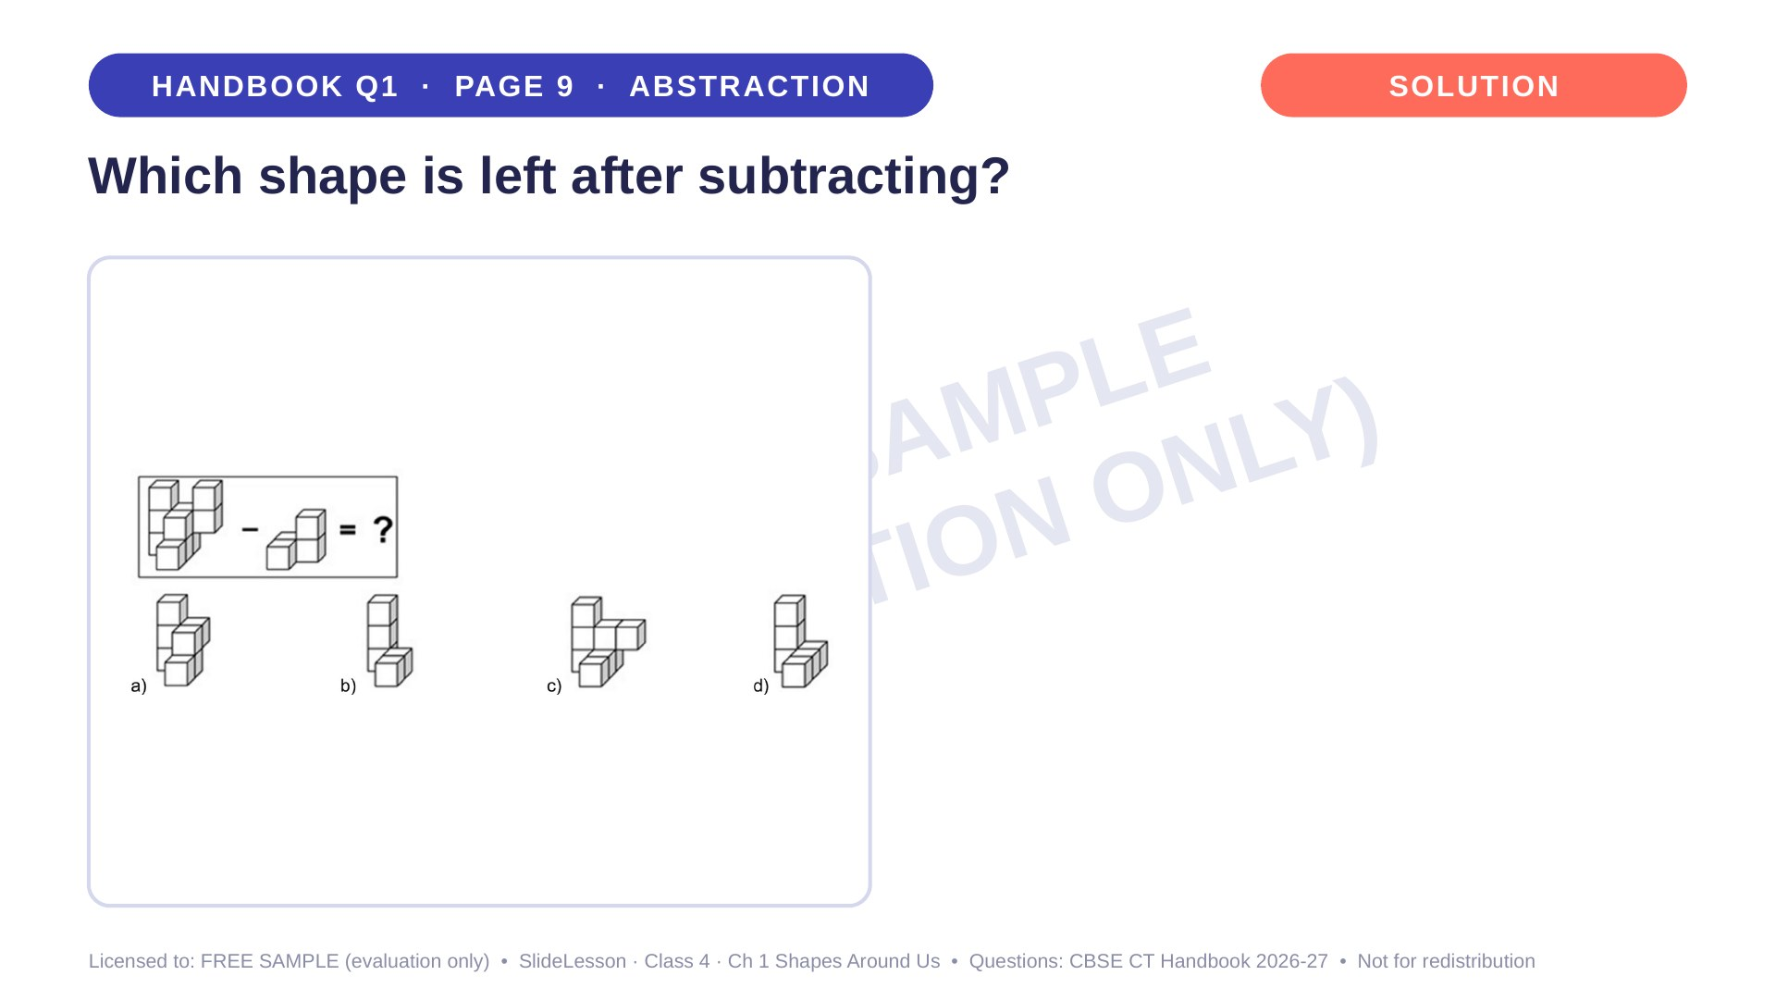
Notes:
WHILE SOLVING: build both shapes with snap cubes and physically remove the smaller one. COMMON MISTAKE: rotating the result, which is not allowed. EXTENSION: what would you get if you subtracted a single cube from the top?

Slide 6
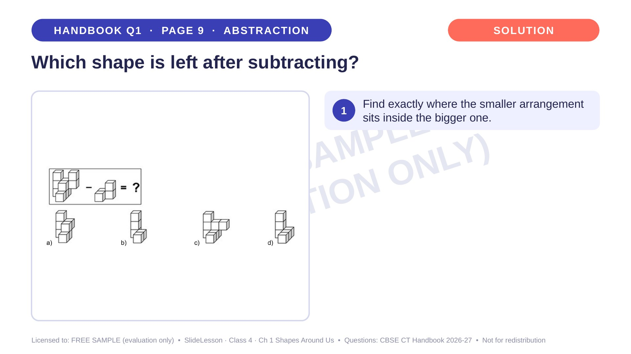
Notes:
Step 1 of 4

Slide 7
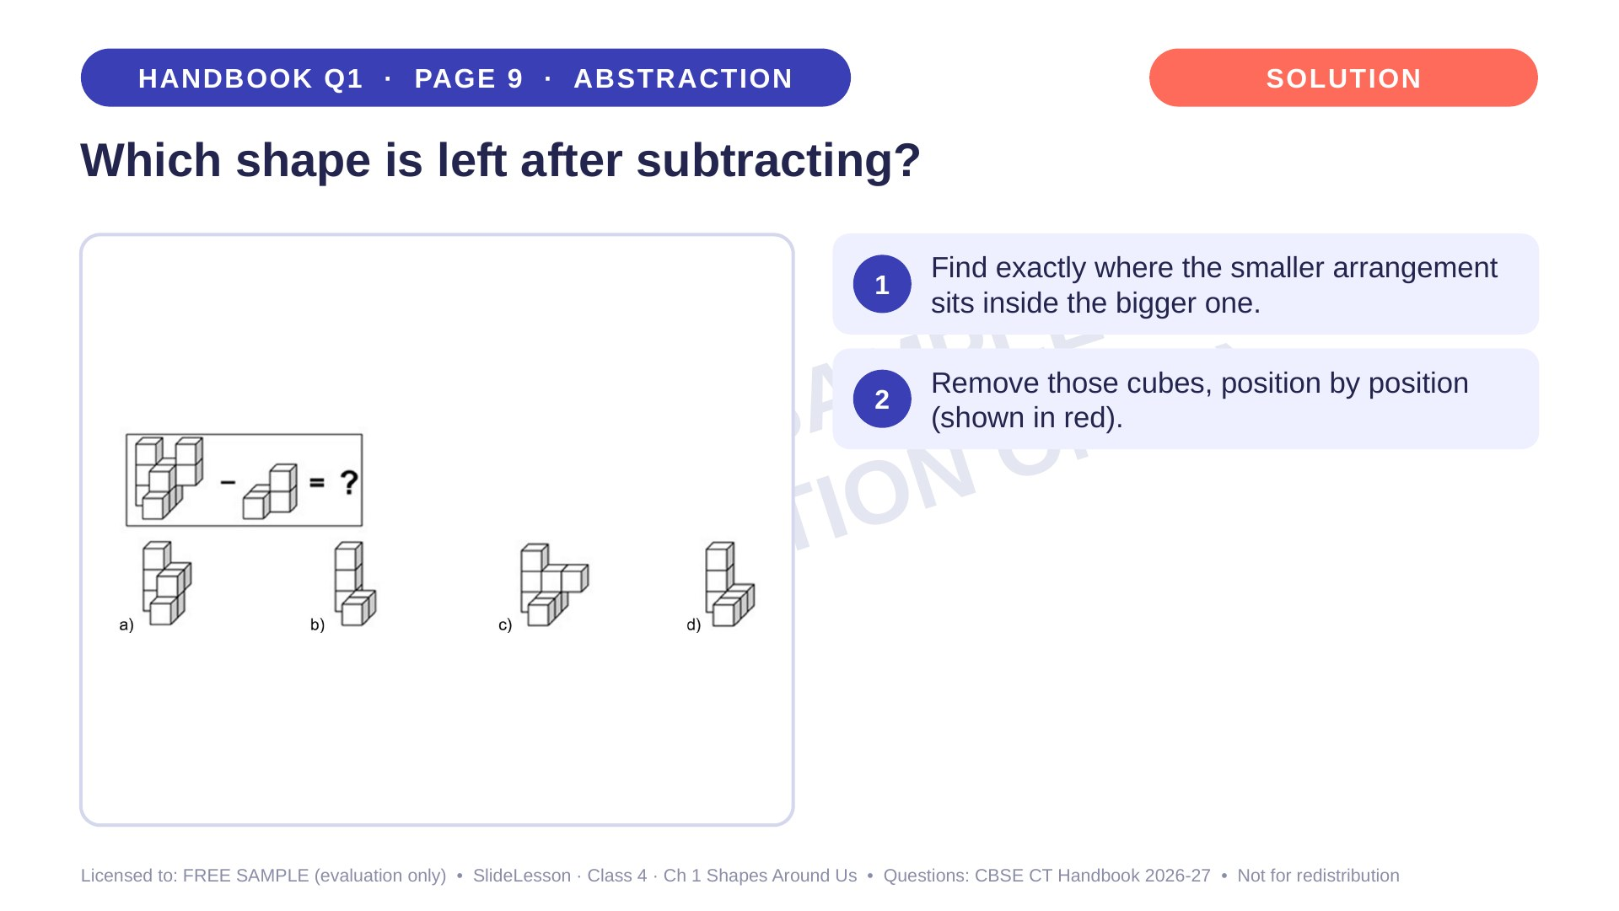
Notes:
Step 2 of 4

Slide 8
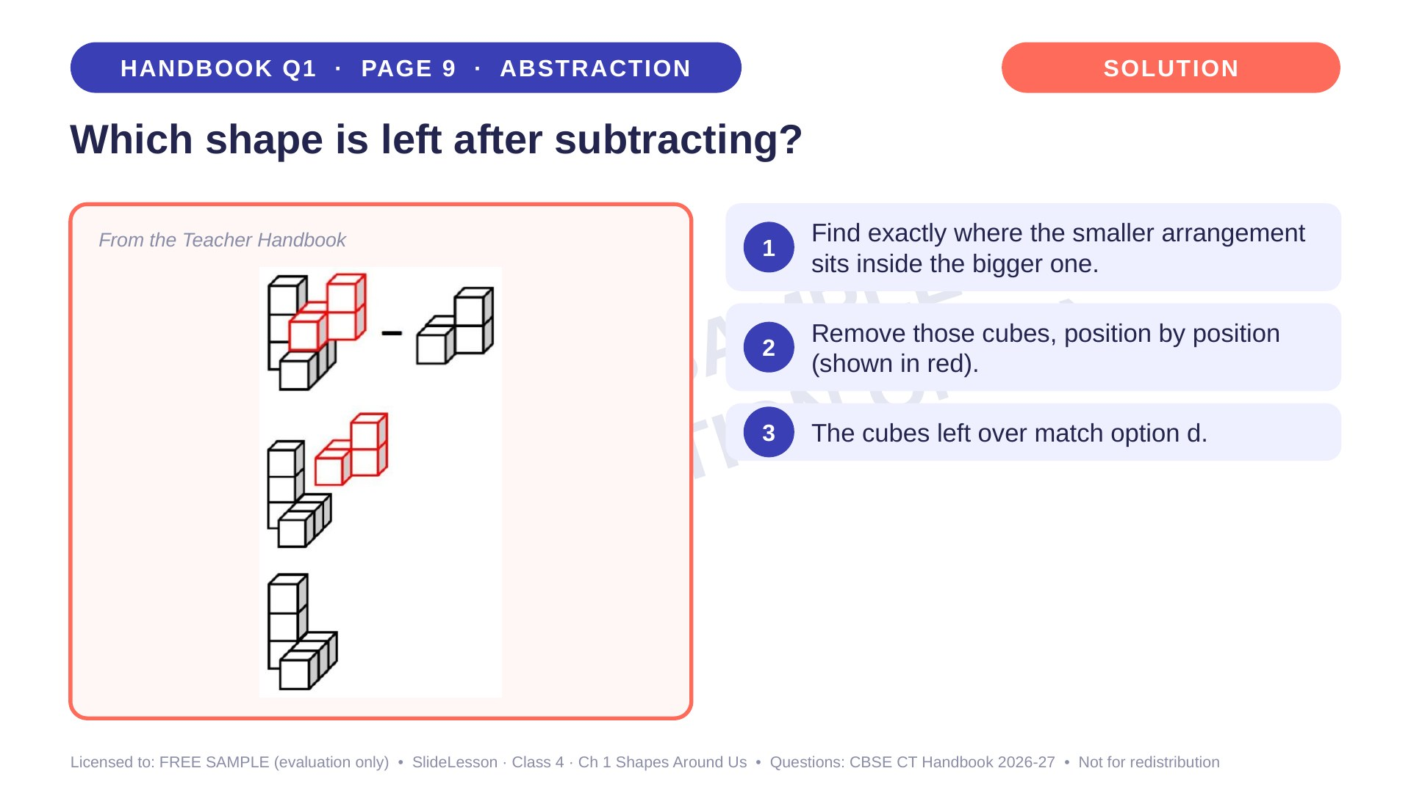
Notes:
Step 3 of 4

Slide 9
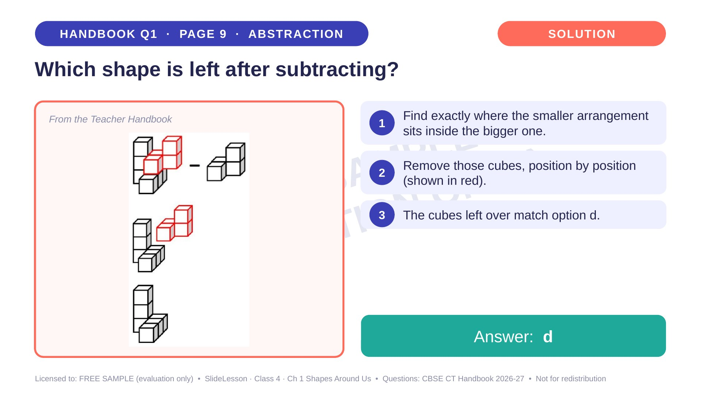
Notes:
Step 4 of 4

Slide 10
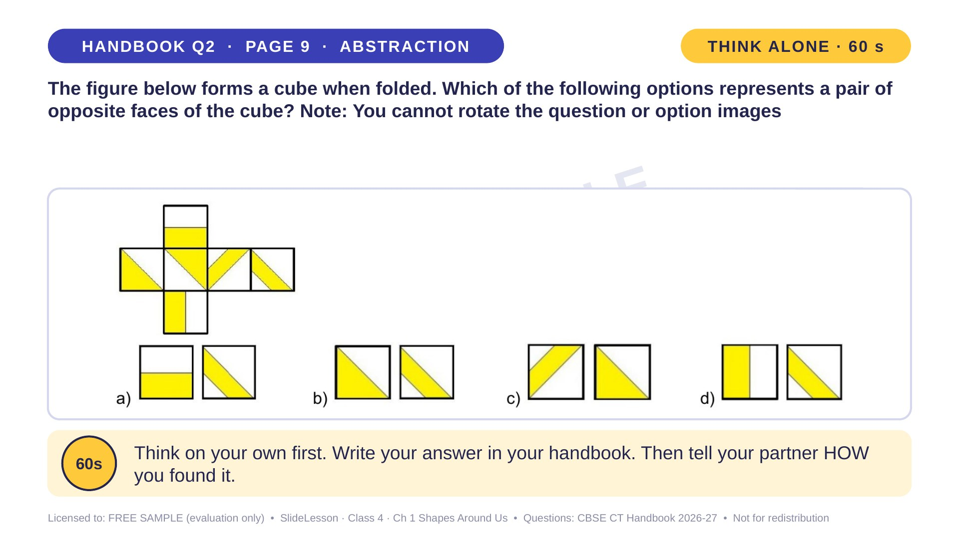
Notes:
WHILE SOLVING: print the net, cut it out and fold it. This is the fastest way to build the mental picture. COMMON MISTAKE: thinking faces next to each other in the net are opposite. TIP: in a straight row of 3, the 1st and 3rd faces are opposite. EXTENSION: draw another net of a cube.
ANSWER (do not tell yet): c

Slide 11
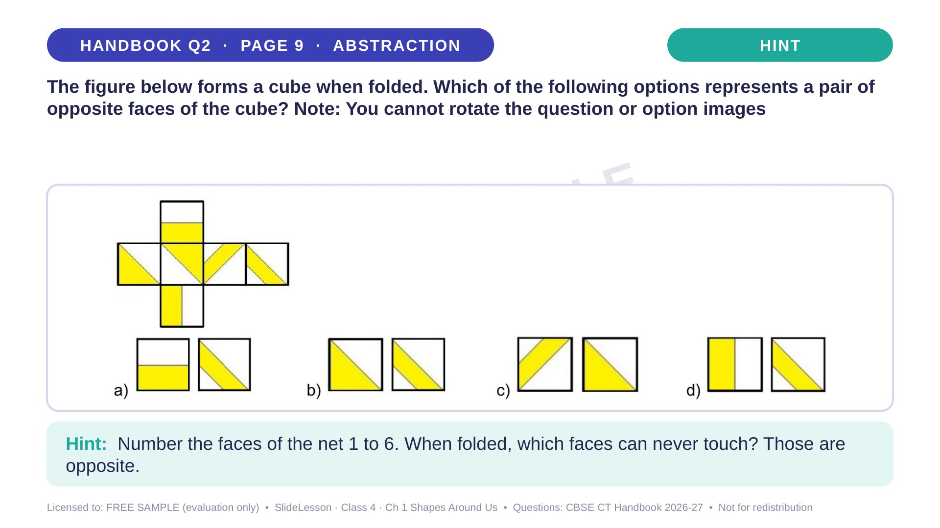
Notes:
Give the hint, then 1 more minute. Ask 2-3 children with DIFFERENT answers to explain their thinking before moving on.
WHILE SOLVING: print the net, cut it out and fold it. This is the fastest way to build the mental picture. COMMON MISTAKE: thinking faces next to each other in the net are opposite. TIP: in a straight row of 3, the 1st and 3rd faces are opposite. EXTENSION: draw another net of a cube.

Slide 12
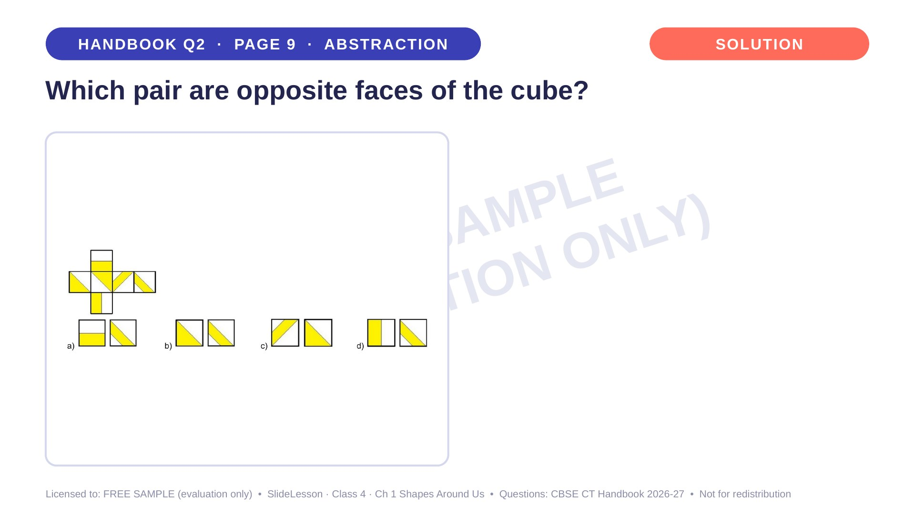
Notes:
WHILE SOLVING: print the net, cut it out and fold it. This is the fastest way to build the mental picture. COMMON MISTAKE: thinking faces next to each other in the net are opposite. TIP: in a straight row of 3, the 1st and 3rd faces are opposite. EXTENSION: draw another net of a cube.

Slide 13
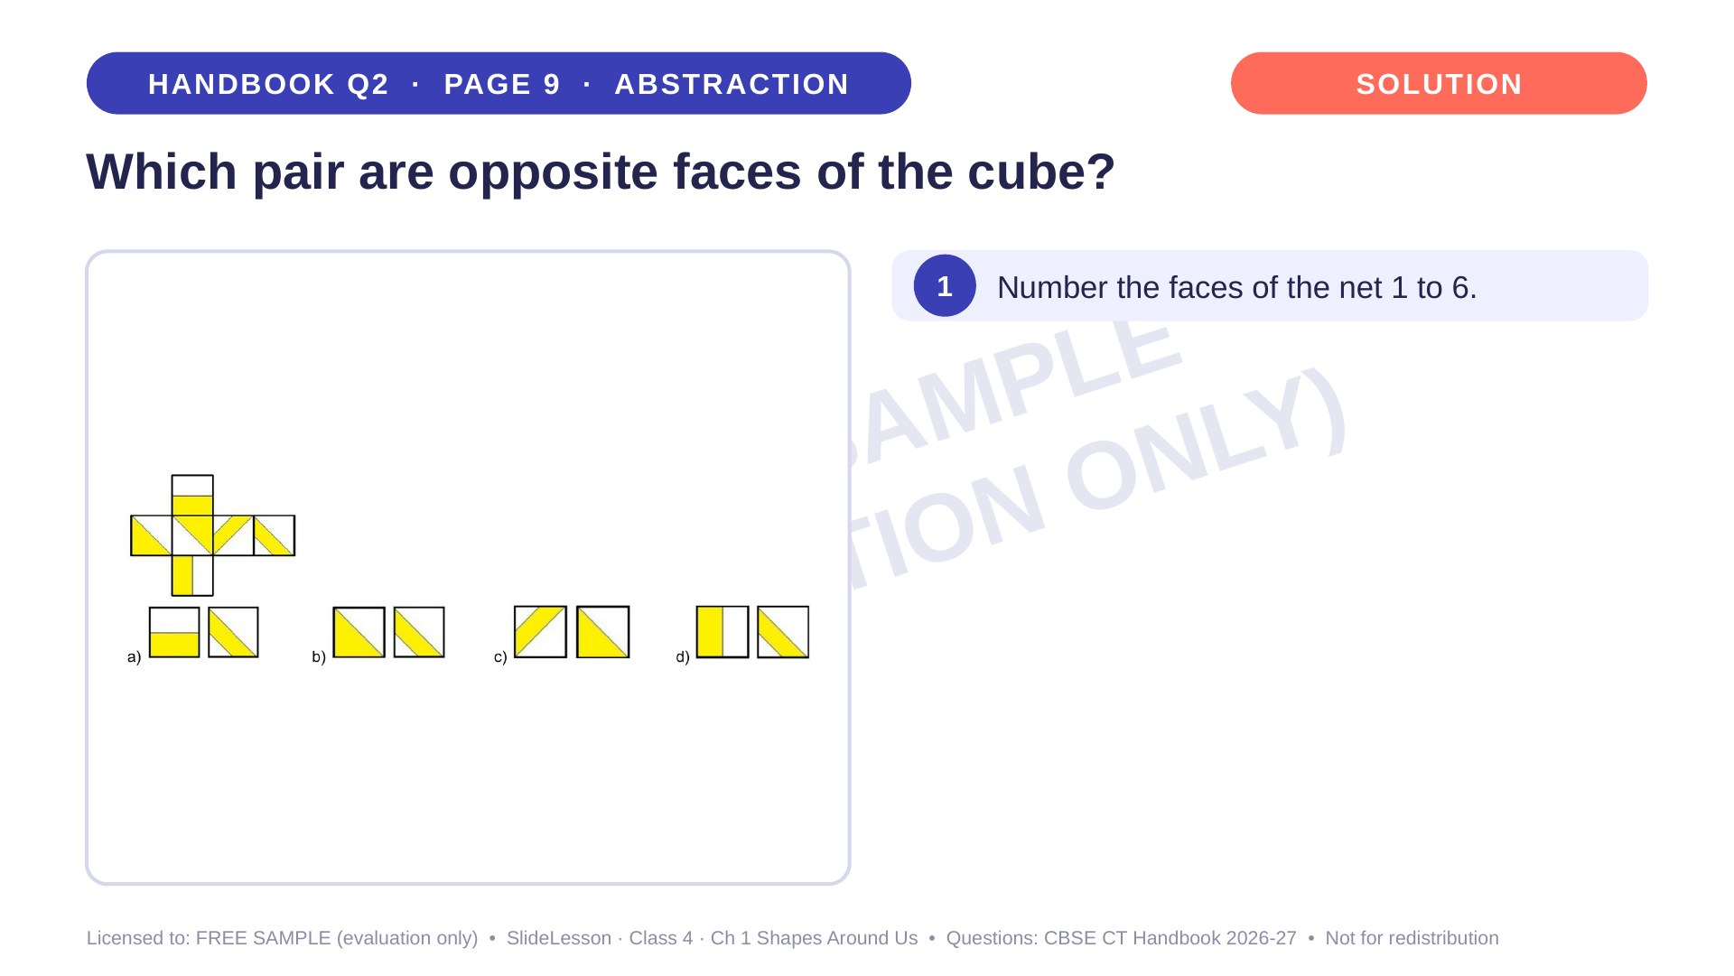
Notes:
Step 1 of 4

Slide 14
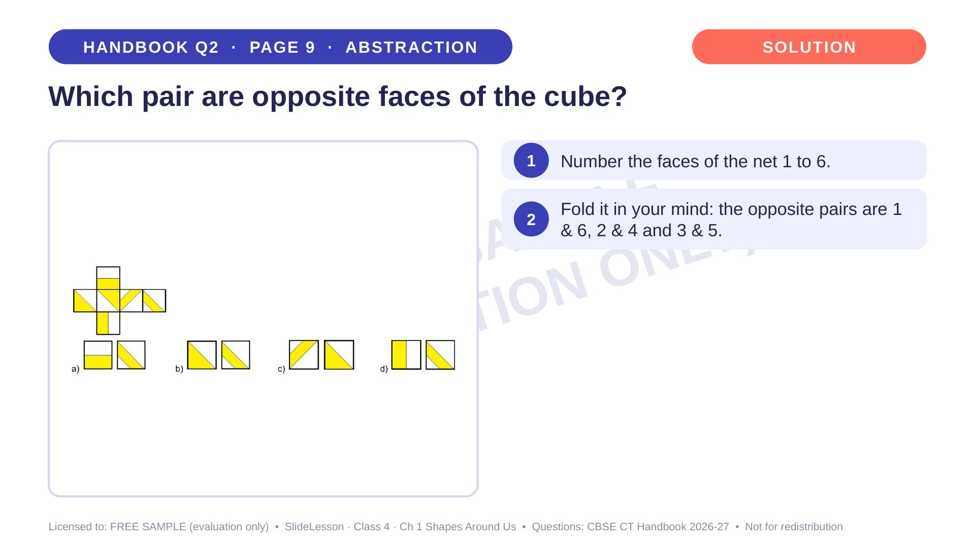
Notes:
Step 2 of 4

Slide 15
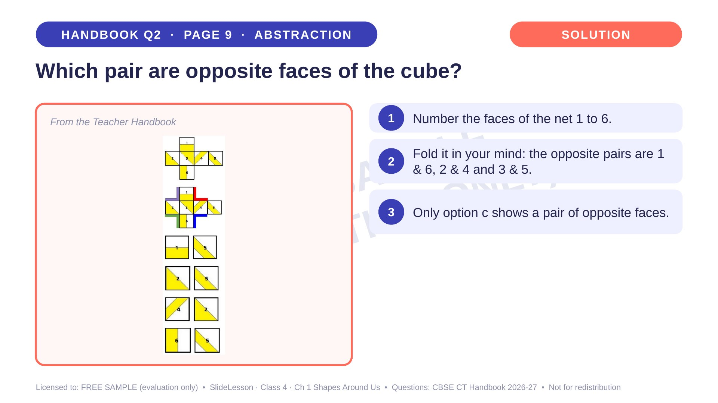
Notes:
Step 3 of 4

Slide 16
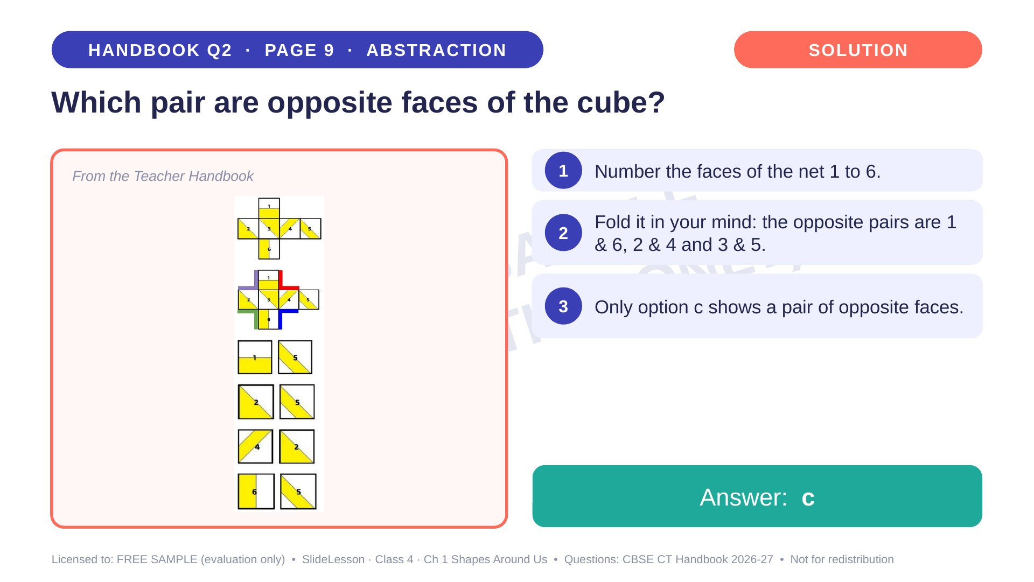
Notes:
Step 4 of 4

Slide 17
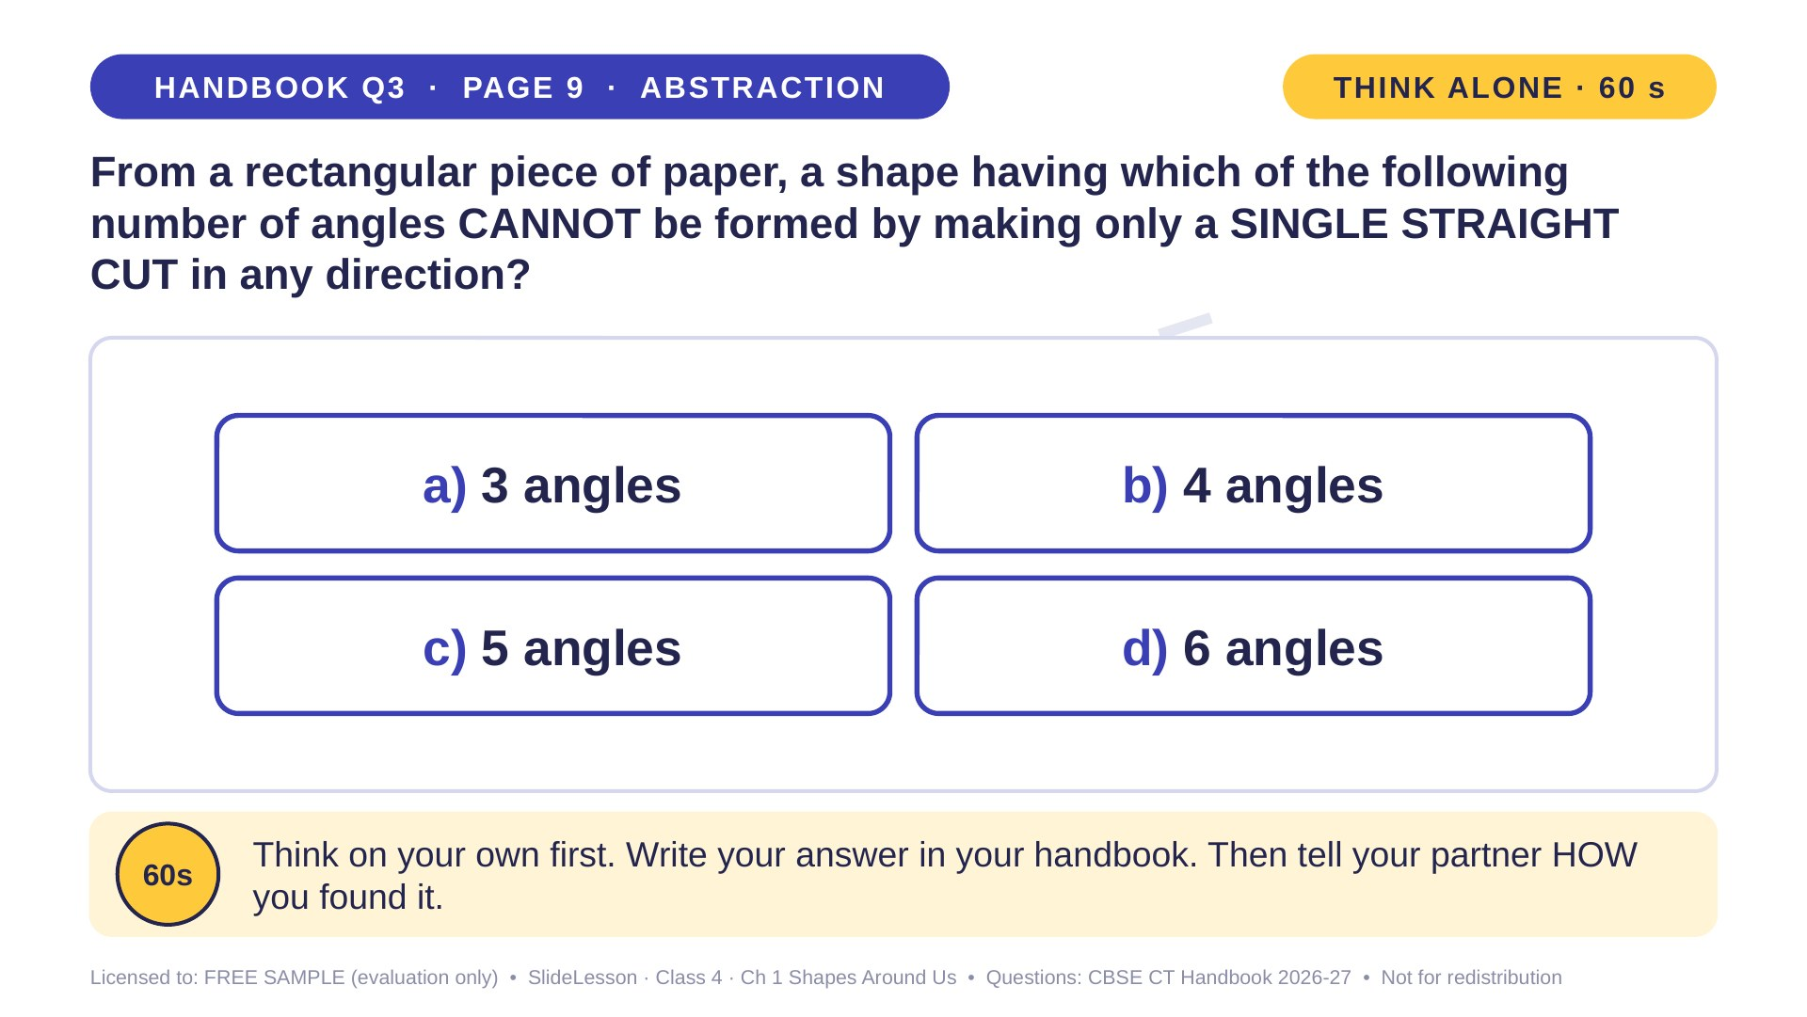
Notes:
WHILE SOLVING: give each pair a paper rectangle and scissors to test each case. COMMON MISTAKE: thinking cutting off a corner reduces the angles (it adds one!). EXTENSION: with one cut on a triangle, what shapes can you get?
ANSWER (do not tell yet): d) 6 angles

Slide 18
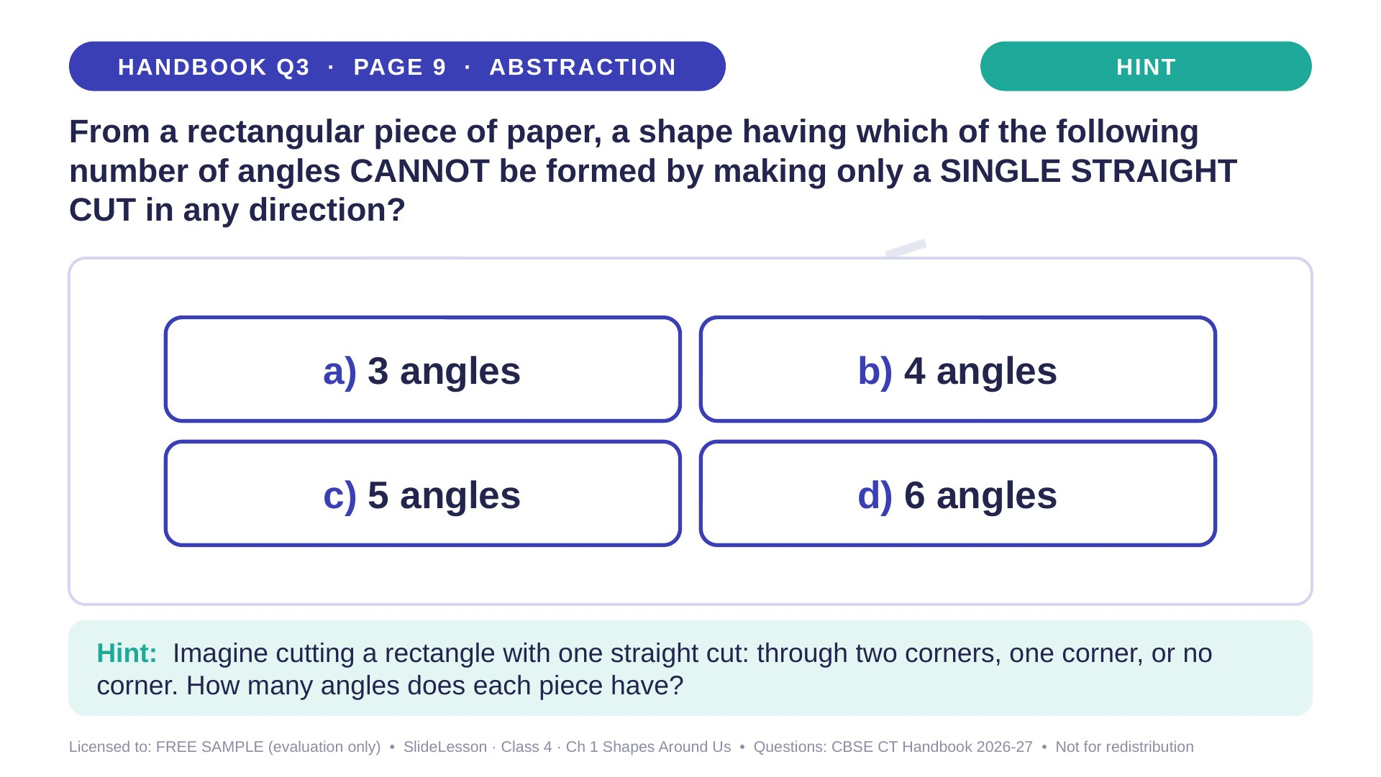
Notes:
Give the hint, then 1 more minute. Ask 2-3 children with DIFFERENT answers to explain their thinking before moving on.
WHILE SOLVING: give each pair a paper rectangle and scissors to test each case. COMMON MISTAKE: thinking cutting off a corner reduces the angles (it adds one!). EXTENSION: with one cut on a triangle, what shapes can you get?

Slide 19
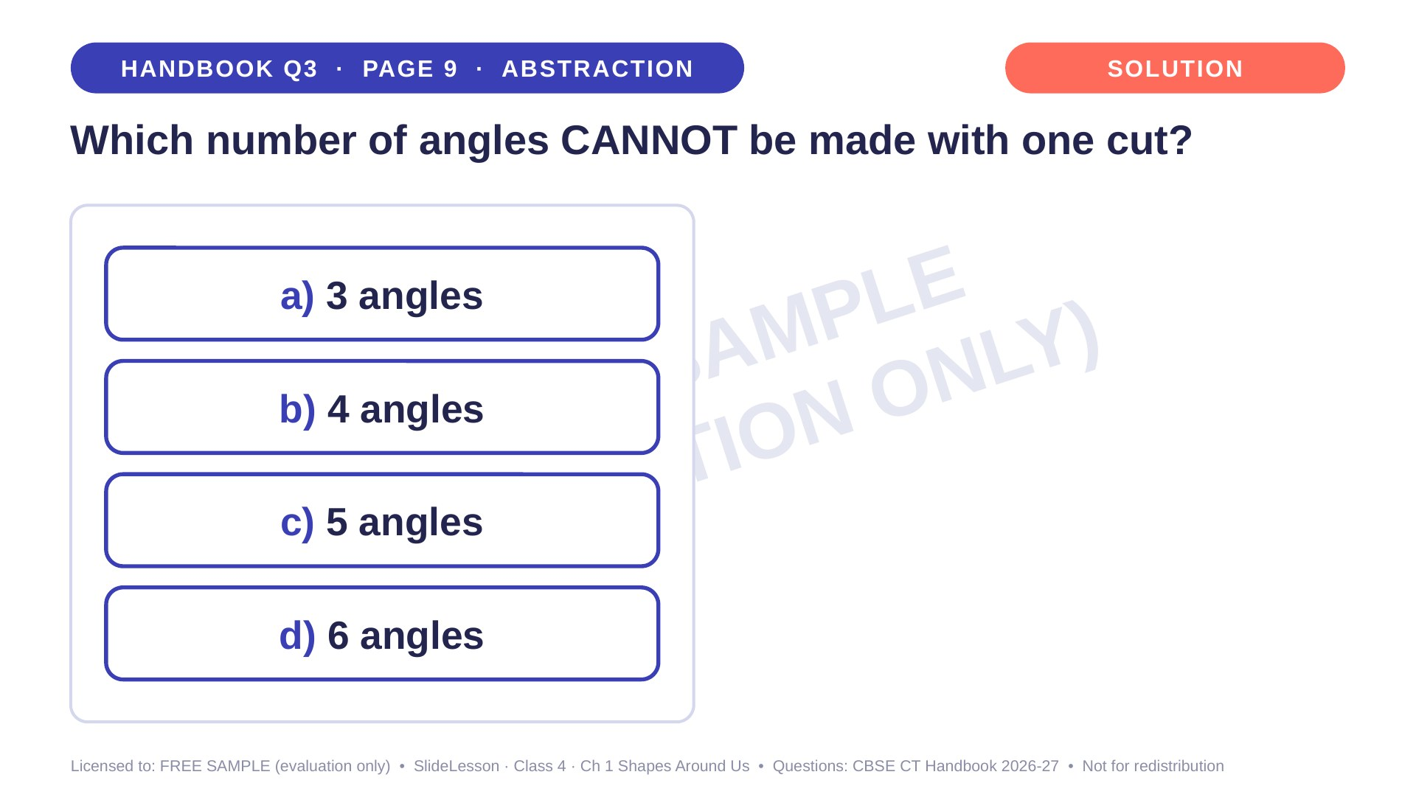
Notes:
WHILE SOLVING: give each pair a paper rectangle and scissors to test each case. COMMON MISTAKE: thinking cutting off a corner reduces the angles (it adds one!). EXTENSION: with one cut on a triangle, what shapes can you get?

Slide 20
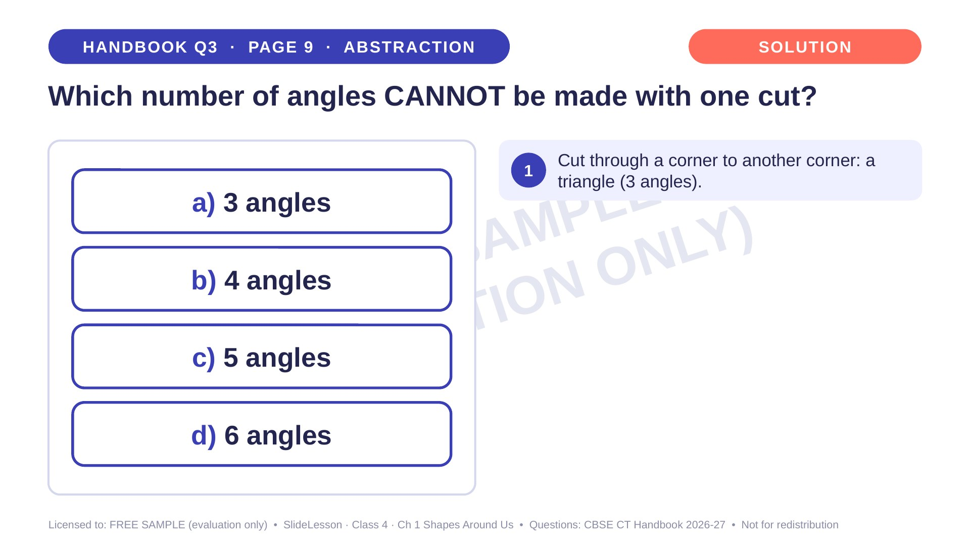
Notes:
Step 1 of 4

Slide 21
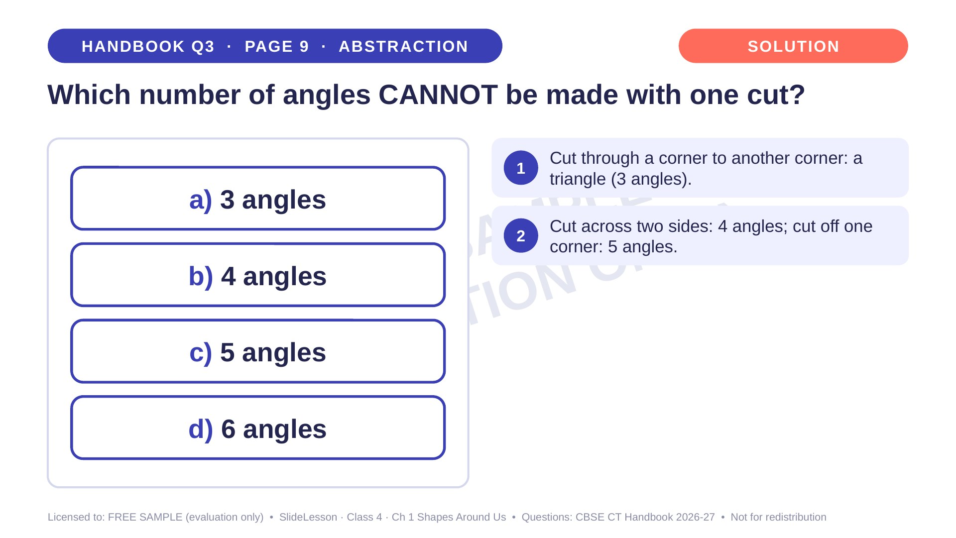
Notes:
Step 2 of 4

Slide 22
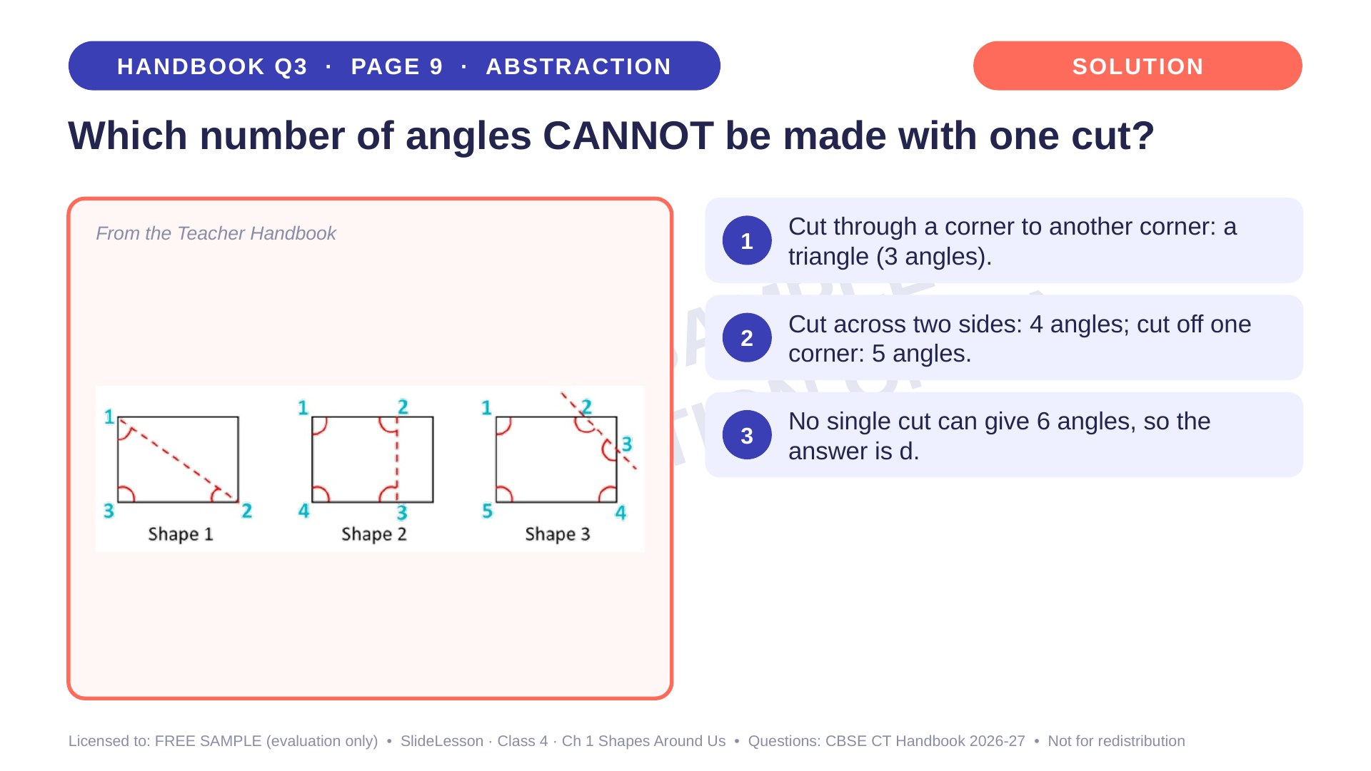
Notes:
Step 3 of 4

Slide 23
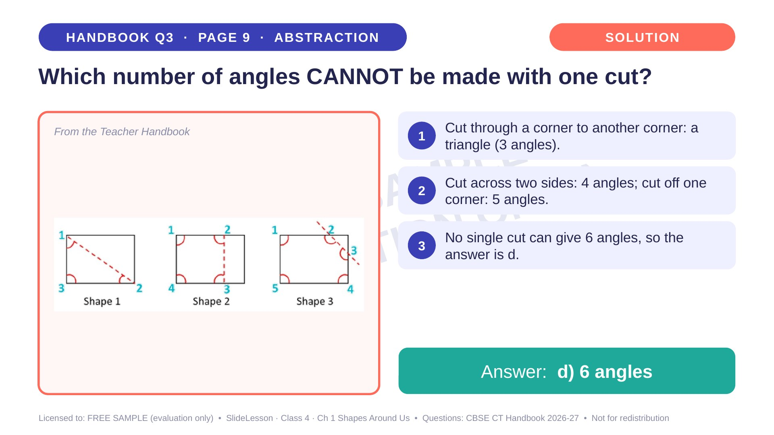
Notes:
Step 4 of 4

Slide 24
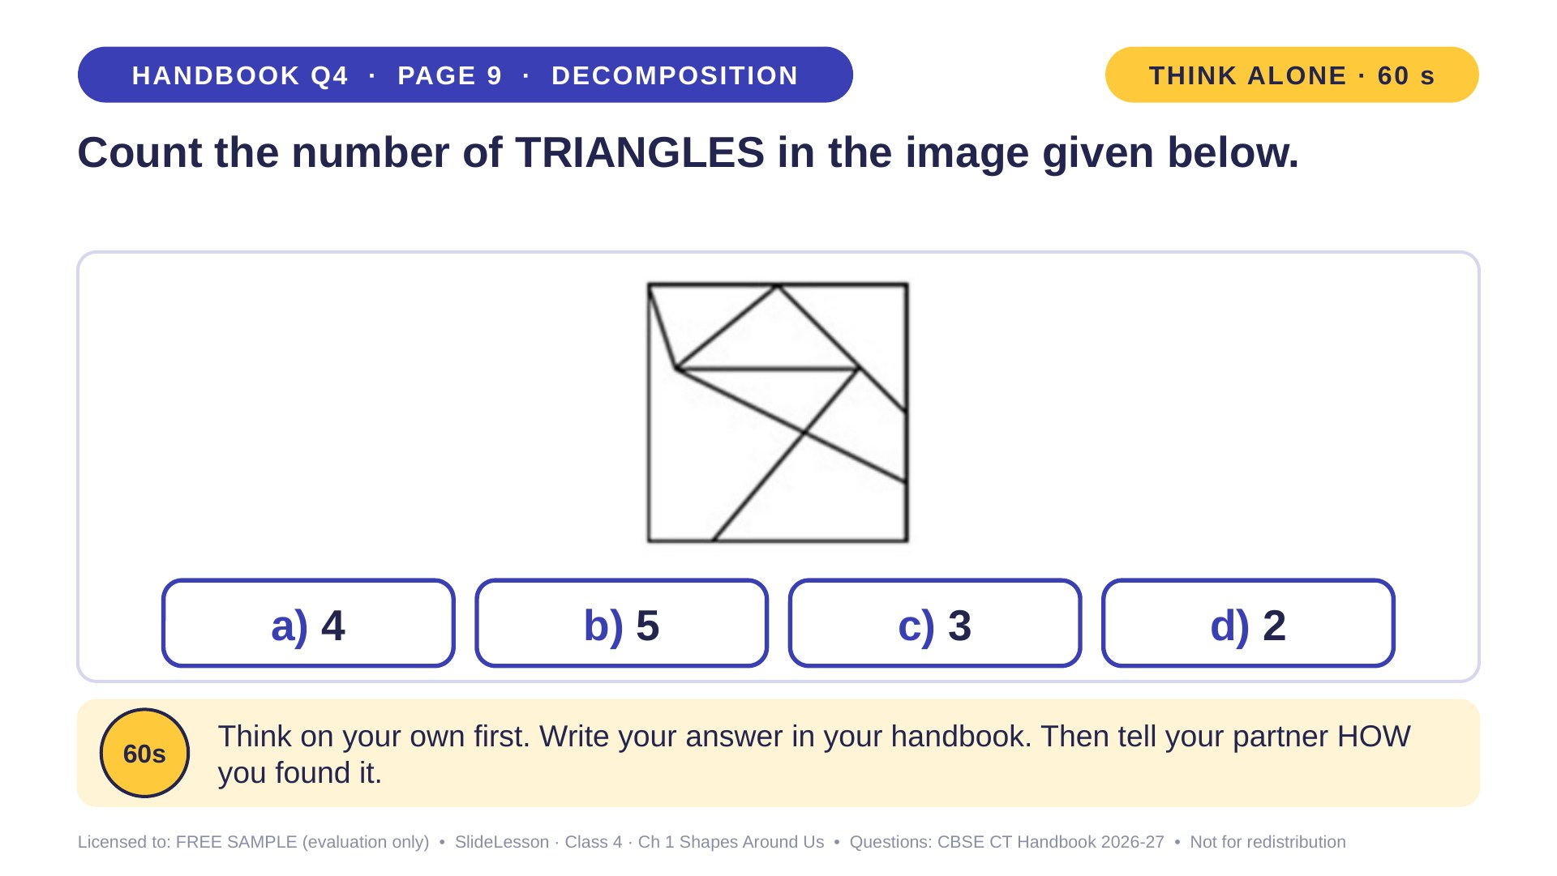
Notes:
WHILE SOLVING: children trace each triangle in a different colour on a printed copy. COMMON MISTAKE: missing the bigger triangles. EXTENSION: add one line to make more triangles.
ANSWER (do not tell yet): a) 4

Slide 25
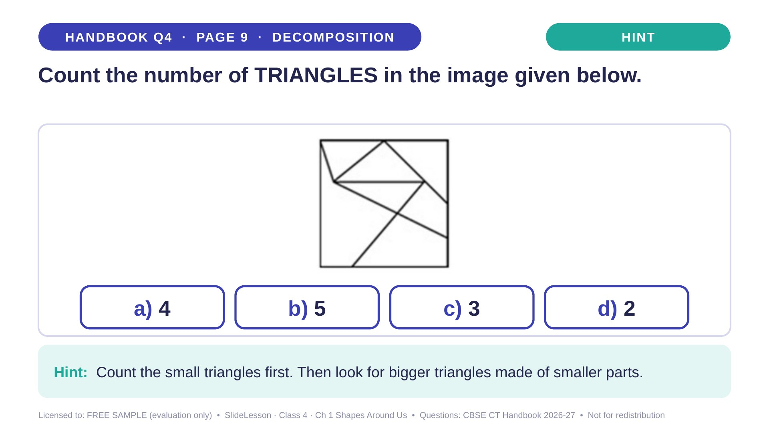
Notes:
Give the hint, then 1 more minute. Ask 2-3 children with DIFFERENT answers to explain their thinking before moving on.
WHILE SOLVING: children trace each triangle in a different colour on a printed copy. COMMON MISTAKE: missing the bigger triangles. EXTENSION: add one line to make more triangles.

Slide 26
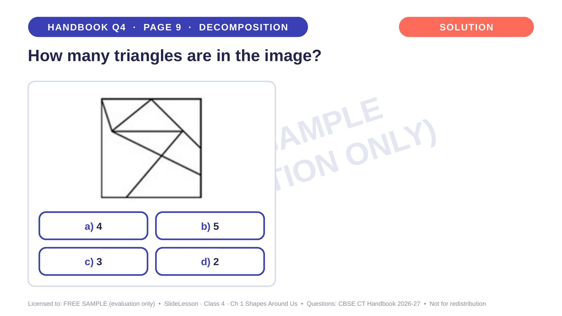
Notes:
WHILE SOLVING: children trace each triangle in a different colour on a printed copy. COMMON MISTAKE: missing the bigger triangles. EXTENSION: add one line to make more triangles.

Slide 27
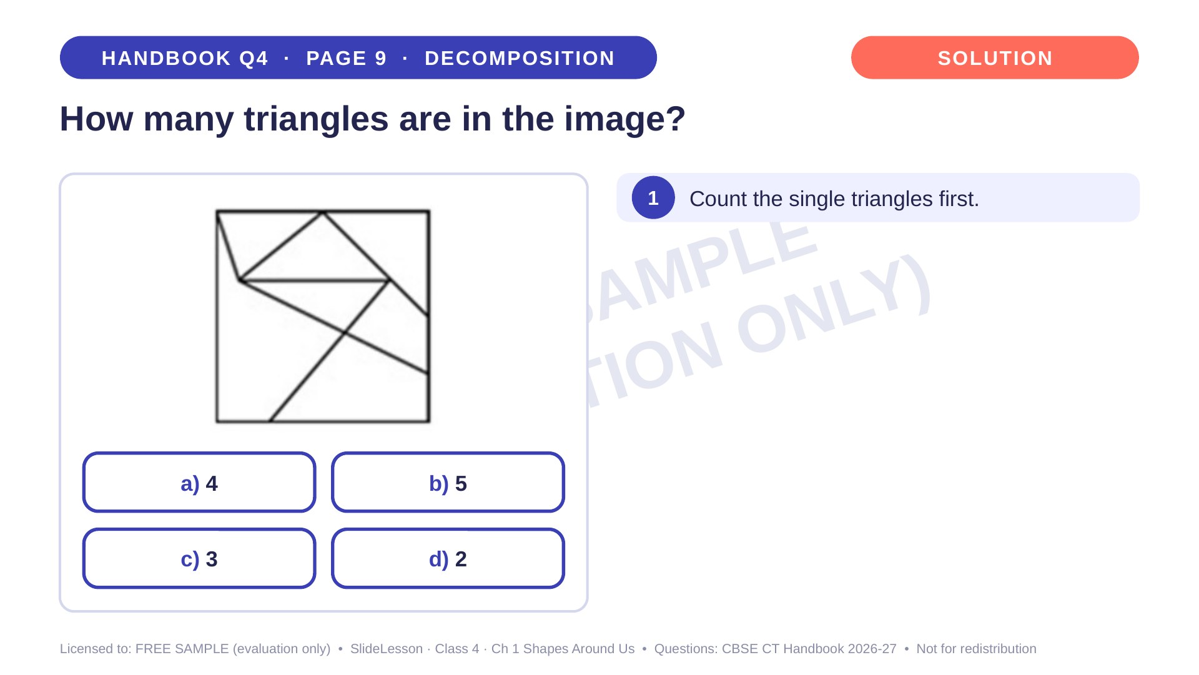
Notes:
Step 1 of 4

Slide 28
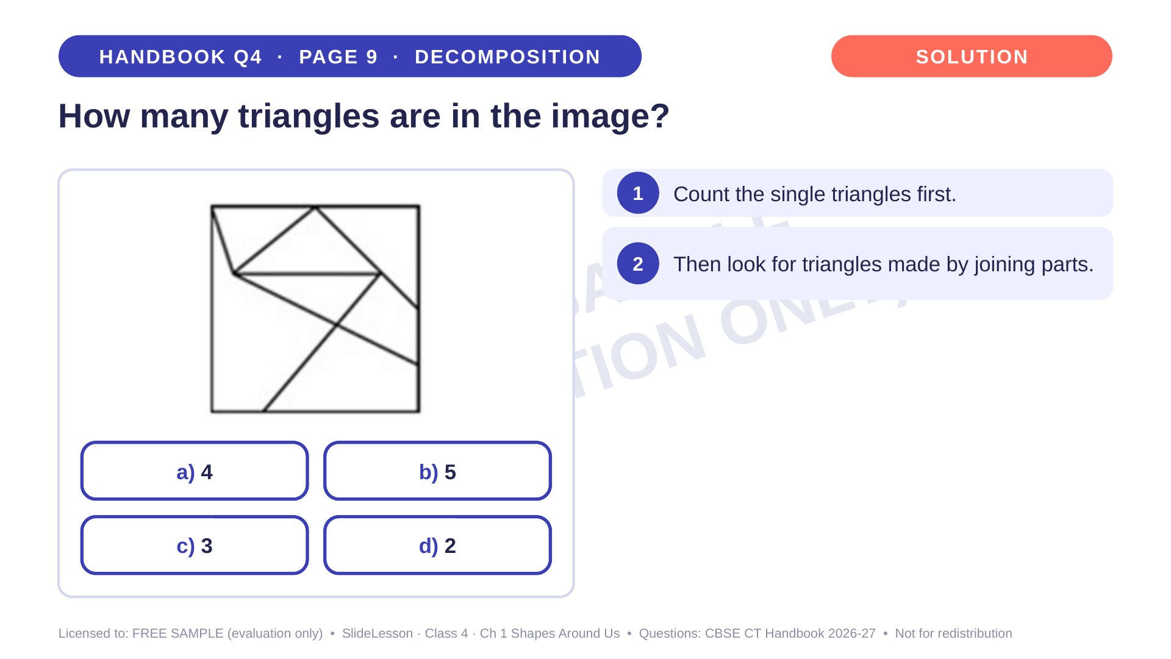
Notes:
Step 2 of 4

Slide 29
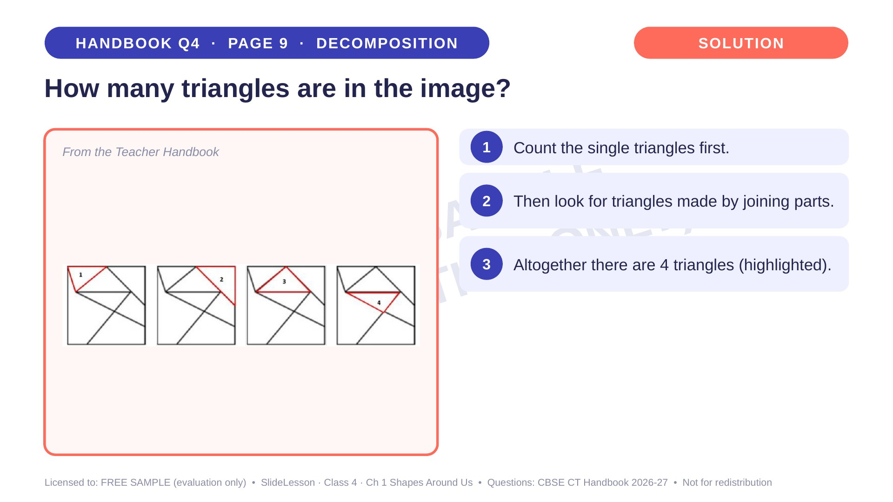
Notes:
Step 3 of 4

Slide 30
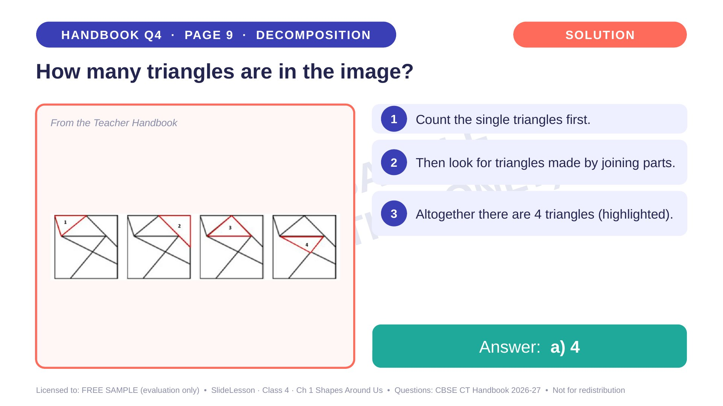
Notes:
Step 4 of 4

Slide 31
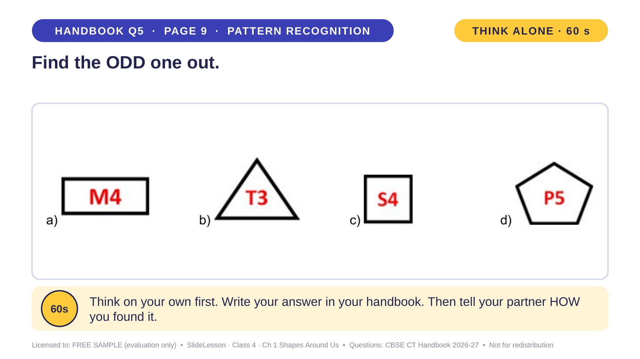
Notes:
WHILE SOLVING: ask children to say the rule before choosing. COMMON MISTAKE: judging by colour or size. EXTENSION: what would a hexagon's label be? (H6)
ANSWER (do not tell yet): a

Slide 32
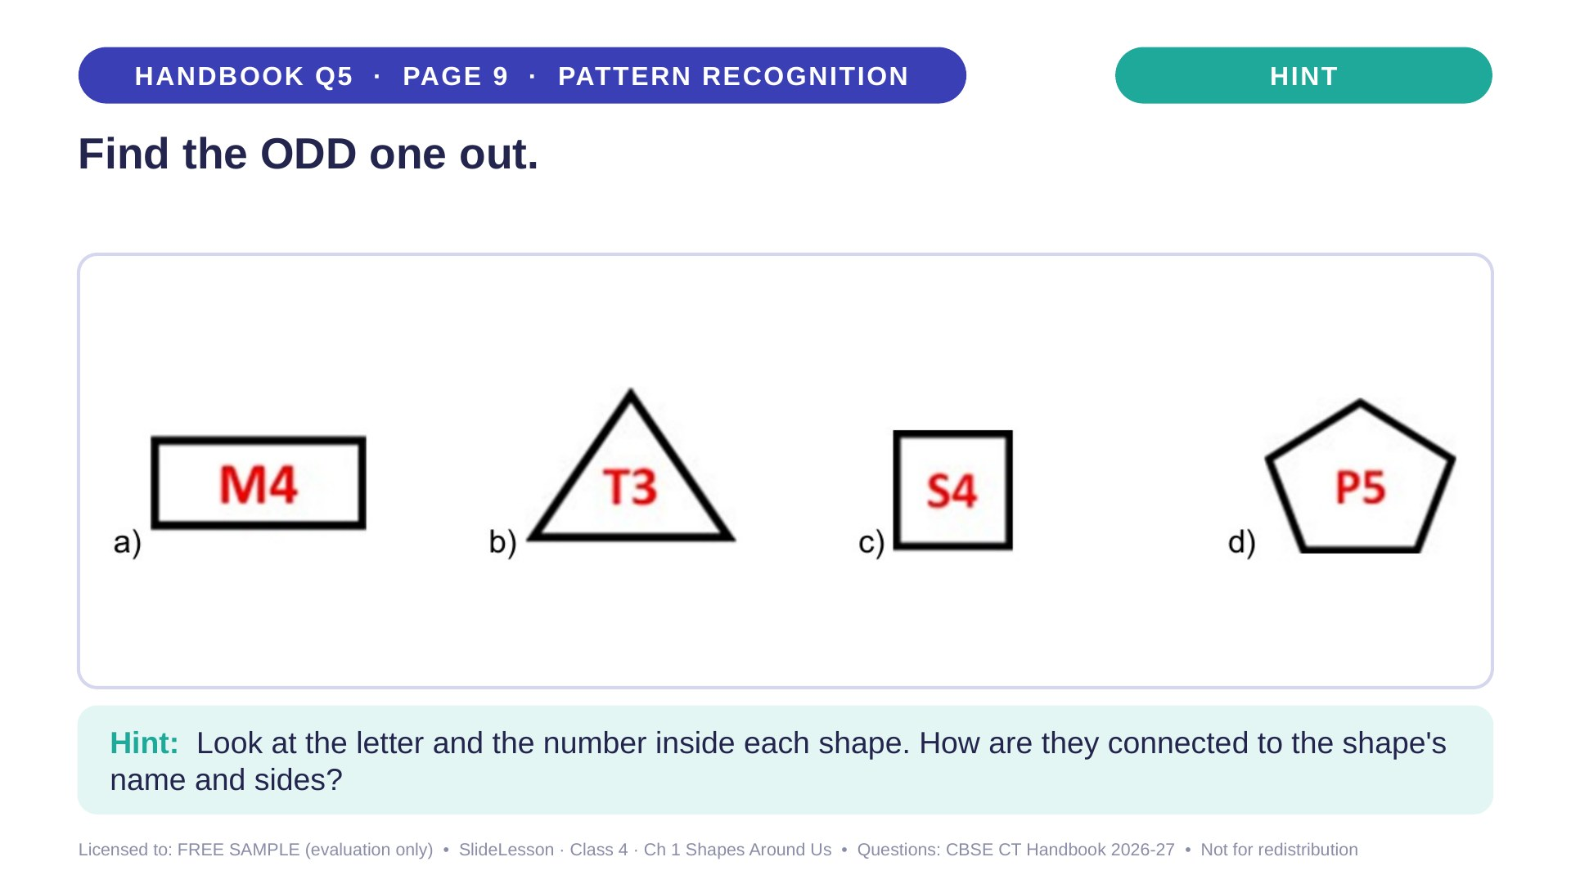
Notes:
Give the hint, then 1 more minute. Ask 2-3 children with DIFFERENT answers to explain their thinking before moving on.
WHILE SOLVING: ask children to say the rule before choosing. COMMON MISTAKE: judging by colour or size. EXTENSION: what would a hexagon's label be? (H6)

Slide 33
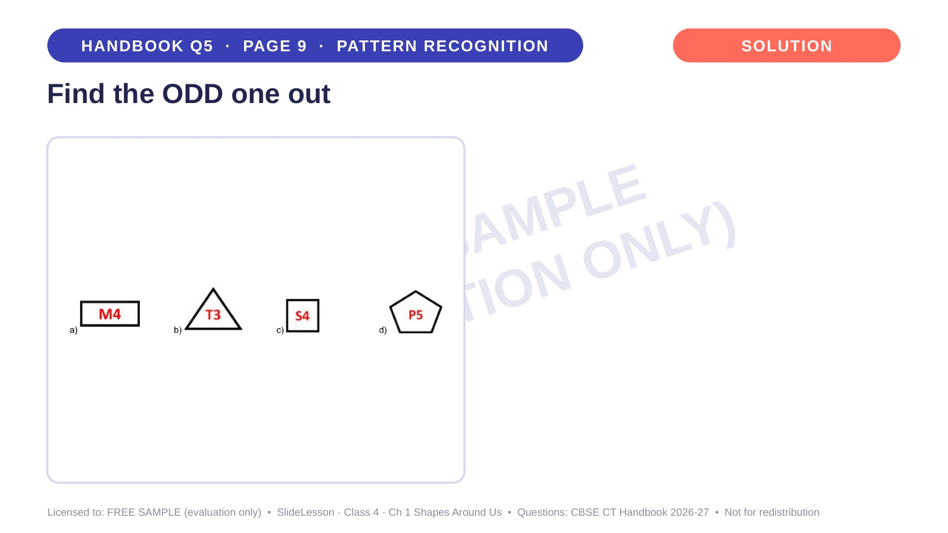
Notes:
WHILE SOLVING: ask children to say the rule before choosing. COMMON MISTAKE: judging by colour or size. EXTENSION: what would a hexagon's label be? (H6)

Slide 34
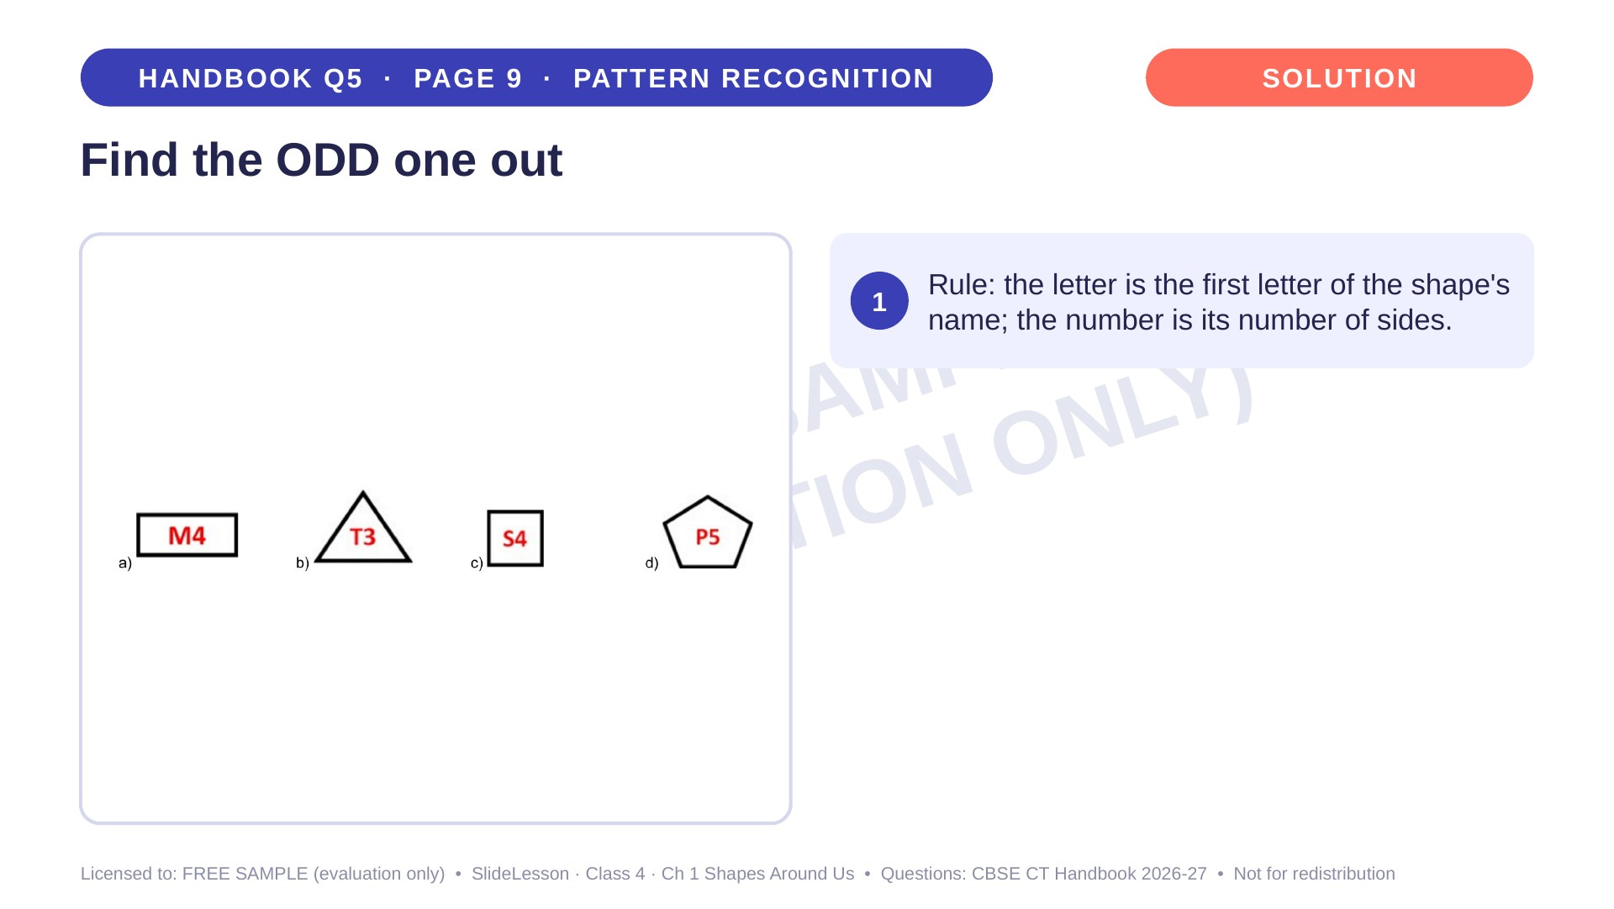
Notes:
Step 1 of 4

Slide 35
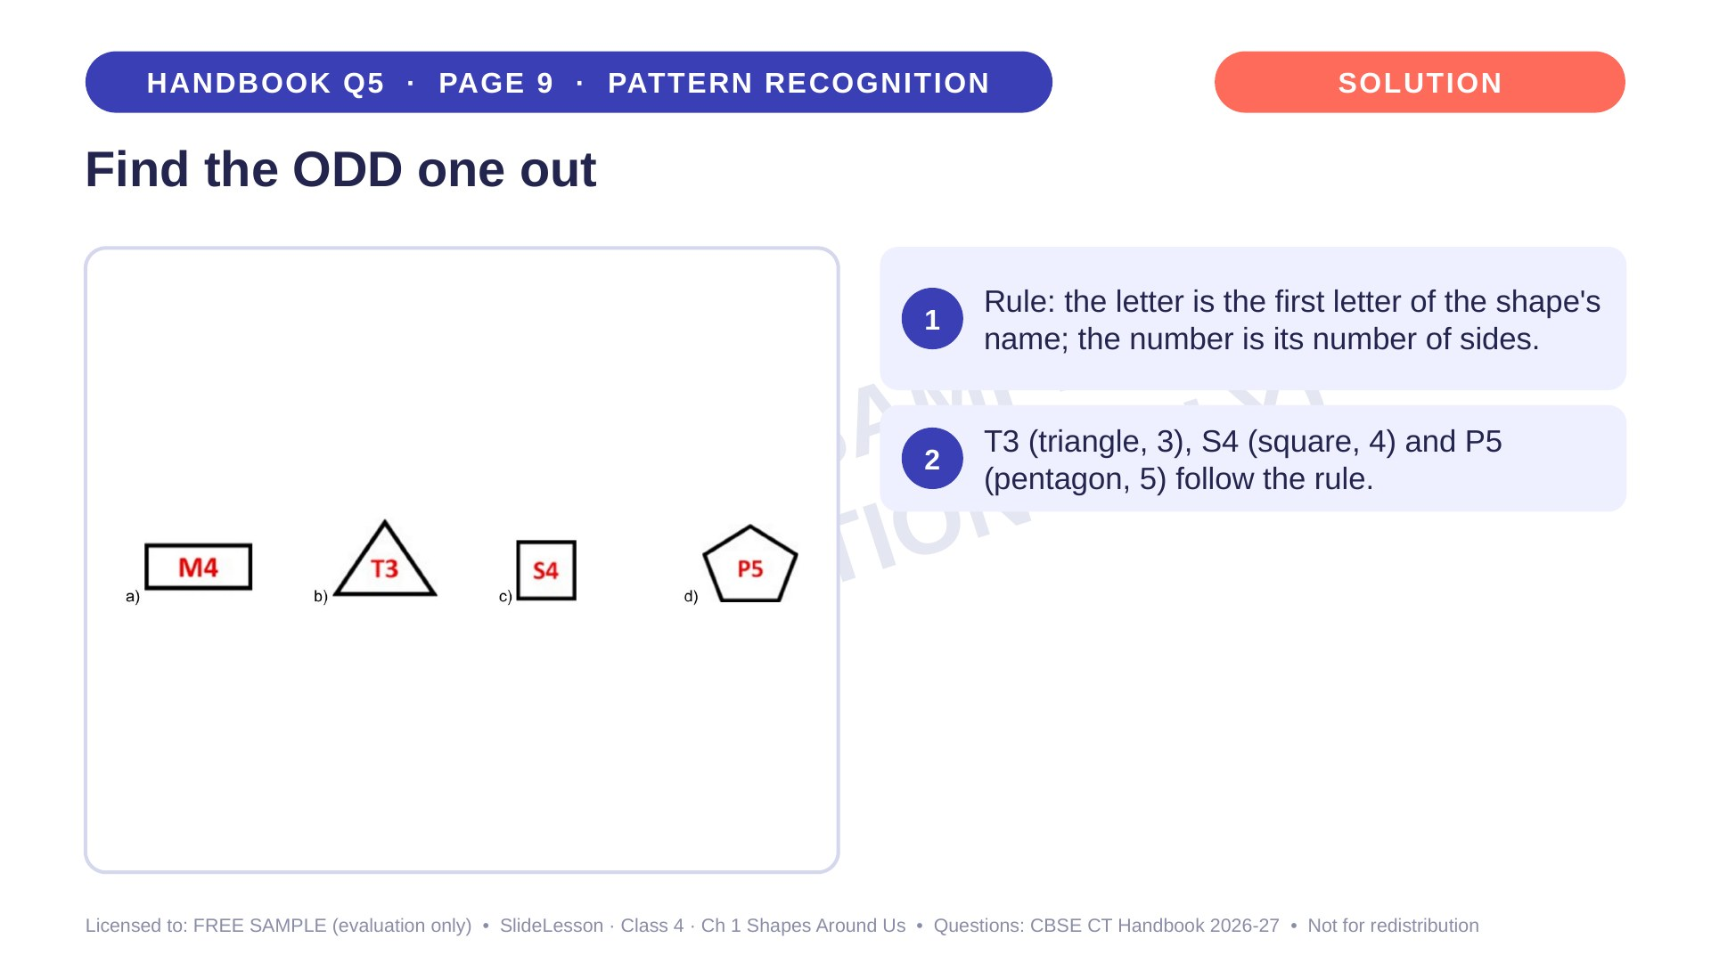
Notes:
Step 2 of 4

Slide 36
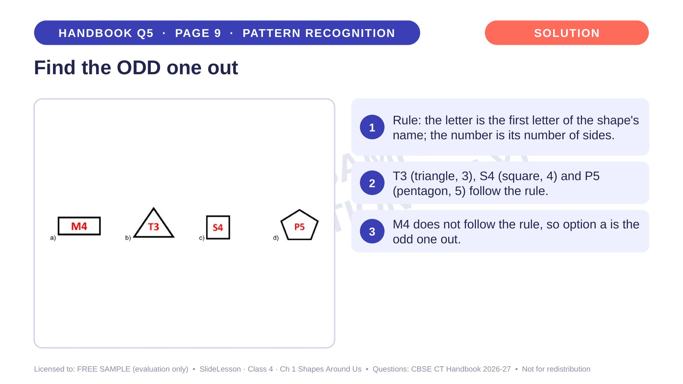
Notes:
Step 3 of 4

Slide 37
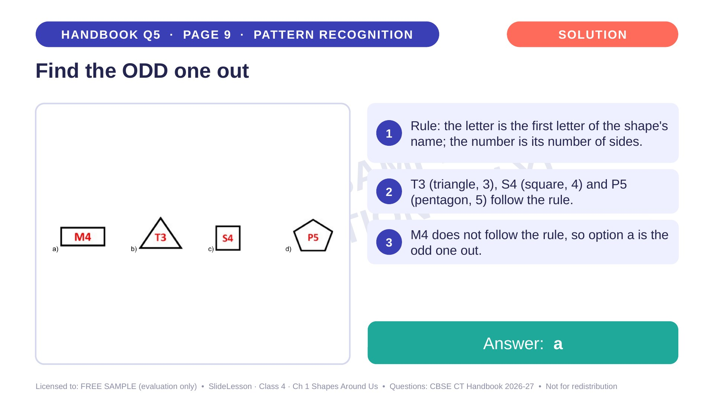
Notes:
Step 4 of 4

Slide 38
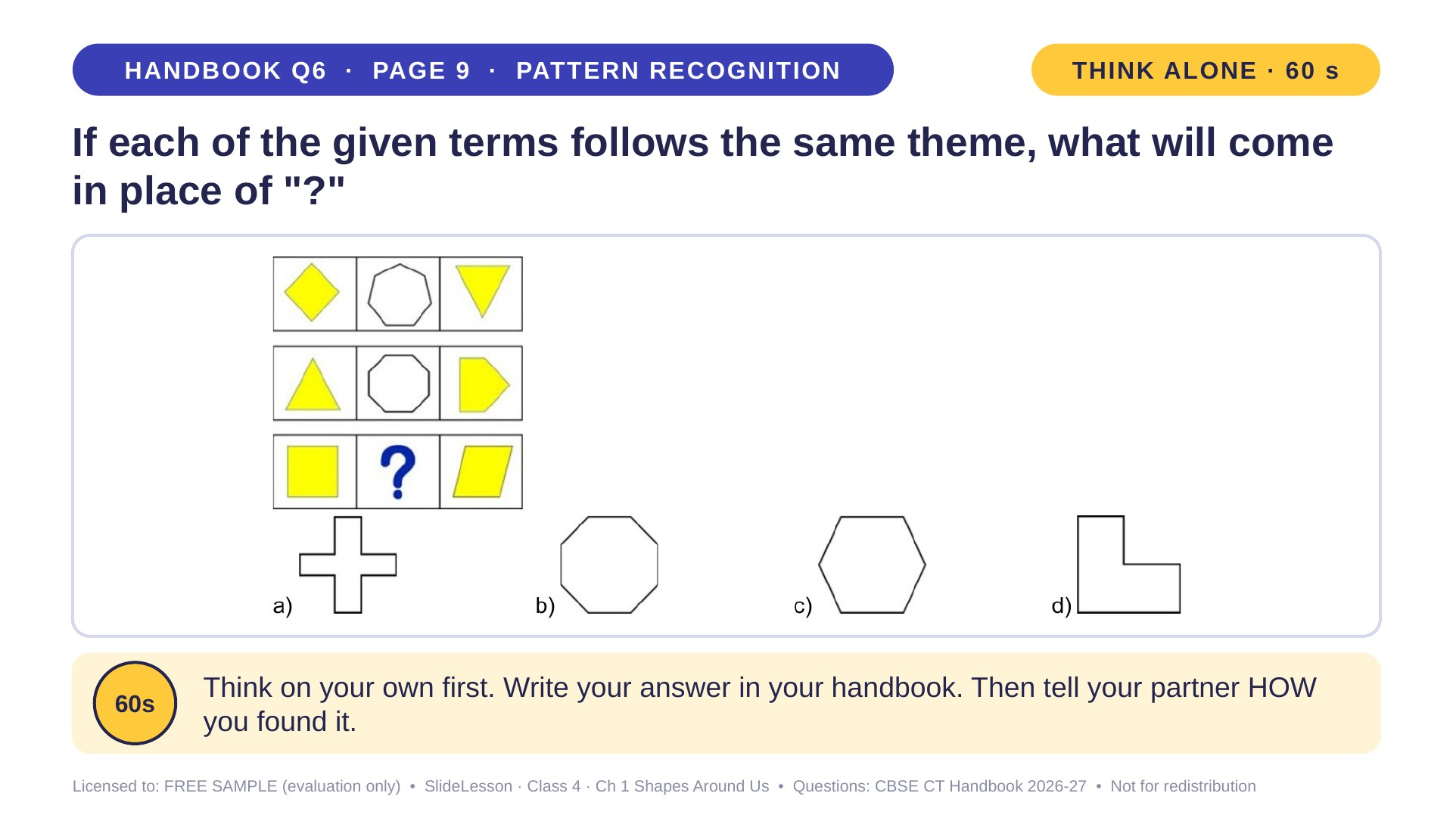
Notes:
WHILE SOLVING: write the side counts beside each shape. COMMON MISTAKE: counting only one yellow shape. EXTENSION: which two shapes would give a hexagon in the middle?
ANSWER (do not tell yet): b

Slide 39
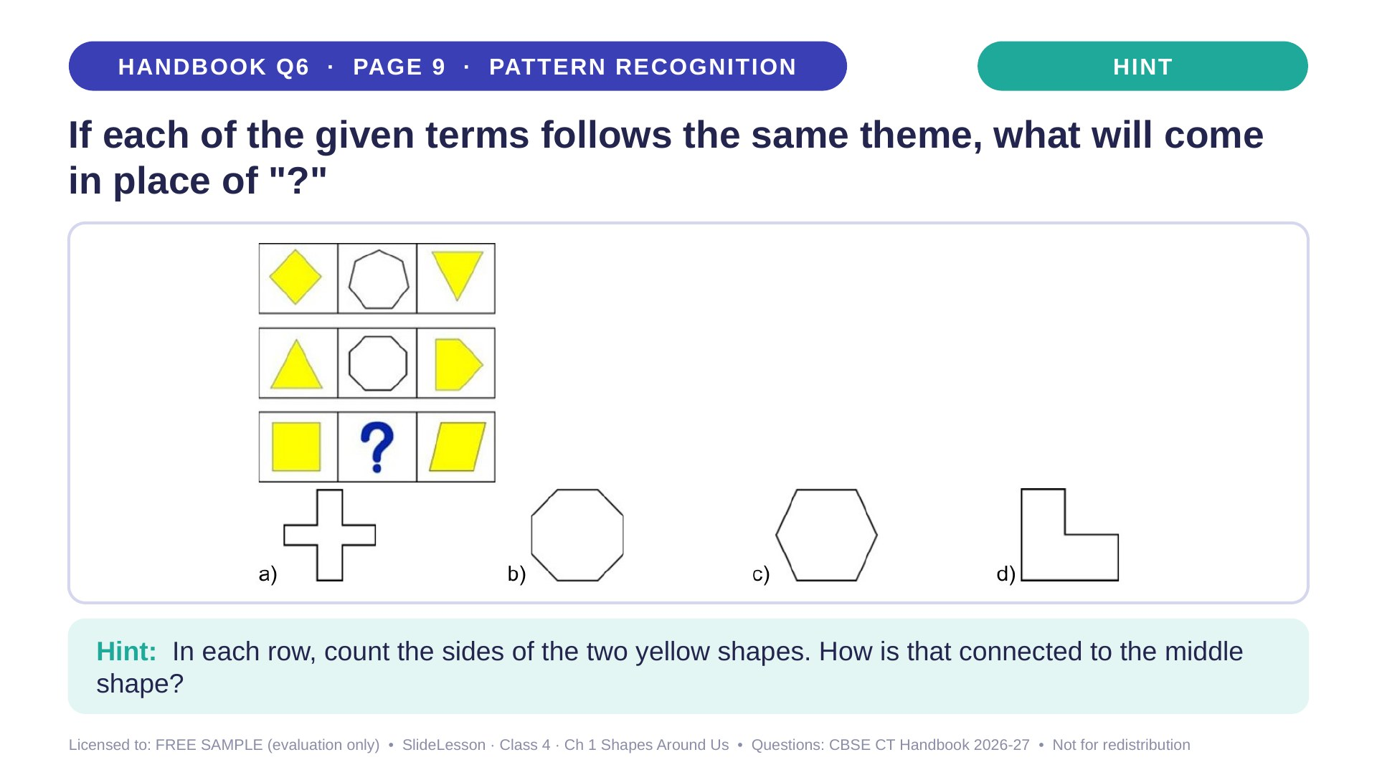
Notes:
Give the hint, then 1 more minute. Ask 2-3 children with DIFFERENT answers to explain their thinking before moving on.
WHILE SOLVING: write the side counts beside each shape. COMMON MISTAKE: counting only one yellow shape. EXTENSION: which two shapes would give a hexagon in the middle?

Slide 40
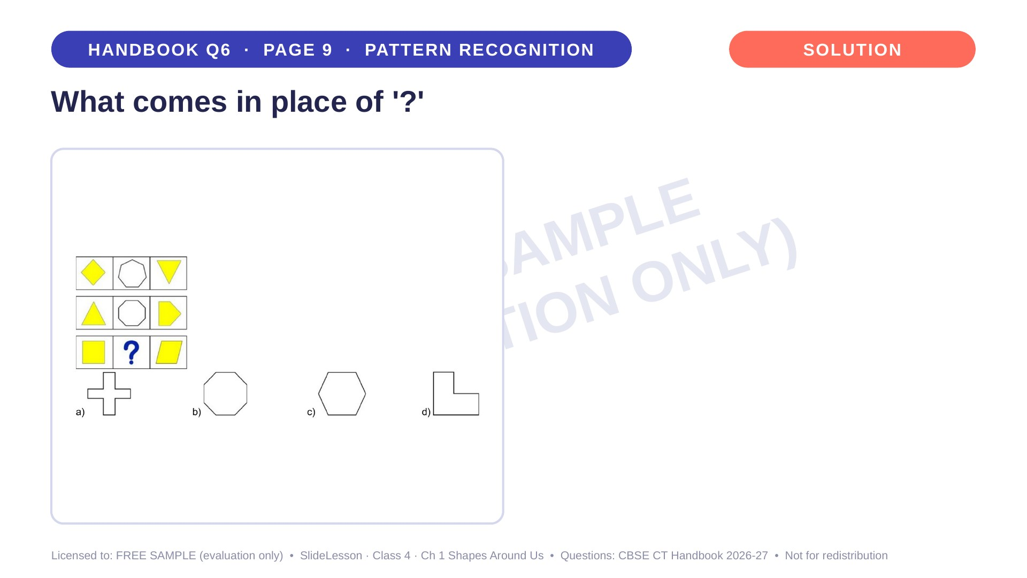
Notes:
WHILE SOLVING: write the side counts beside each shape. COMMON MISTAKE: counting only one yellow shape. EXTENSION: which two shapes would give a hexagon in the middle?

Slide 41
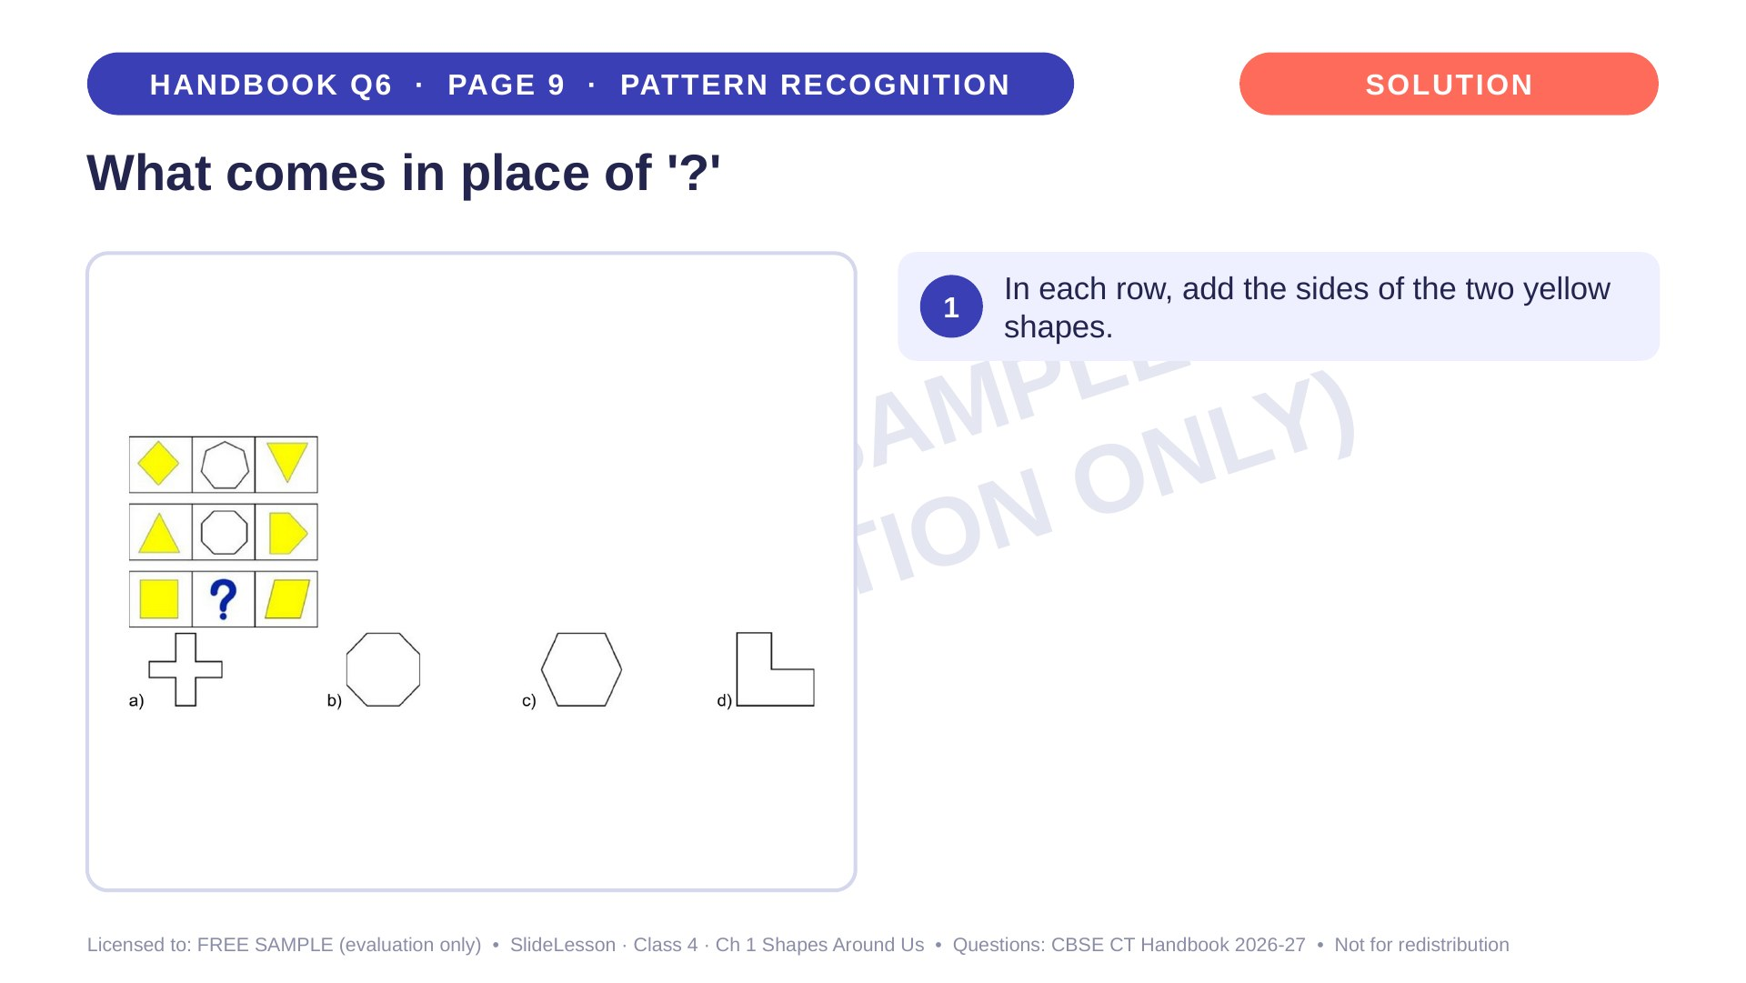
Notes:
Step 1 of 4

Slide 42
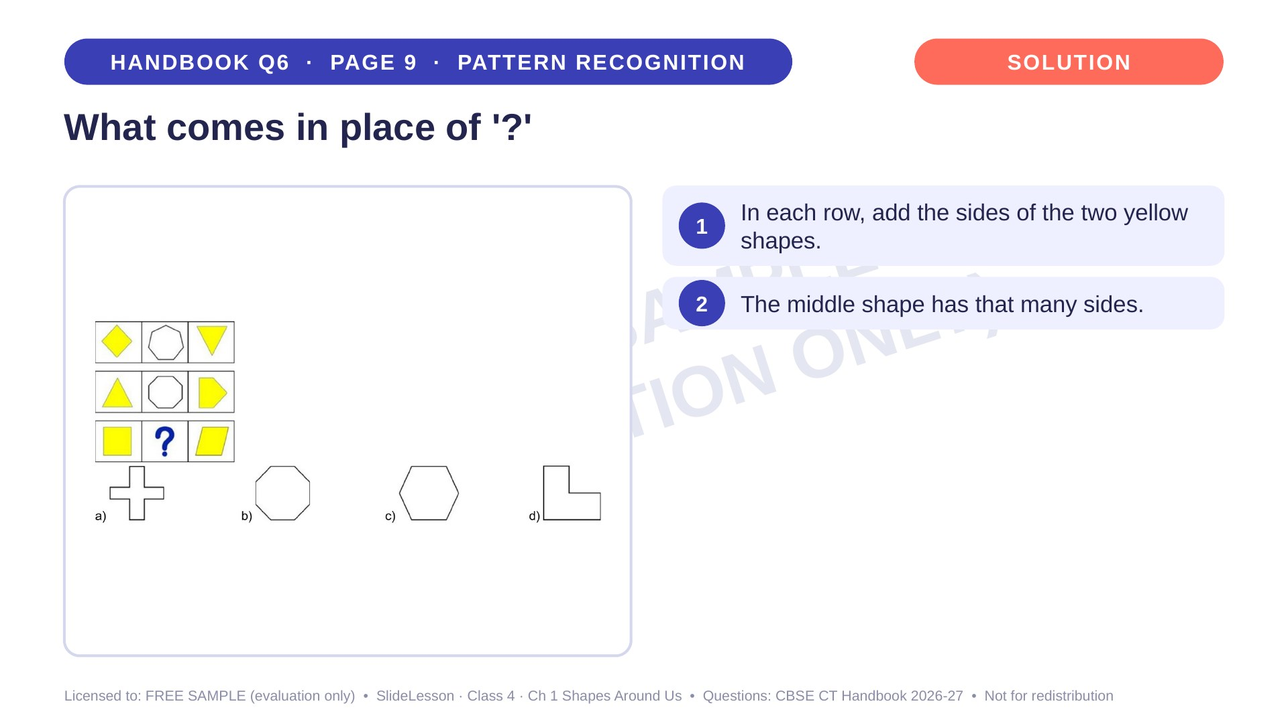
Notes:
Step 2 of 4

Slide 43
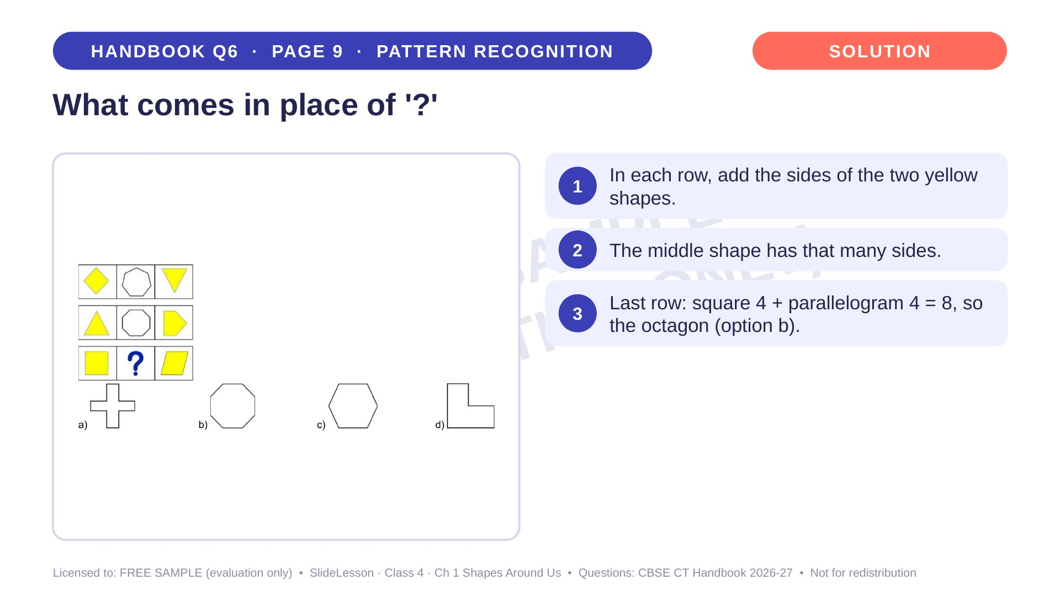
Notes:
Step 3 of 4

Slide 44
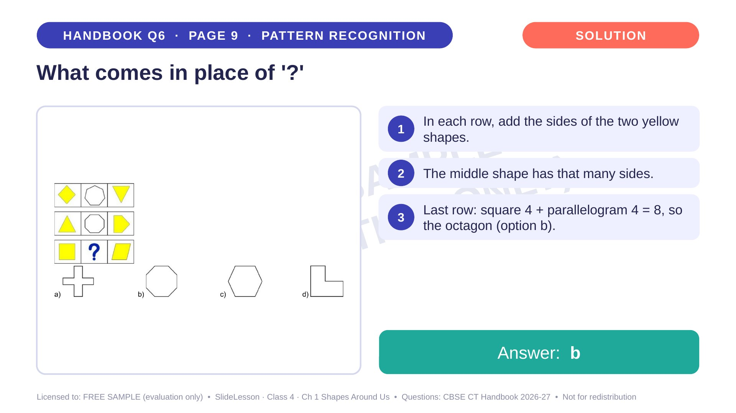
Notes:
Step 4 of 4

Slide 45
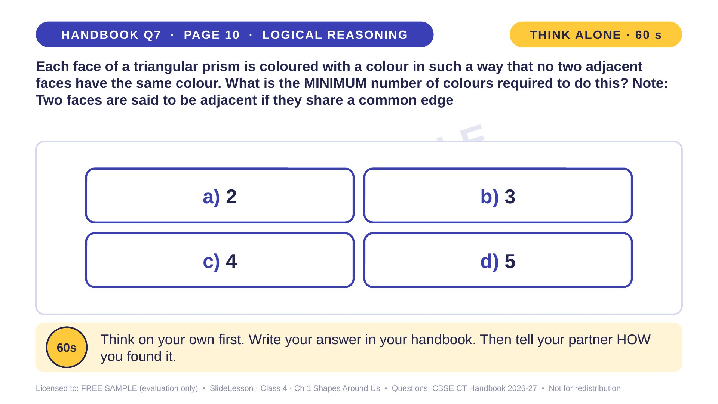
Notes:
WHILE SOLVING: use a Toblerone-style box or a paper prism. COMMON MISTAKE: answering 5 by giving every face a new colour. EXTENSION: what is the minimum for a cube? (3)
ANSWER (do not tell yet): c) 4

Slide 46
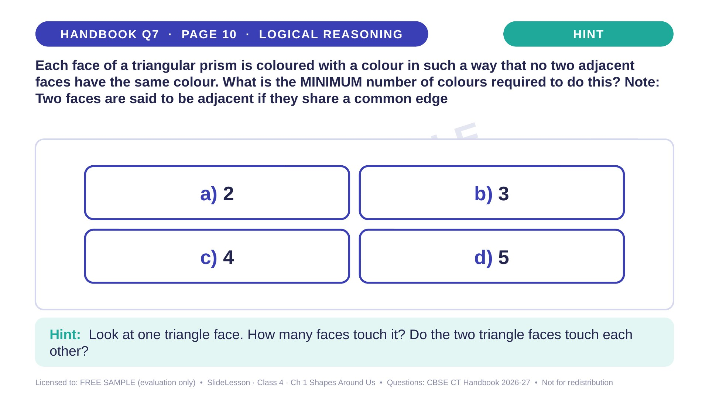
Notes:
Give the hint, then 1 more minute. Ask 2-3 children with DIFFERENT answers to explain their thinking before moving on.
WHILE SOLVING: use a Toblerone-style box or a paper prism. COMMON MISTAKE: answering 5 by giving every face a new colour. EXTENSION: what is the minimum for a cube? (3)

Slide 47
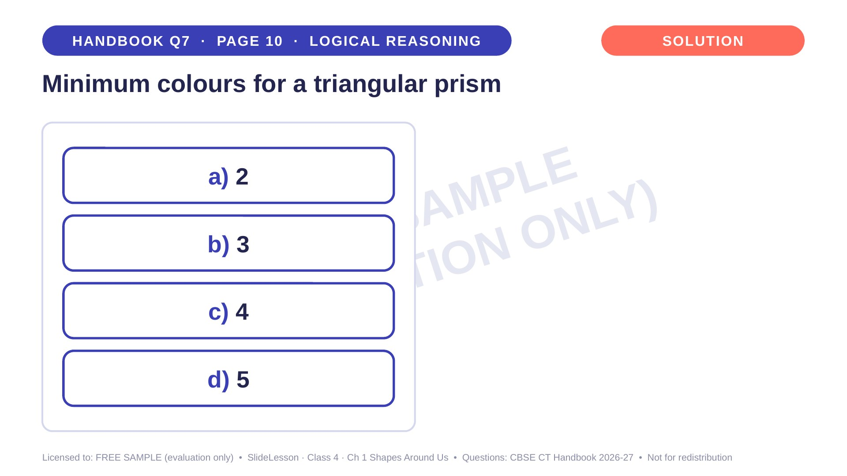
Notes:
WHILE SOLVING: use a Toblerone-style box or a paper prism. COMMON MISTAKE: answering 5 by giving every face a new colour. EXTENSION: what is the minimum for a cube? (3)

Slide 48
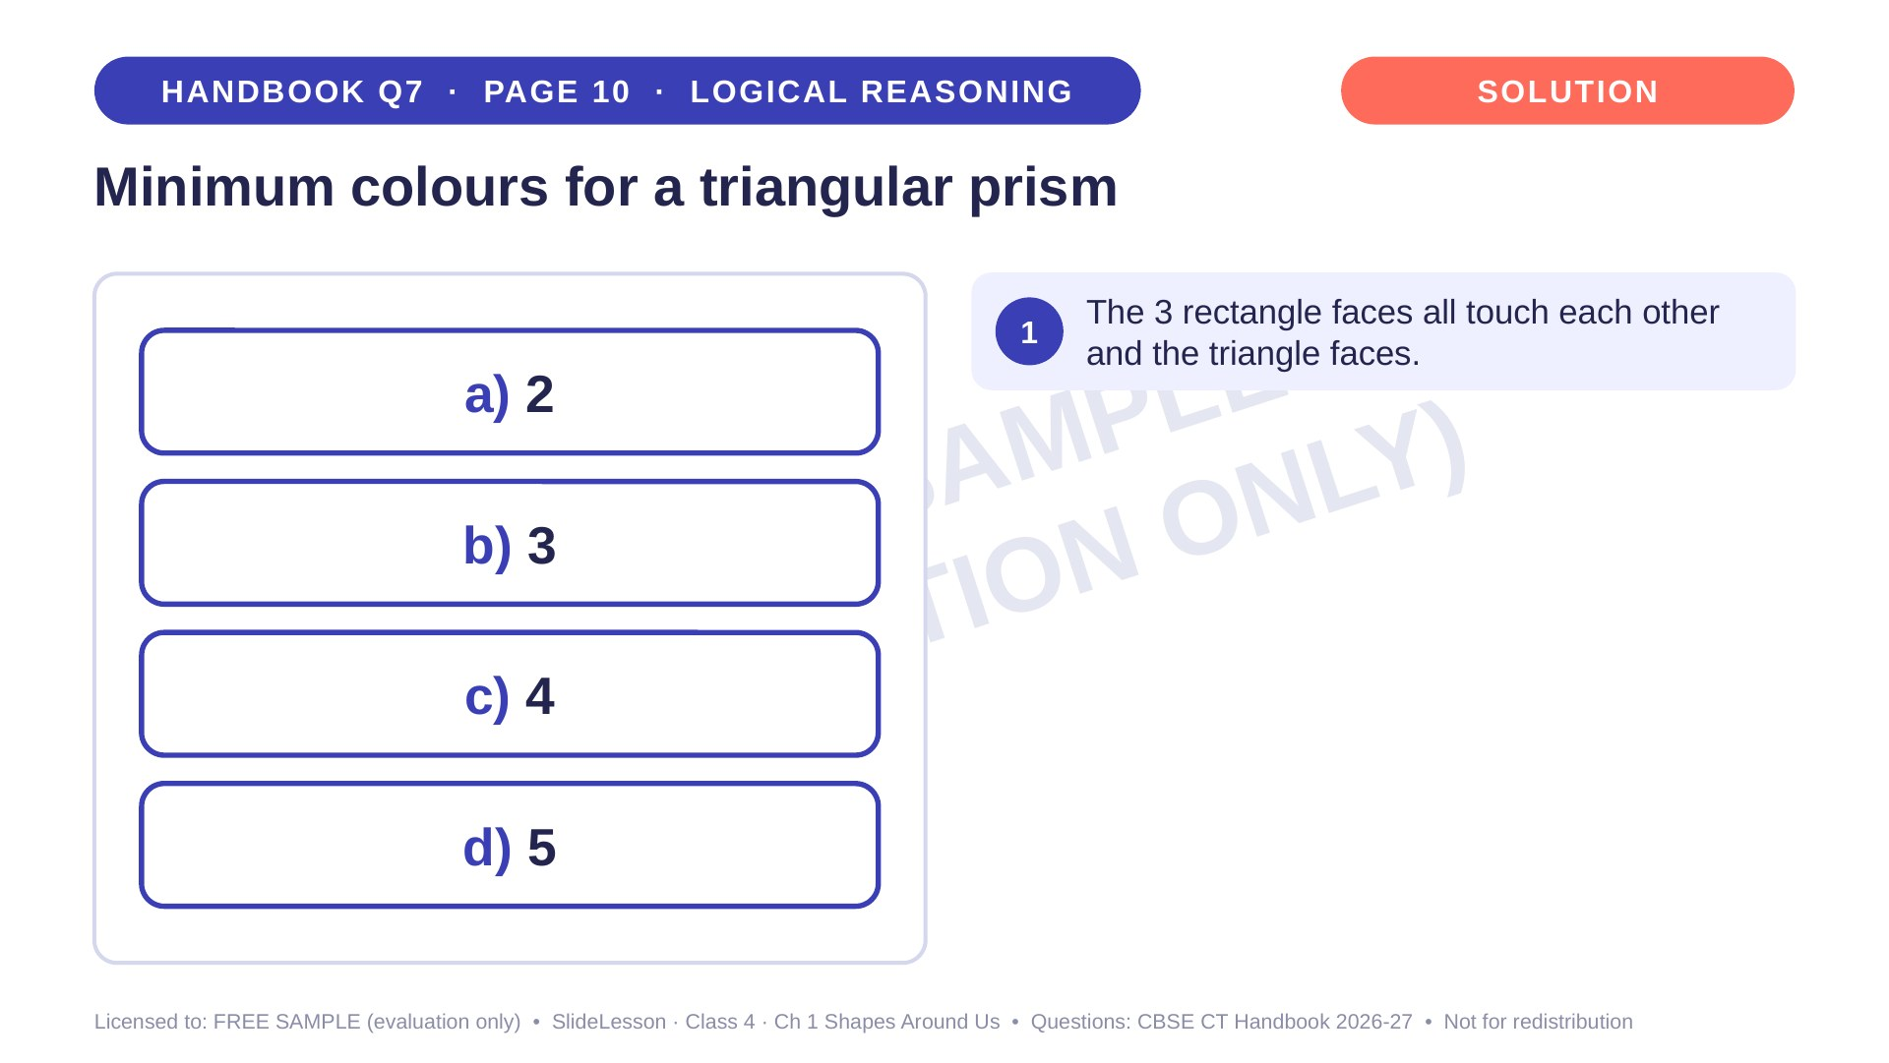
Notes:
Step 1 of 4

Slide 49
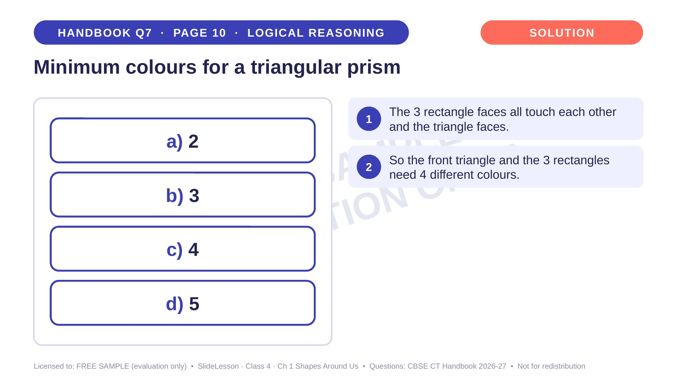
Notes:
Step 2 of 4

Slide 50
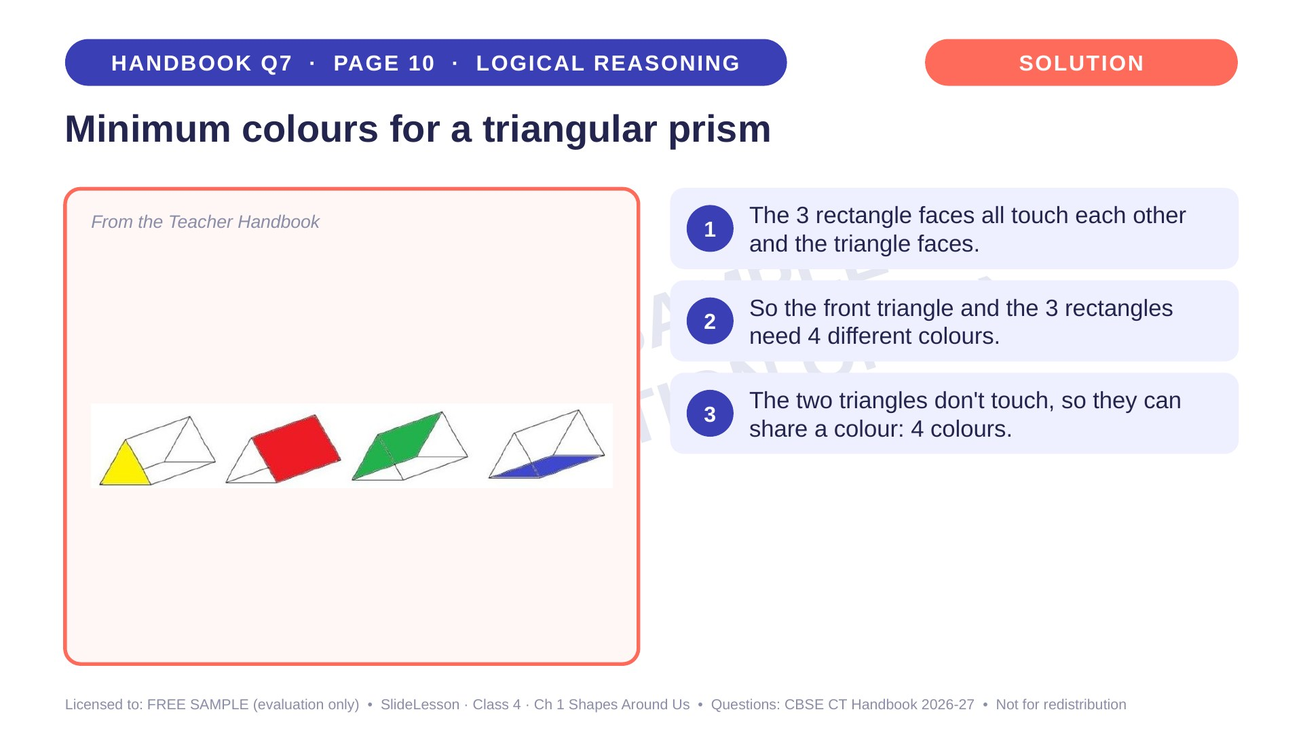
Notes:
Step 3 of 4

Slide 51

Notes:
Step 4 of 4

Slide 52

Notes:
WHILE SOLVING: check one condition at a time (sides, then pattern, then colour). COMMON MISTAKE: checking only the row. EXTENSION: find another shape that could go in an empty block.
ANSWER (do not tell yet): a

Slide 53

Notes:
Give the hint, then 1 more minute. Ask 2-3 children with DIFFERENT answers to explain their thinking before moving on.
WHILE SOLVING: check one condition at a time (sides, then pattern, then colour). COMMON MISTAKE: checking only the row. EXTENSION: find another shape that could go in an empty block.

Slide 54

Notes:
WHILE SOLVING: check one condition at a time (sides, then pattern, then colour). COMMON MISTAKE: checking only the row. EXTENSION: find another shape that could go in an empty block.

Slide 55

Notes:
Step 1 of 4

Slide 56

Notes:
Step 2 of 4

Slide 57

Notes:
Step 3 of 4

Slide 58

Notes:
Step 4 of 4

Slide 59

Notes:
WHILE SOLVING: praise the 'total minus visible' strategy. The handbook also shows splitting into left and right sides. COMMON MISTAKE: counting visible faces twice. EXTENSION: for 3 separate cubes, how many faces are hidden if you can see 9? (18 − 9 = 9)
ANSWER (do not tell yet): c) 21

Slide 60

Notes:
Give the hint, then 1 more minute. Ask 2-3 children with DIFFERENT answers to explain their thinking before moving on.
WHILE SOLVING: praise the 'total minus visible' strategy. The handbook also shows splitting into left and right sides. COMMON MISTAKE: counting visible faces twice. EXTENSION: for 3 separate cubes, how many faces are hidden if you can see 9? (18 − 9 = 9)

Slide 61

Notes:
WHILE SOLVING: praise the 'total minus visible' strategy. The handbook also shows splitting into left and right sides. COMMON MISTAKE: counting visible faces twice. EXTENSION: for 3 separate cubes, how many faces are hidden if you can see 9? (18 − 9 = 9)

Slide 62

Notes:
Step 1 of 4

Slide 63

Notes:
Step 2 of 4

Slide 64

Notes:
Step 3 of 4

Slide 65

Notes:
Step 4 of 4

Slide 66

Notes:
WHILE SOLVING: trace each edge with a finger. COMMON MISTAKE: counting edges with yellow at both ends twice. EXTENSION: how many edges does a square pyramid have? (8)
ANSWER (do not tell yet): b) 2

Slide 67

Notes:
Give the hint, then 1 more minute. Ask 2-3 children with DIFFERENT answers to explain their thinking before moving on.
WHILE SOLVING: trace each edge with a finger. COMMON MISTAKE: counting edges with yellow at both ends twice. EXTENSION: how many edges does a square pyramid have? (8)

Slide 68

Notes:
WHILE SOLVING: trace each edge with a finger. COMMON MISTAKE: counting edges with yellow at both ends twice. EXTENSION: how many edges does a square pyramid have? (8)

Slide 69

Notes:
Step 1 of 4

Slide 70

Notes:
Step 2 of 4

Slide 71

Notes:
Step 3 of 4

Slide 72

Notes:
Step 4 of 4

Slide 73

Notes:
THE THINKING SPOT. WHILE SOLVING: give cut-out shapes and let pairs try placements. COMMON MISTAKE: placing shapes without checking every rule. EXTENSION: add a new rule and see if a solution still exists.
ANSWER (do not tell yet): a

Slide 74

Notes:
Give the hint, then 1 more minute. Ask 2-3 children with DIFFERENT answers to explain their thinking before moving on.
THE THINKING SPOT. WHILE SOLVING: give cut-out shapes and let pairs try placements. COMMON MISTAKE: placing shapes without checking every rule. EXTENSION: add a new rule and see if a solution still exists.

Slide 75

Notes:
THE THINKING SPOT. WHILE SOLVING: give cut-out shapes and let pairs try placements. COMMON MISTAKE: placing shapes without checking every rule. EXTENSION: add a new rule and see if a solution still exists.

Slide 76

Notes:
Step 1 of 4

Slide 77

Notes:
Step 2 of 4

Slide 78

Notes:
Step 3 of 4

Slide 79

Notes:
Step 4 of 4

Slide 80


Slide 81


