Slide 1
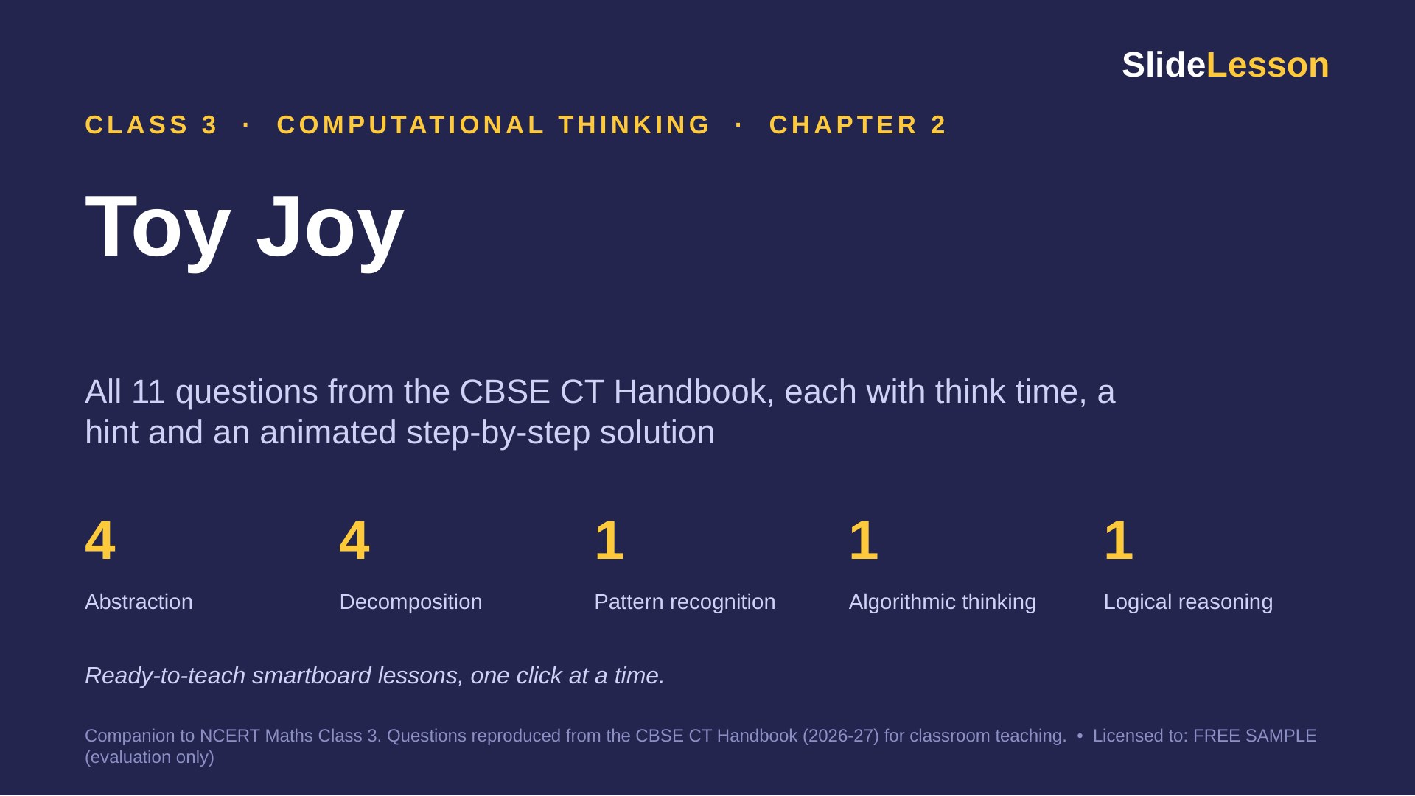
Notes:
This deck covers every question in Chapter 2 of the Class 3 CT Handbook (11 questions and The Thinking Spot). Each question has 3 slides: THINK (60 seconds alone), HINT, and SOLUTION (click to reveal one step at a time). Speaker notes give facilitation tips, common mistakes and extension questions.

Slide 2
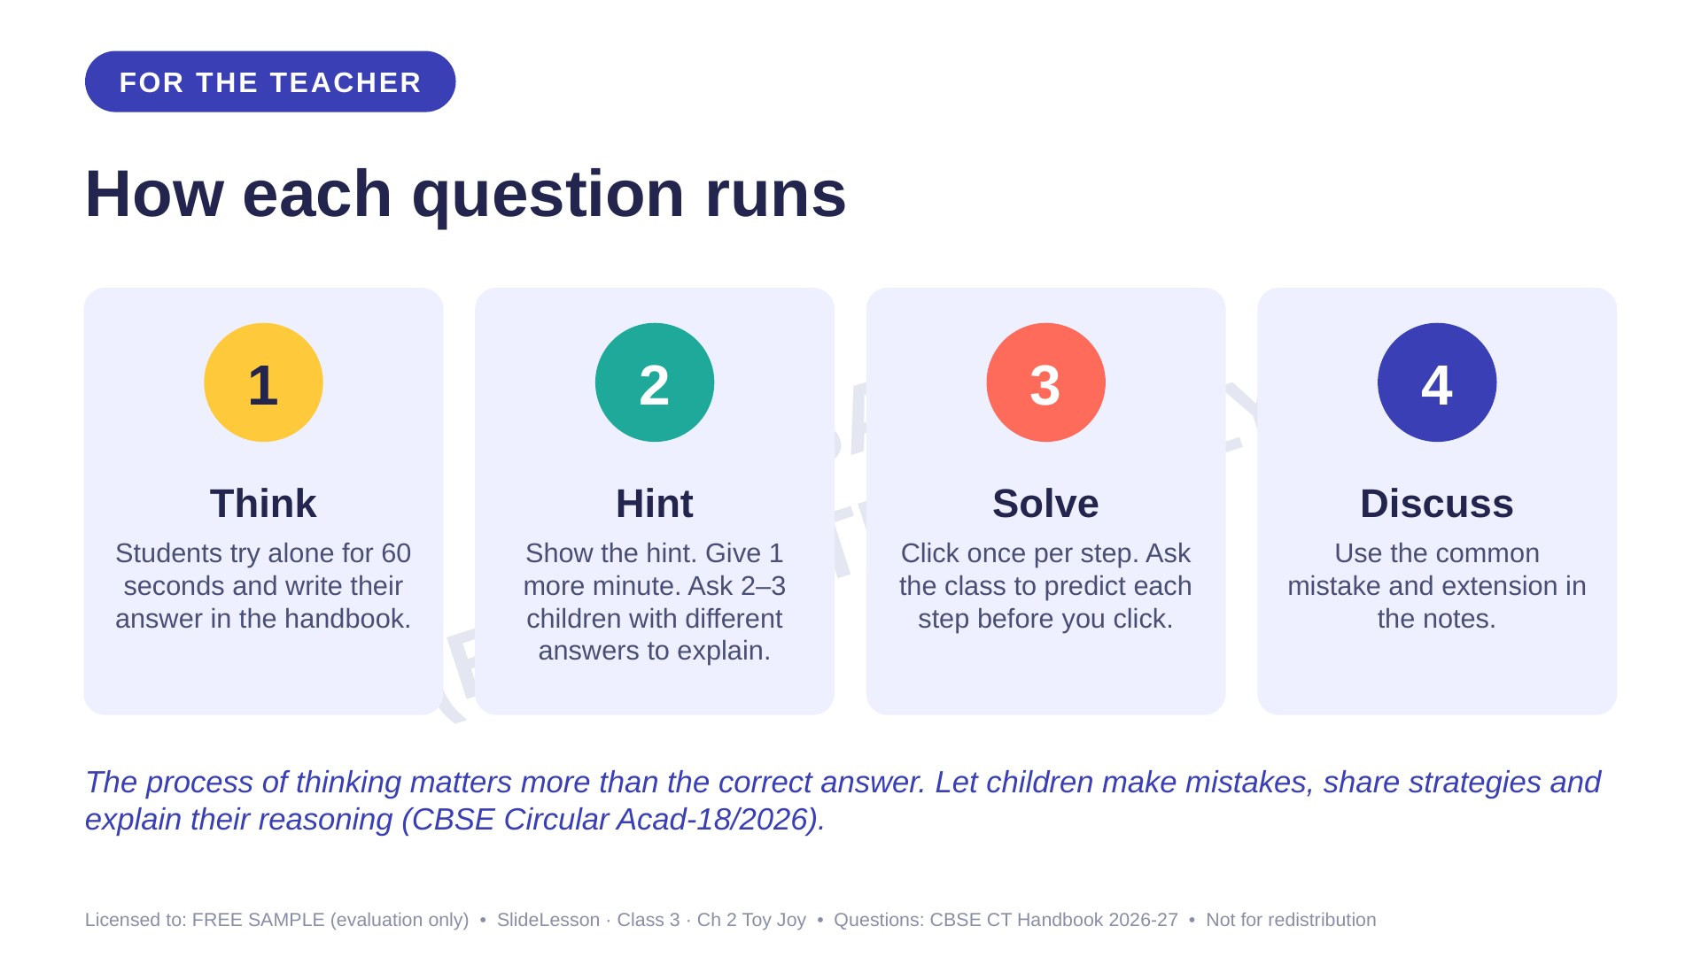

Slide 3
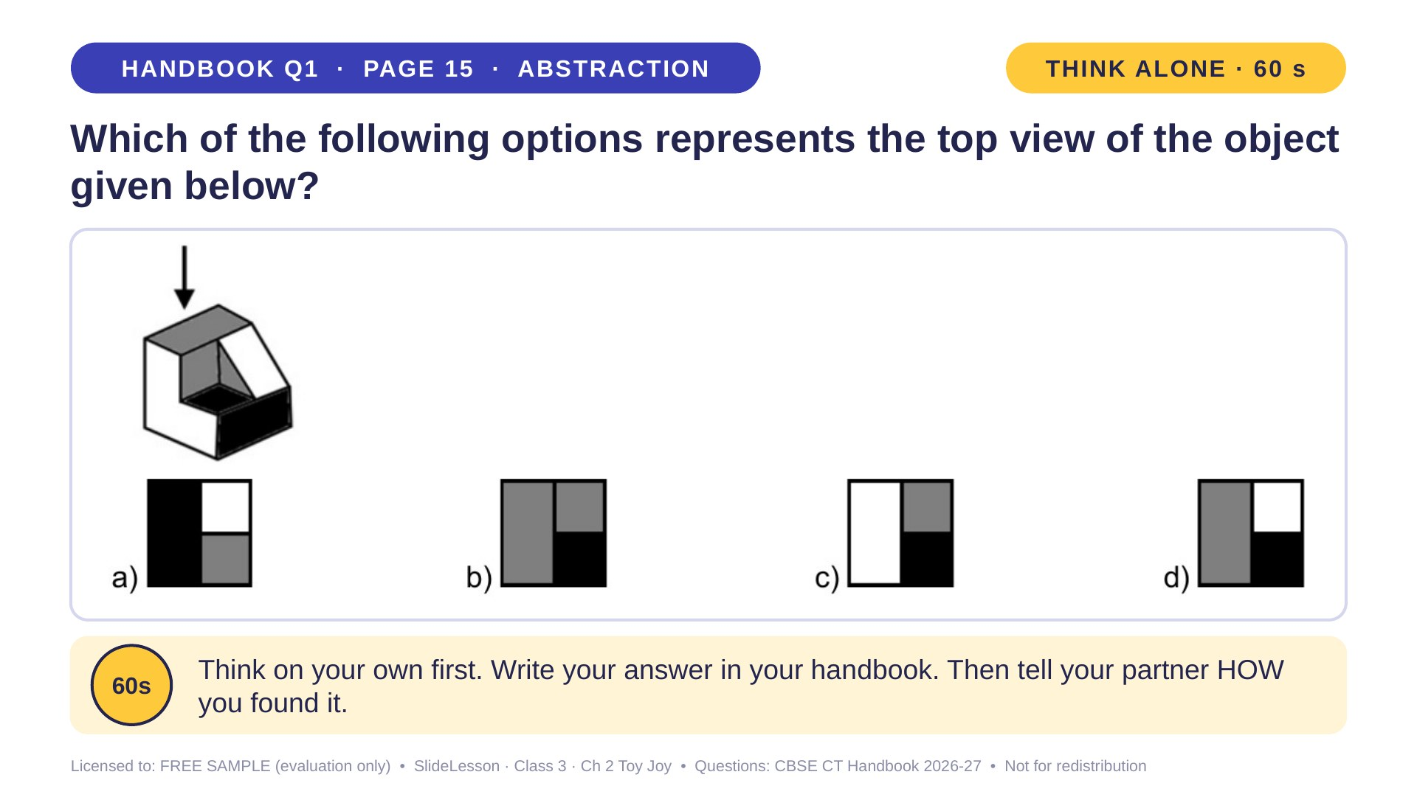
Notes:
WHILE SOLVING: push elimination: 'Which option can we cross out first, and why?' COMMON MISTAKE: imagining the FRONT view. Ask 'Can the bird see the front?' BEFORE: let two children look down at a box with a folded paper step on it. EXTENSION: draw the view from the left.
ANSWER (do not tell yet): d

Slide 4
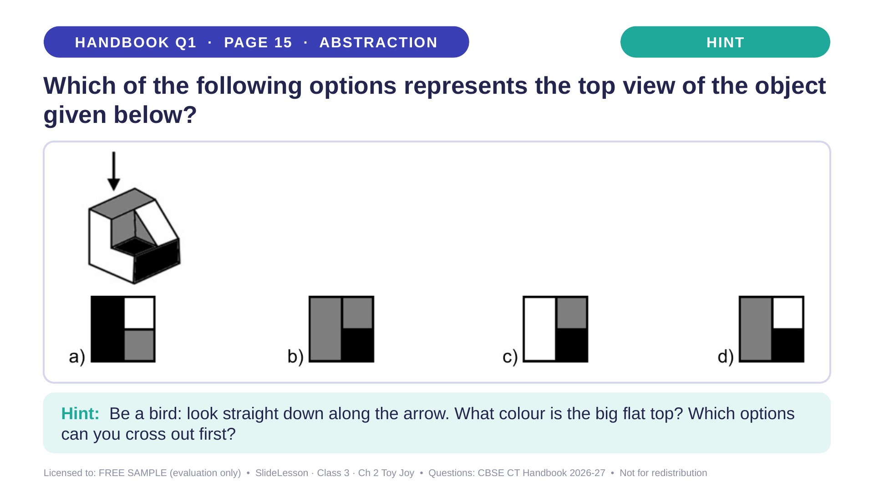
Notes:
Give the hint, then 1 more minute. Ask 2-3 children with DIFFERENT answers to explain their thinking before moving on.
WHILE SOLVING: push elimination: 'Which option can we cross out first, and why?' COMMON MISTAKE: imagining the FRONT view. Ask 'Can the bird see the front?' BEFORE: let two children look down at a box with a folded paper step on it. EXTENSION: draw the view from the left.

Slide 5
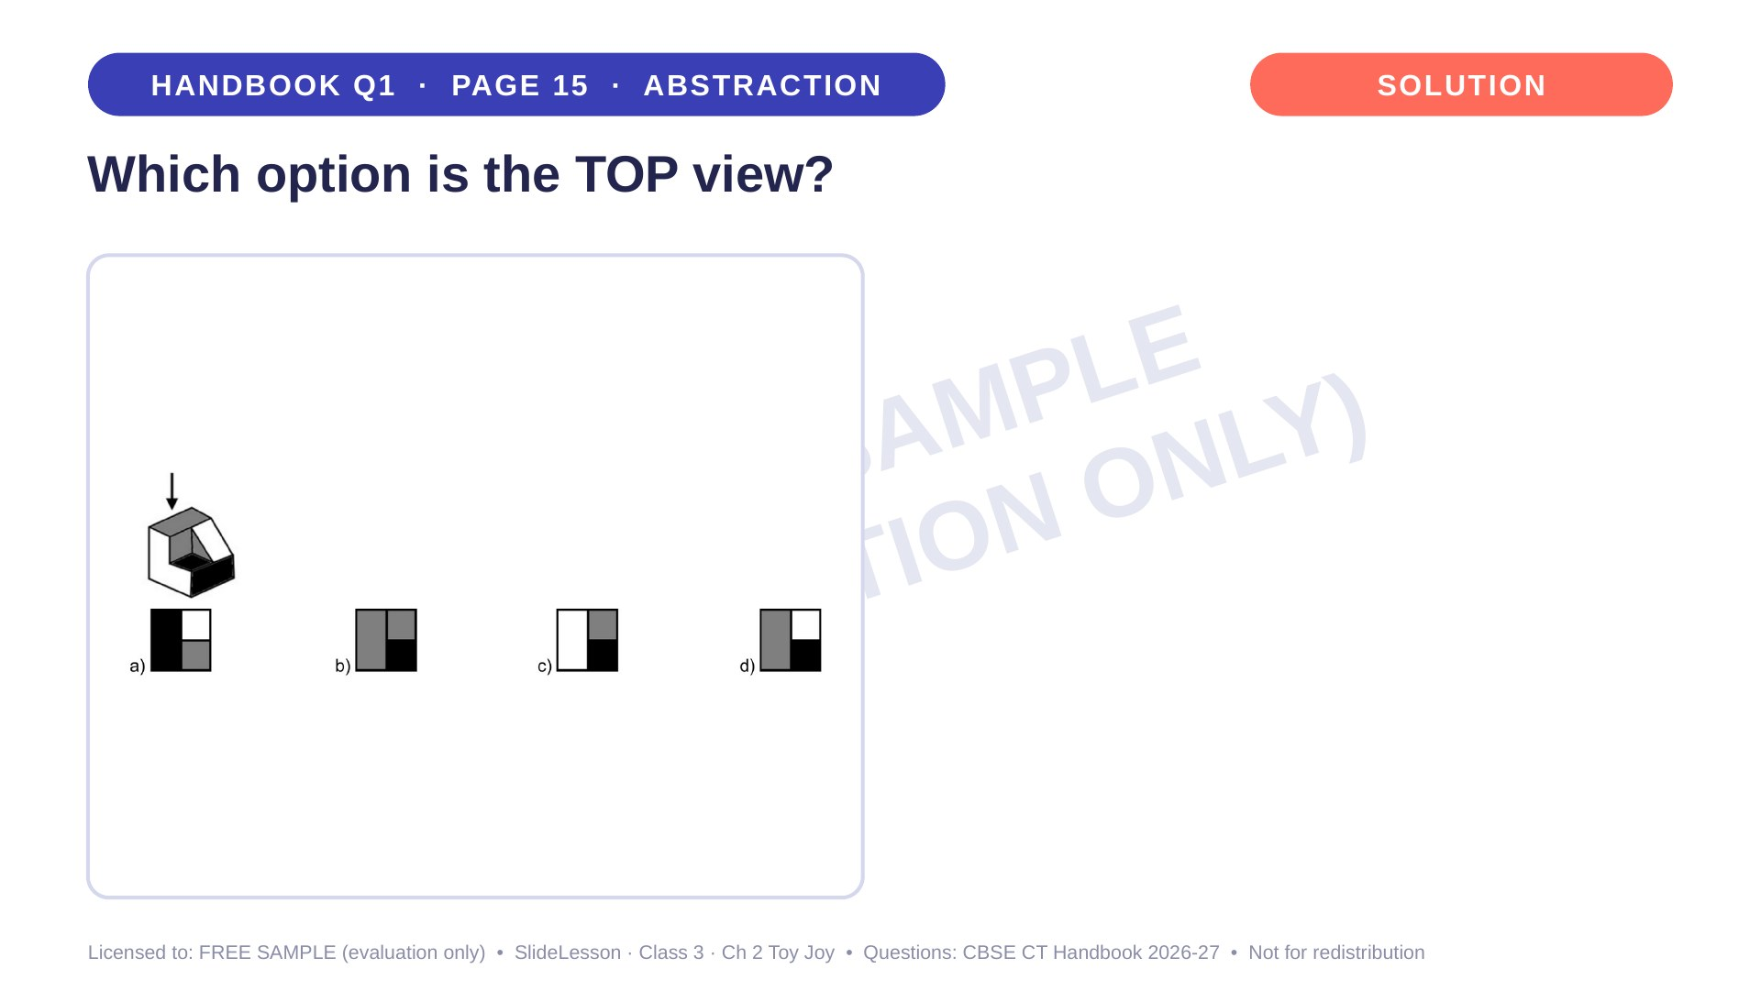
Notes:
WHILE SOLVING: push elimination: 'Which option can we cross out first, and why?' COMMON MISTAKE: imagining the FRONT view. Ask 'Can the bird see the front?' BEFORE: let two children look down at a box with a folded paper step on it. EXTENSION: draw the view from the left.

Slide 6
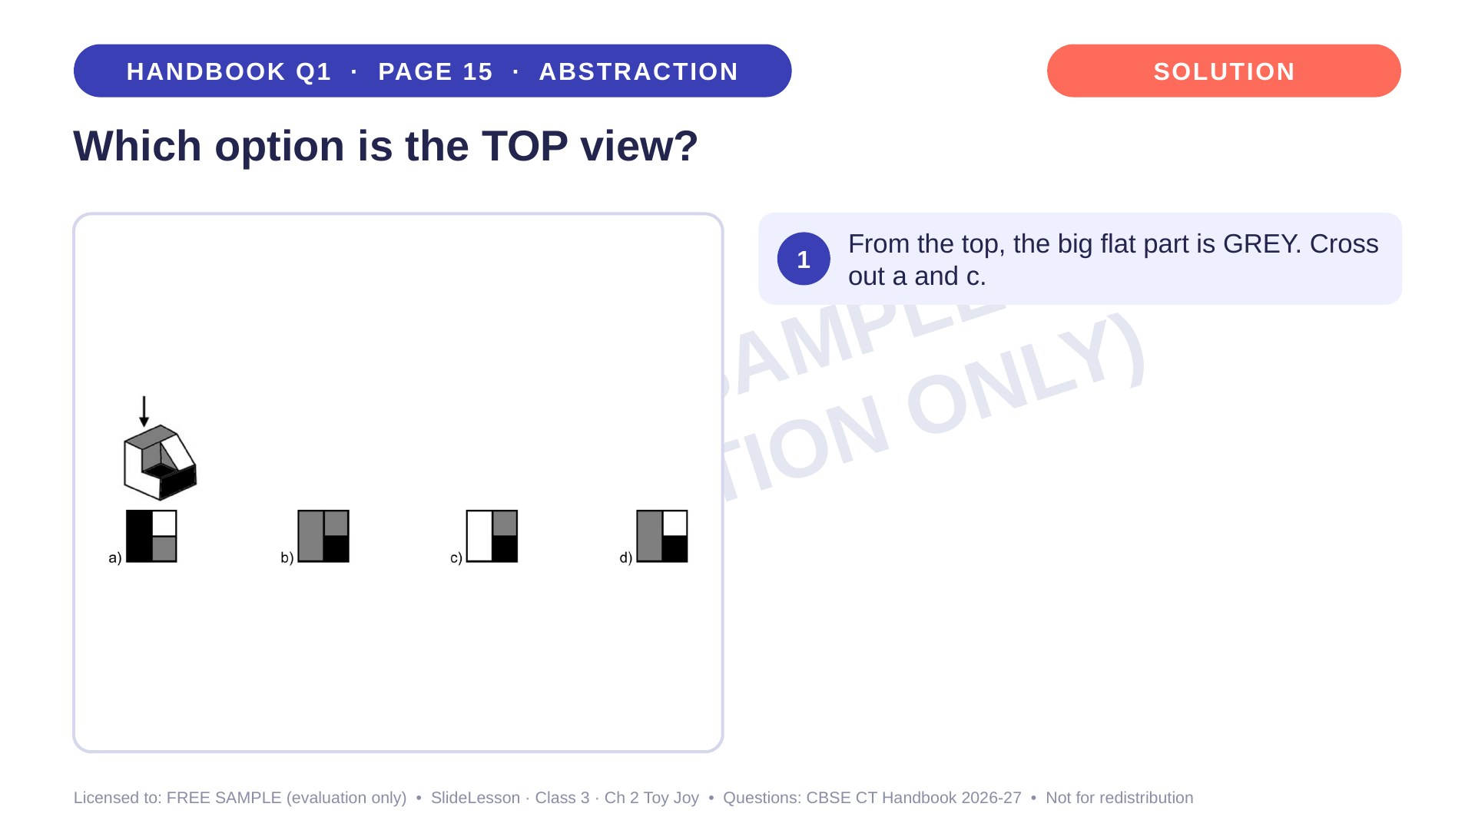
Notes:
Step 1 of 4

Slide 7
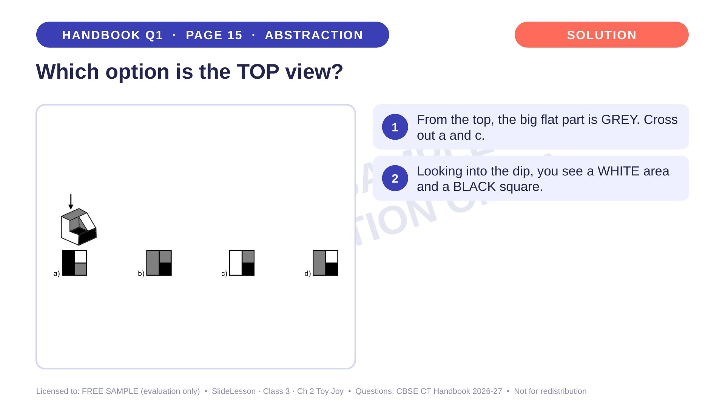
Notes:
Step 2 of 4

Slide 8
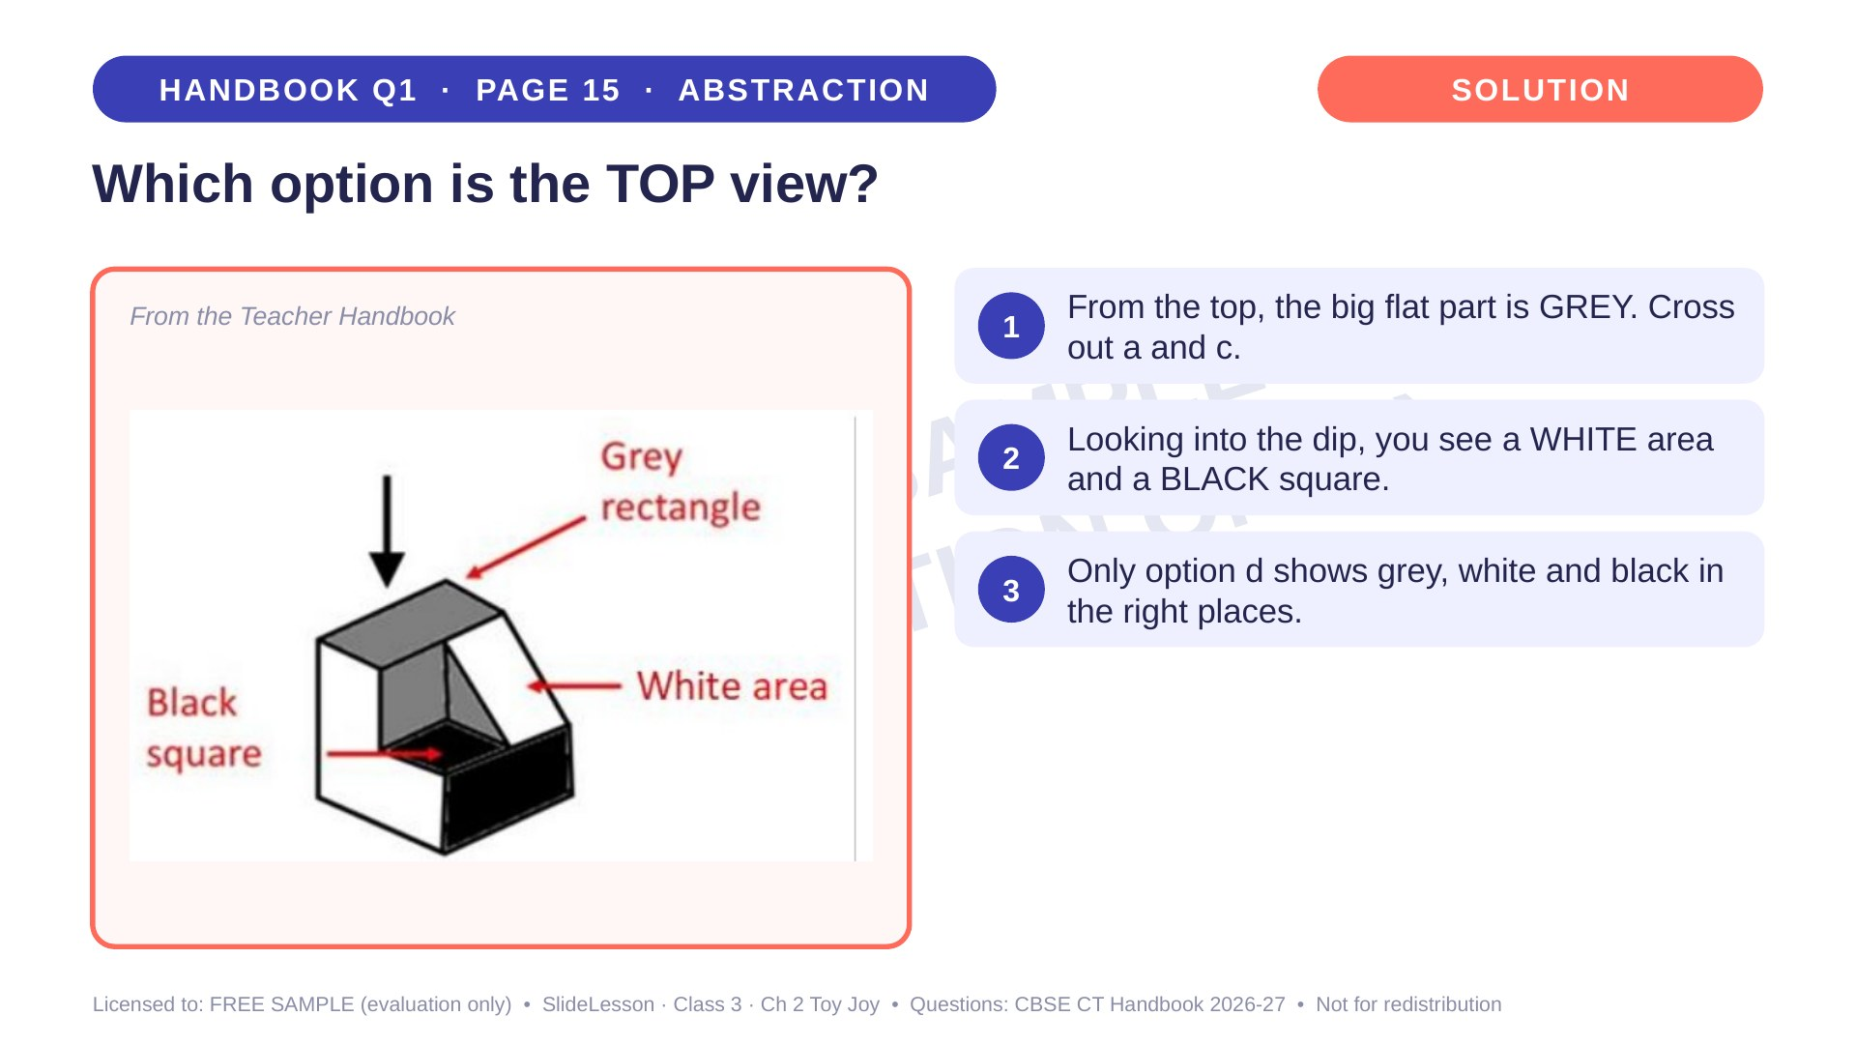
Notes:
Step 3 of 4

Slide 9
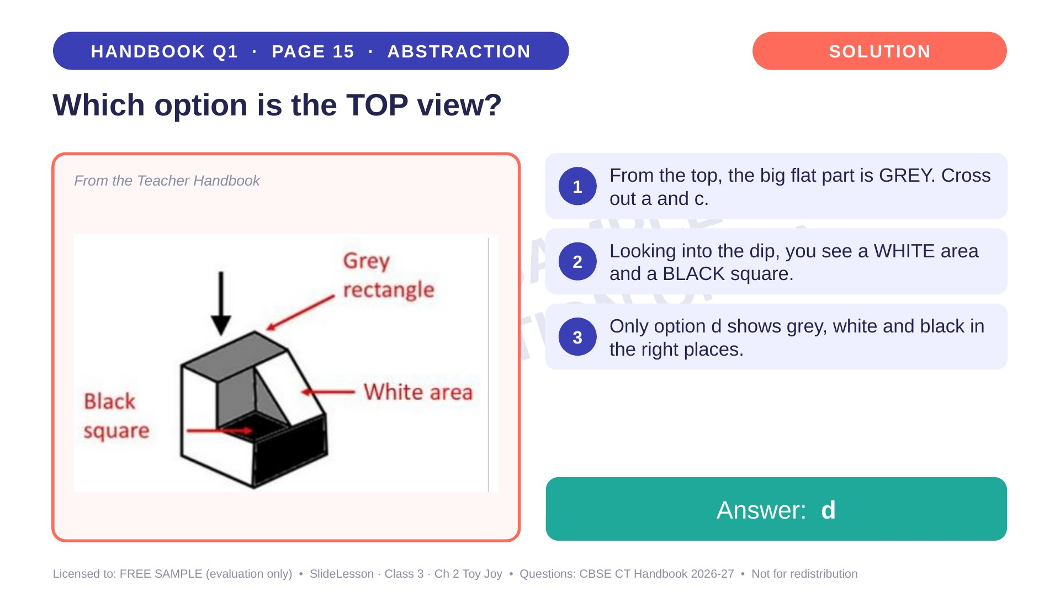
Notes:
Step 4 of 4

Slide 10
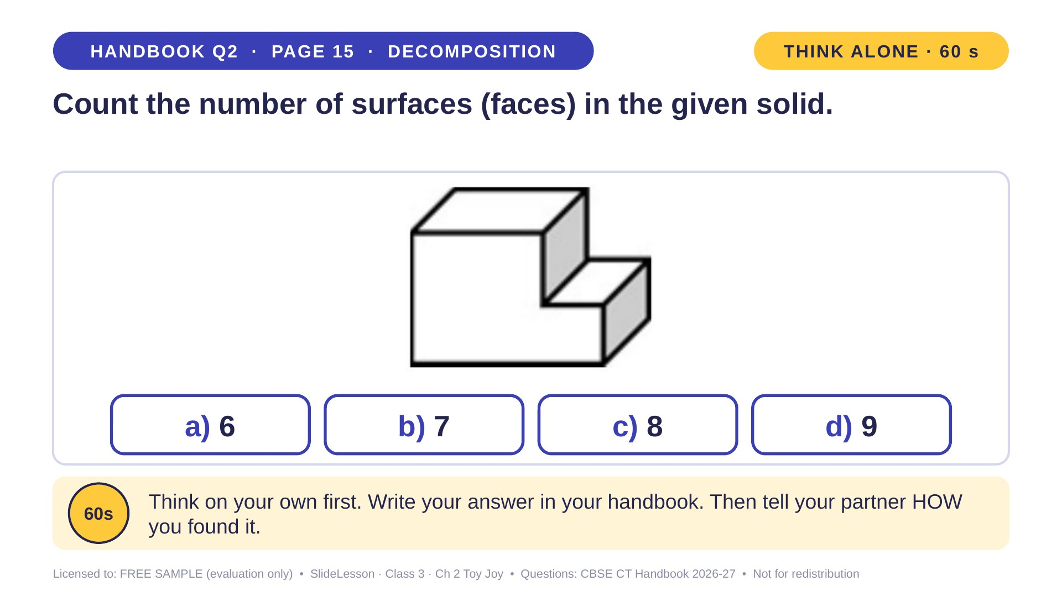
Notes:
WHILE SOLVING: children number the visible faces 1-5 on the picture, then point to where 6, 7 and 8 must be. COMMON MISTAKE: forgetting the bottom face. Ask 'What is it standing on?' BEFORE: build the shape from 3 blocks. EXTENSION: how many edges does it have?
ANSWER (do not tell yet): c) 8

Slide 11
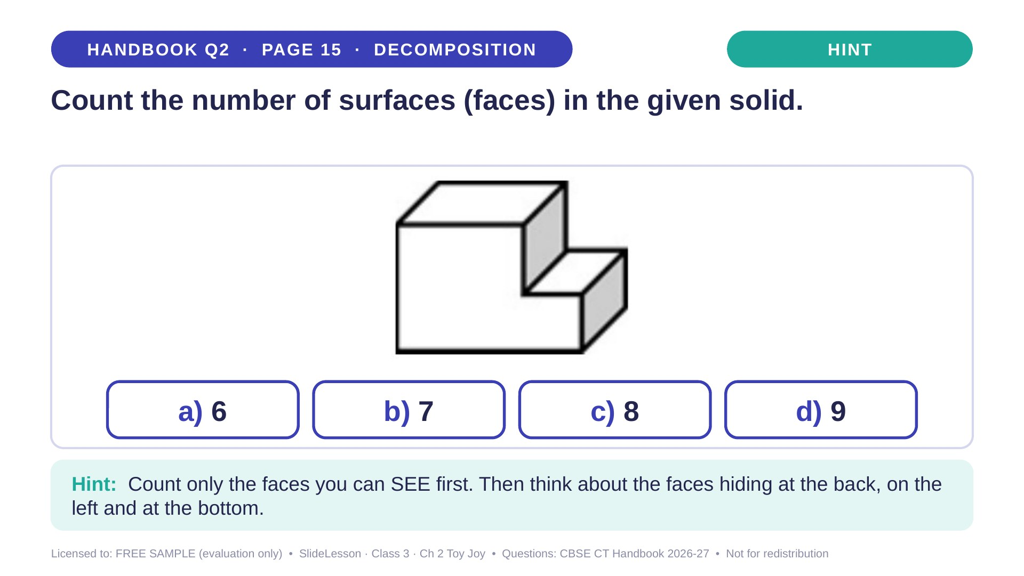
Notes:
Give the hint, then 1 more minute. Ask 2-3 children with DIFFERENT answers to explain their thinking before moving on.
WHILE SOLVING: children number the visible faces 1-5 on the picture, then point to where 6, 7 and 8 must be. COMMON MISTAKE: forgetting the bottom face. Ask 'What is it standing on?' BEFORE: build the shape from 3 blocks. EXTENSION: how many edges does it have?

Slide 12
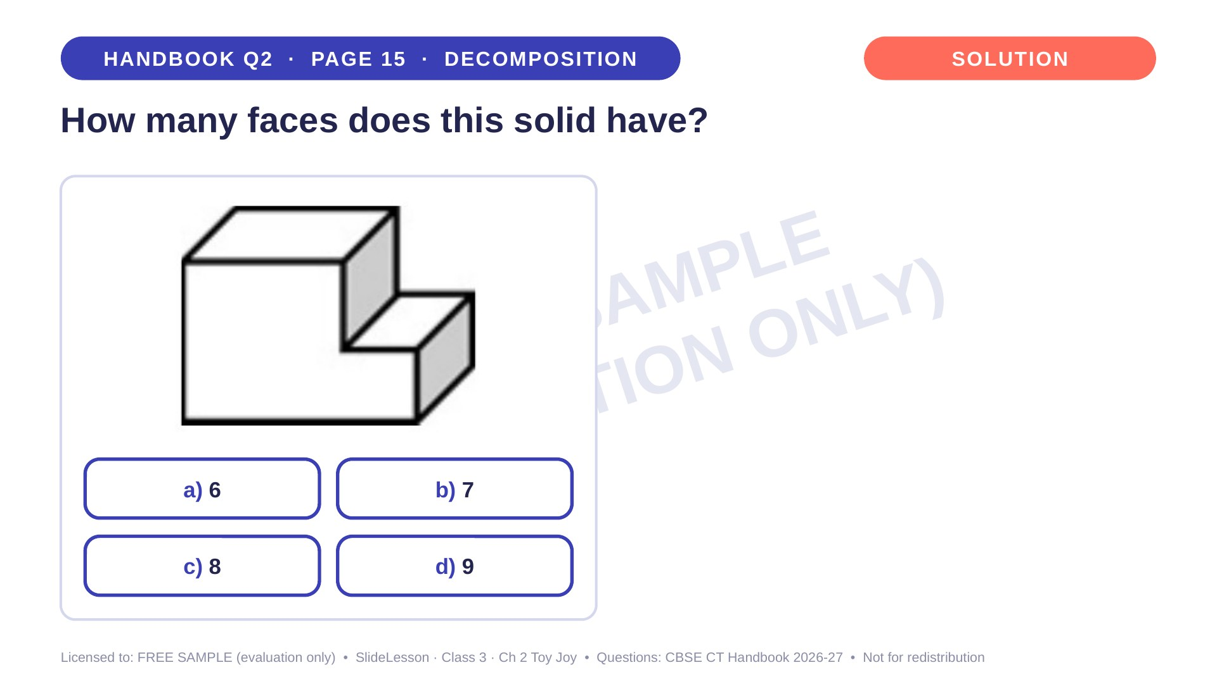
Notes:
WHILE SOLVING: children number the visible faces 1-5 on the picture, then point to where 6, 7 and 8 must be. COMMON MISTAKE: forgetting the bottom face. Ask 'What is it standing on?' BEFORE: build the shape from 3 blocks. EXTENSION: how many edges does it have?

Slide 13
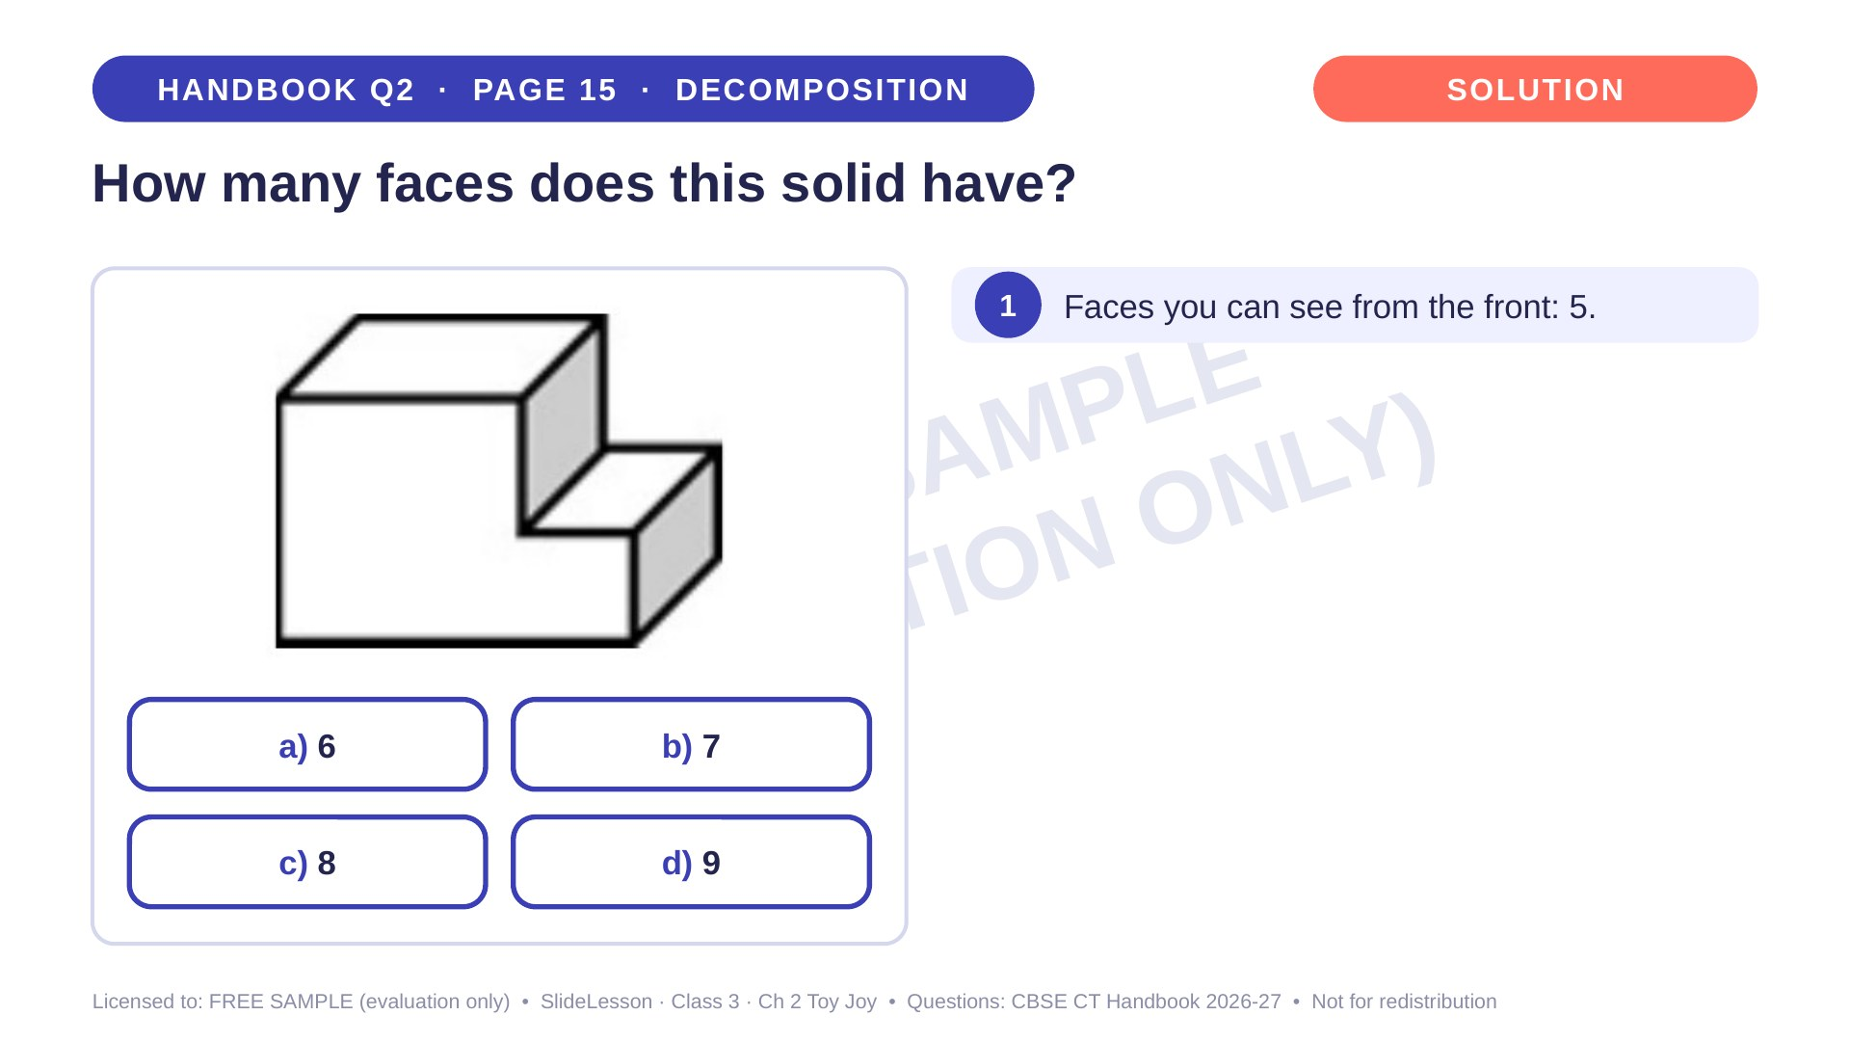
Notes:
Step 1 of 4

Slide 14
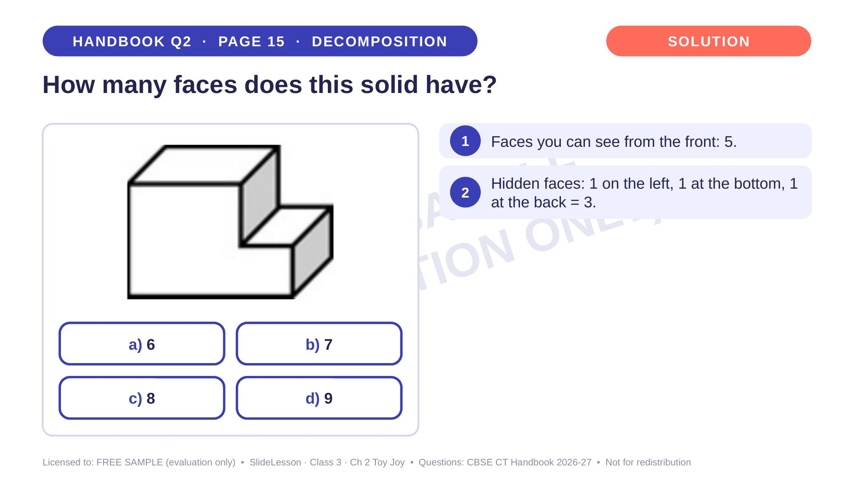
Notes:
Step 2 of 4

Slide 15
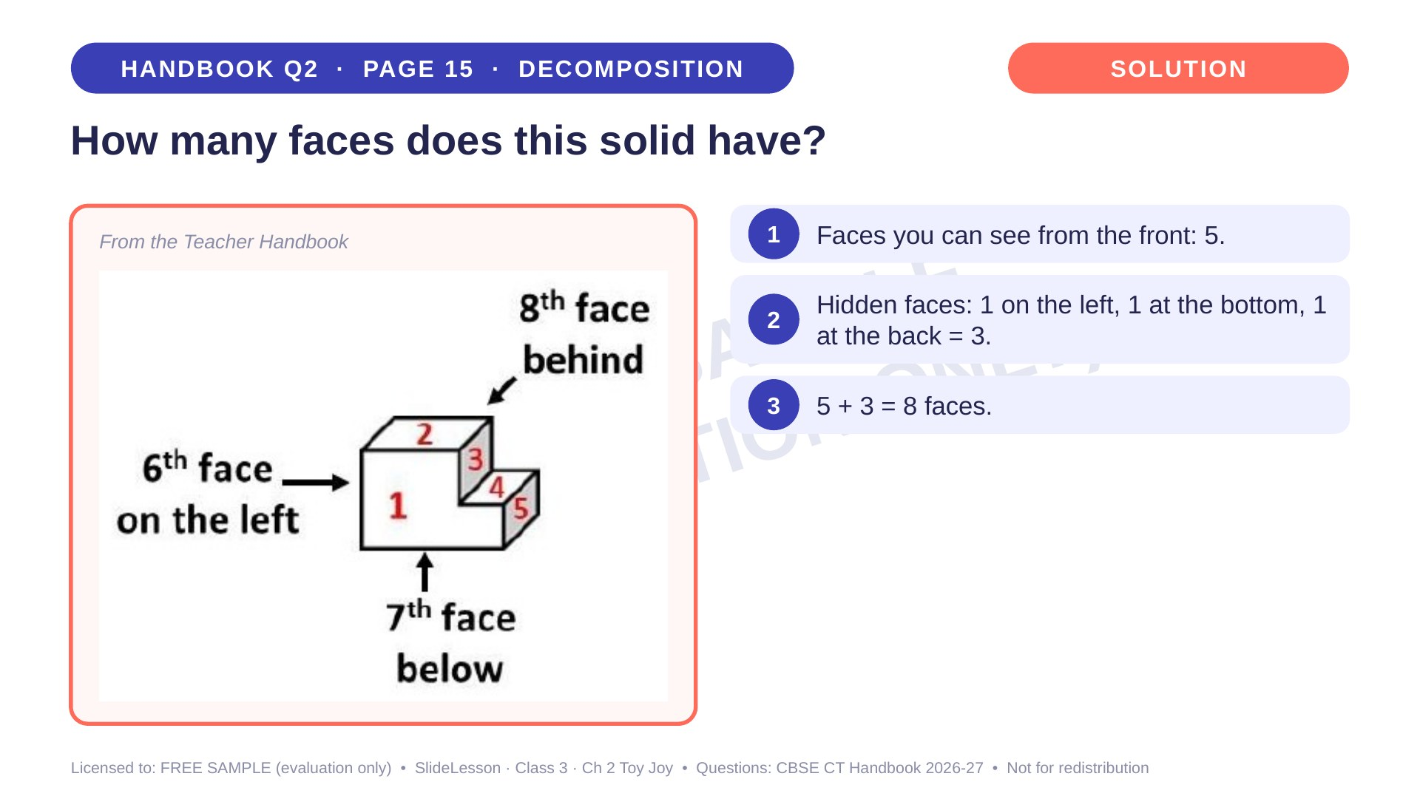
Notes:
Step 3 of 4

Slide 16
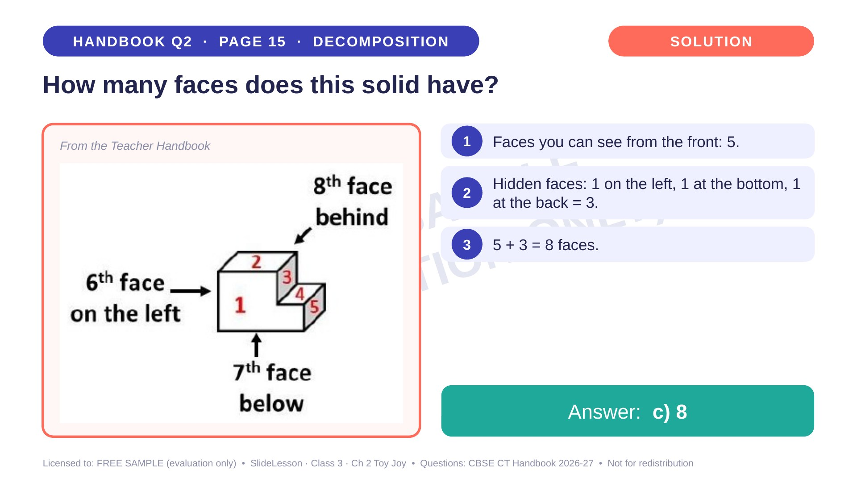
Notes:
Step 4 of 4

Slide 17
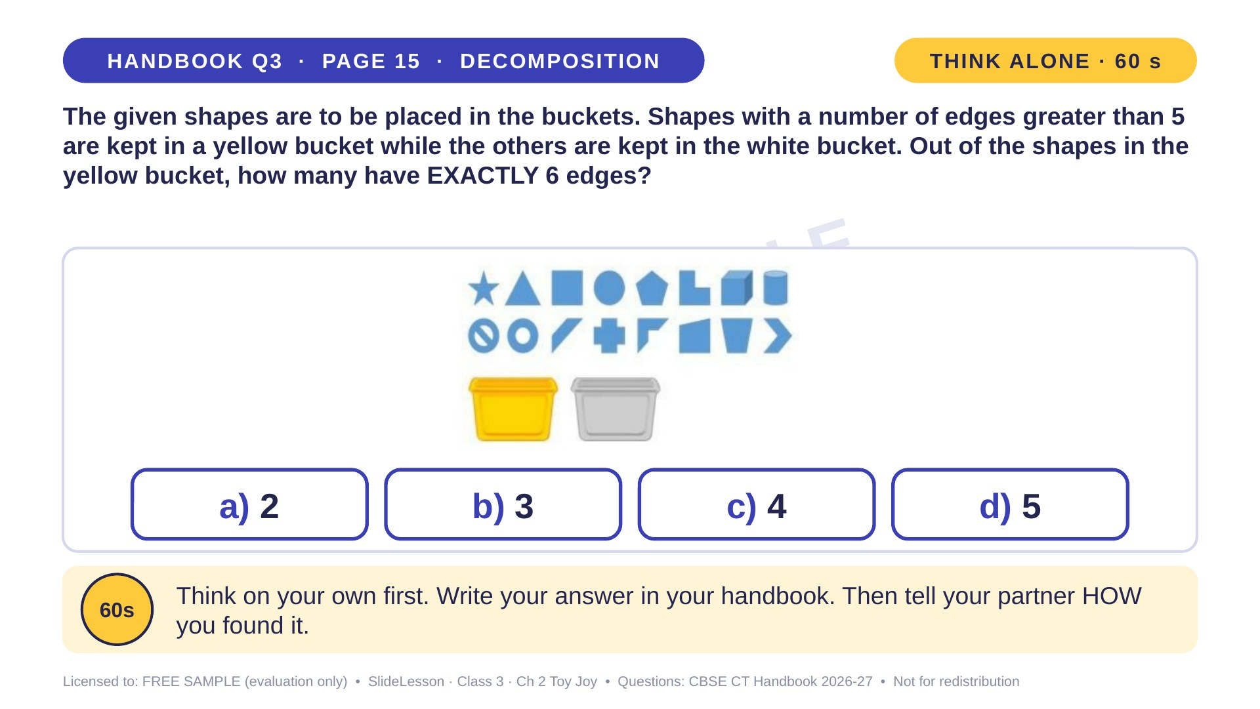
Notes:
WHILE SOLVING: children write the number of edges beside every shape before sorting. COMMON MISTAKE: putting 5-edged shapes in the yellow bucket (greater than 5 means 6 or more), or answering 6. EXTENSION: how many shapes go in the WHITE bucket?
ANSWER (do not tell yet): b) 3

Slide 18
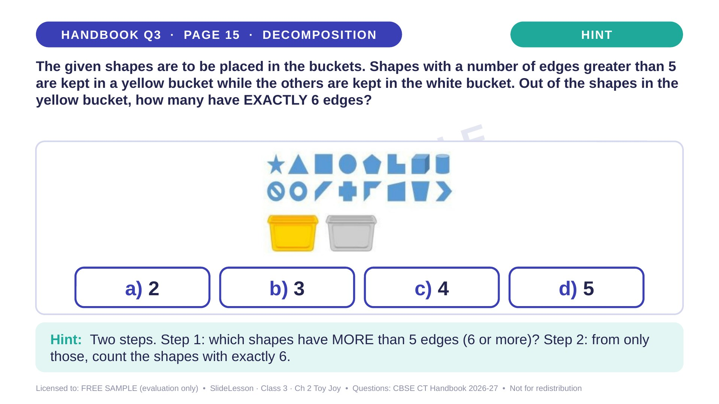
Notes:
Give the hint, then 1 more minute. Ask 2-3 children with DIFFERENT answers to explain their thinking before moving on.
WHILE SOLVING: children write the number of edges beside every shape before sorting. COMMON MISTAKE: putting 5-edged shapes in the yellow bucket (greater than 5 means 6 or more), or answering 6. EXTENSION: how many shapes go in the WHITE bucket?

Slide 19
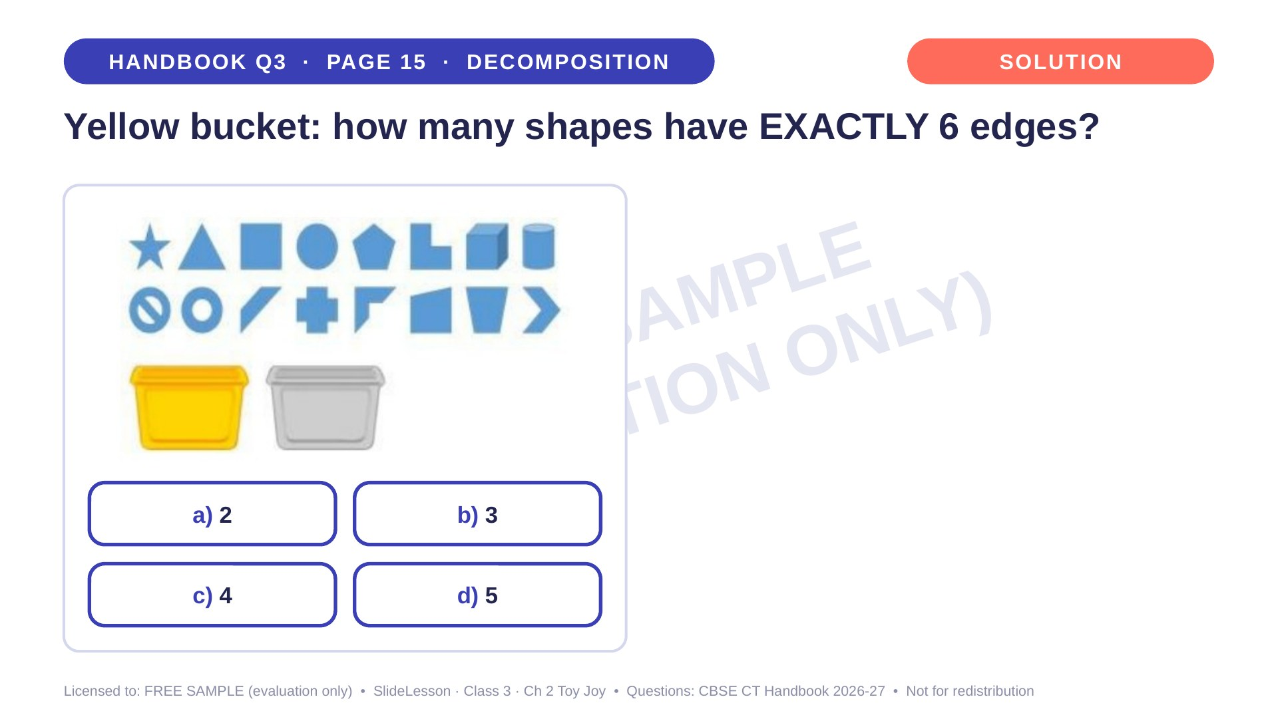
Notes:
WHILE SOLVING: children write the number of edges beside every shape before sorting. COMMON MISTAKE: putting 5-edged shapes in the yellow bucket (greater than 5 means 6 or more), or answering 6. EXTENSION: how many shapes go in the WHITE bucket?

Slide 20
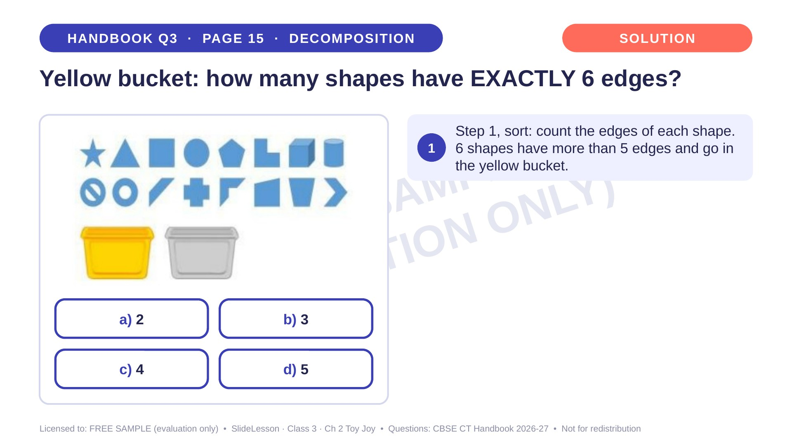
Notes:
Step 1 of 3

Slide 21
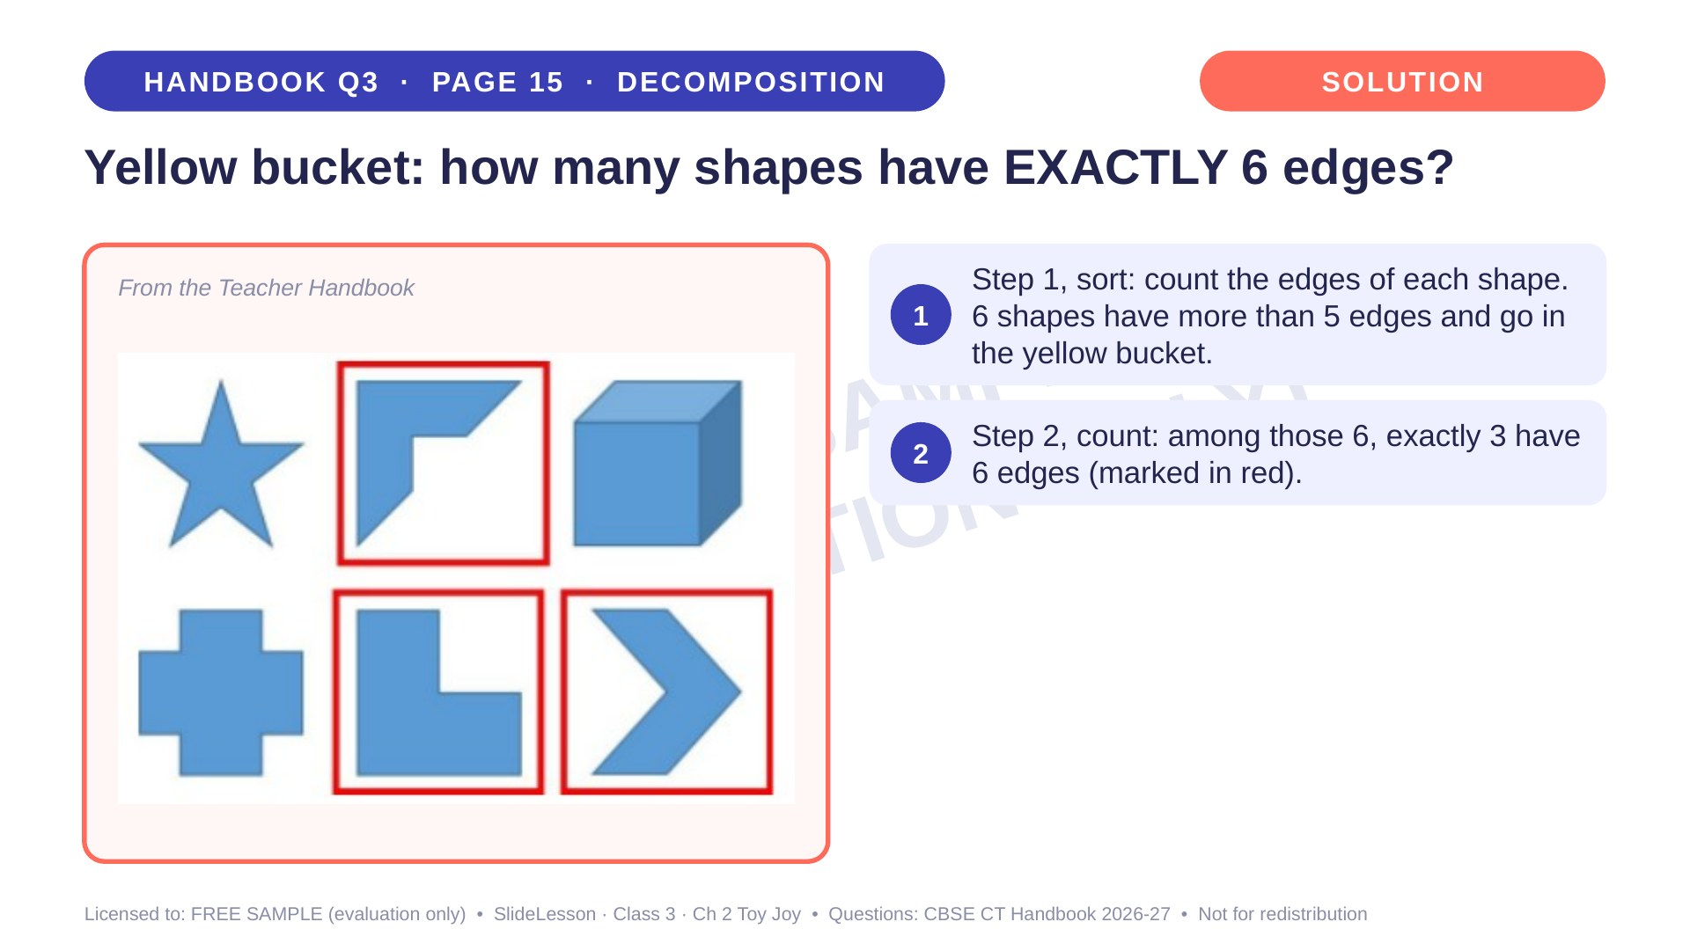
Notes:
Step 2 of 3

Slide 22
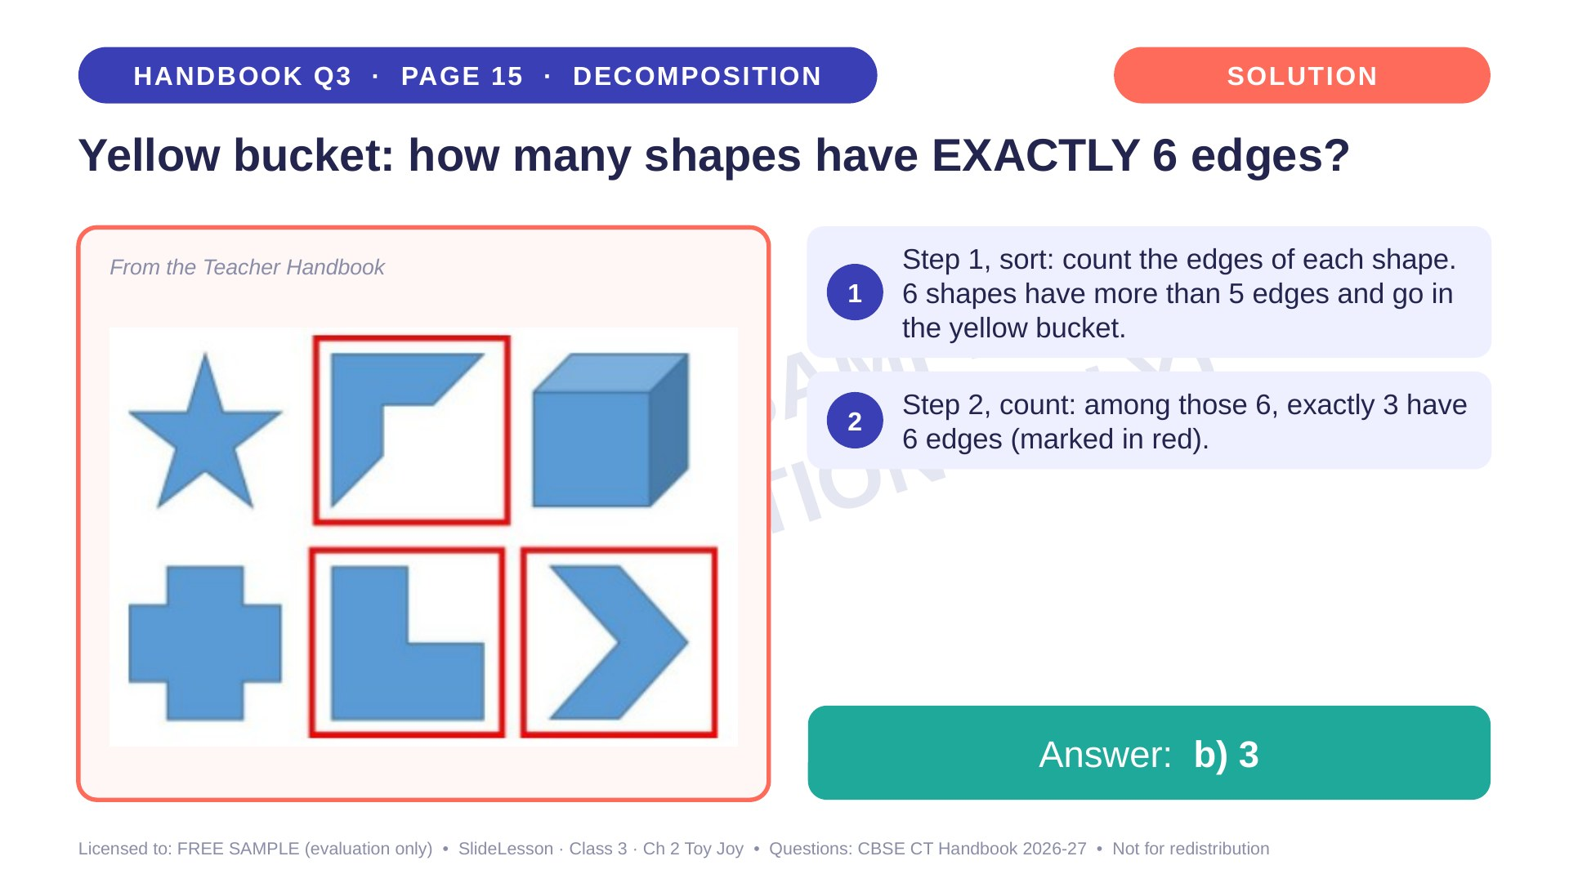
Notes:
Step 3 of 3

Slide 23
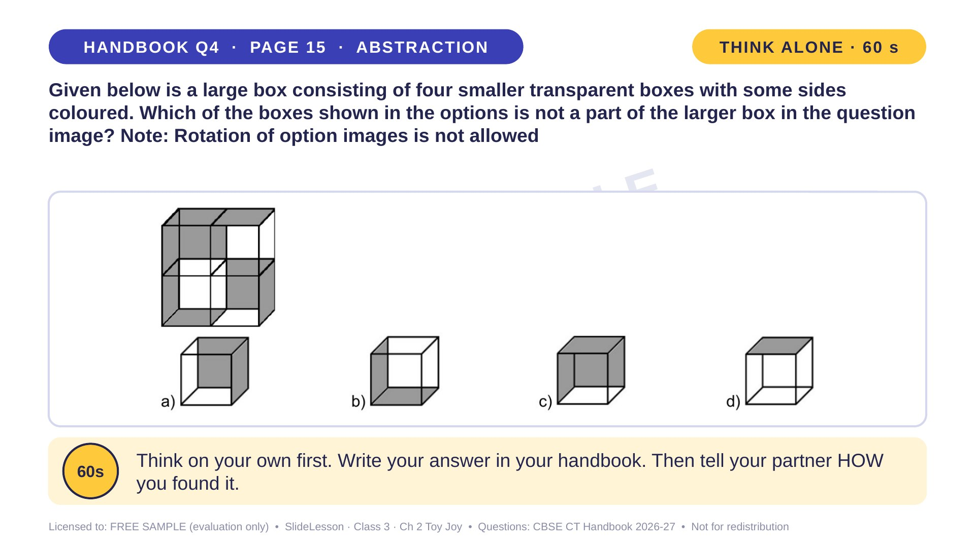
Notes:
WHILE SOLVING: children name the grey faces of an option aloud before searching. COMMON MISTAKE: turning the option in their head. BEFORE: stick grey paper on two faces of a clear box and turn it to show why rotation is not allowed. EXTENSION: which small box has the most grey faces?
ANSWER (do not tell yet): c

Slide 24
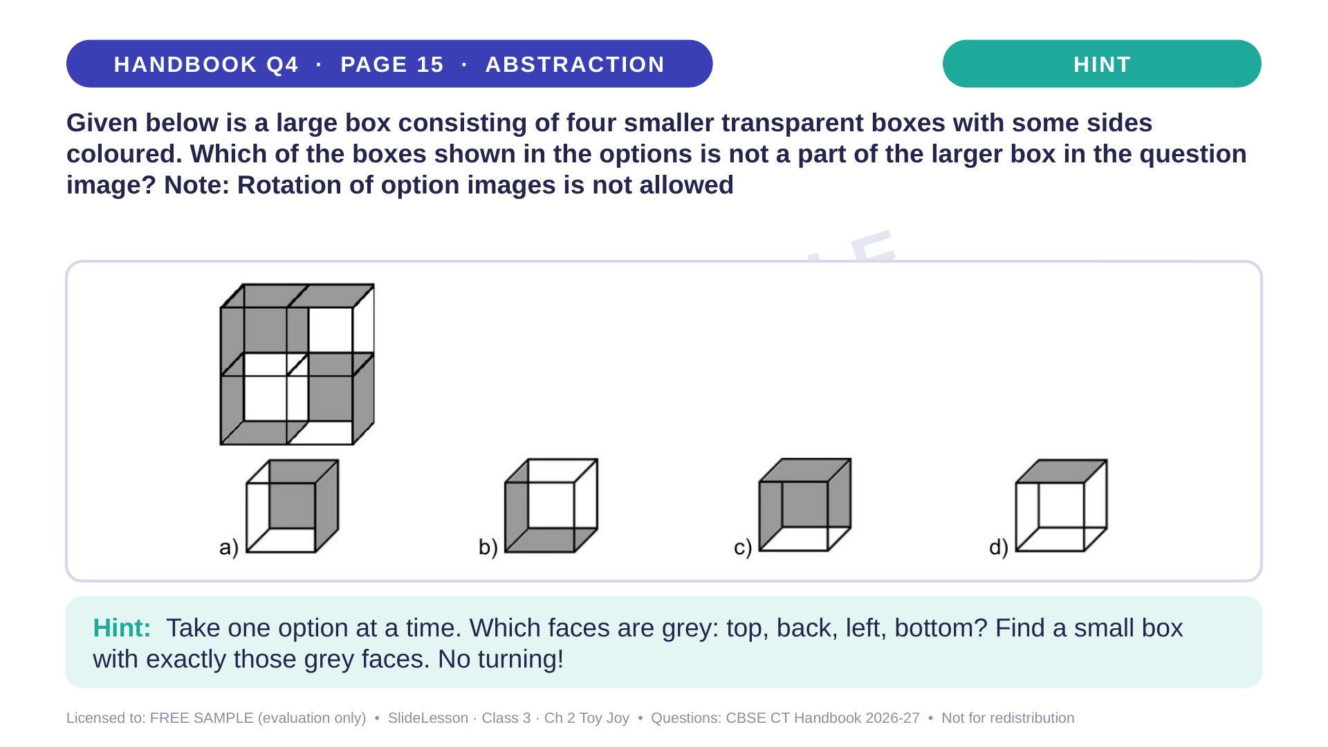
Notes:
Give the hint, then 1 more minute. Ask 2-3 children with DIFFERENT answers to explain their thinking before moving on.
WHILE SOLVING: children name the grey faces of an option aloud before searching. COMMON MISTAKE: turning the option in their head. BEFORE: stick grey paper on two faces of a clear box and turn it to show why rotation is not allowed. EXTENSION: which small box has the most grey faces?

Slide 25
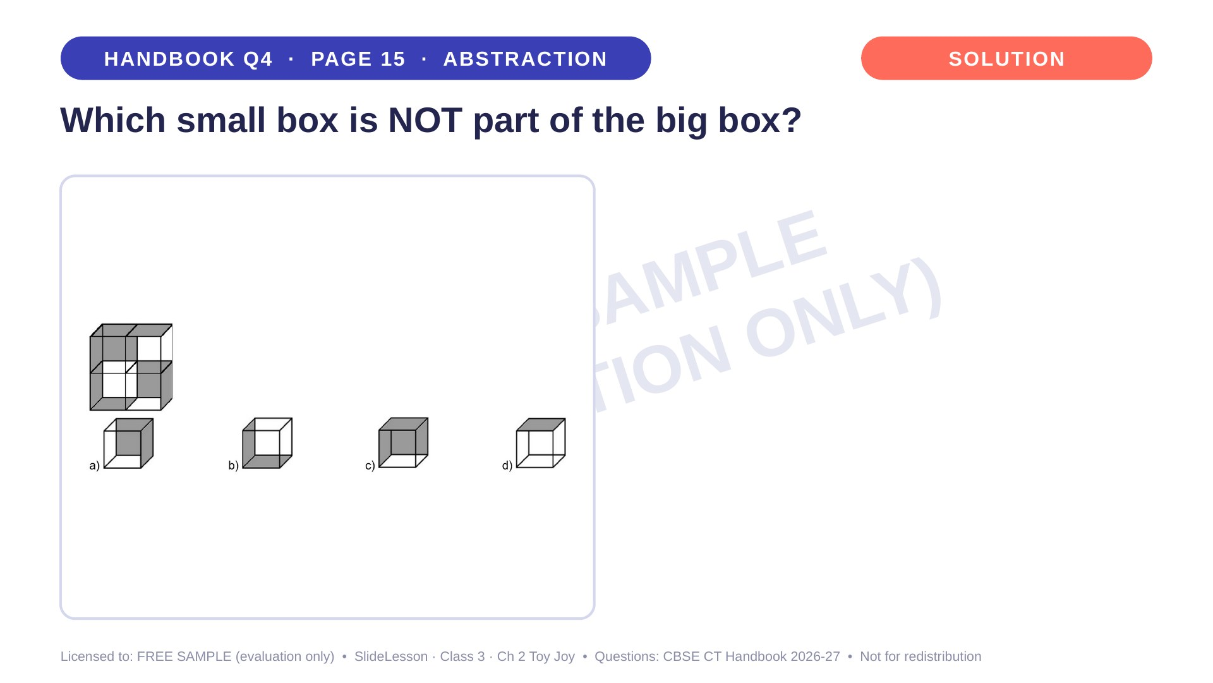
Notes:
WHILE SOLVING: children name the grey faces of an option aloud before searching. COMMON MISTAKE: turning the option in their head. BEFORE: stick grey paper on two faces of a clear box and turn it to show why rotation is not allowed. EXTENSION: which small box has the most grey faces?

Slide 26
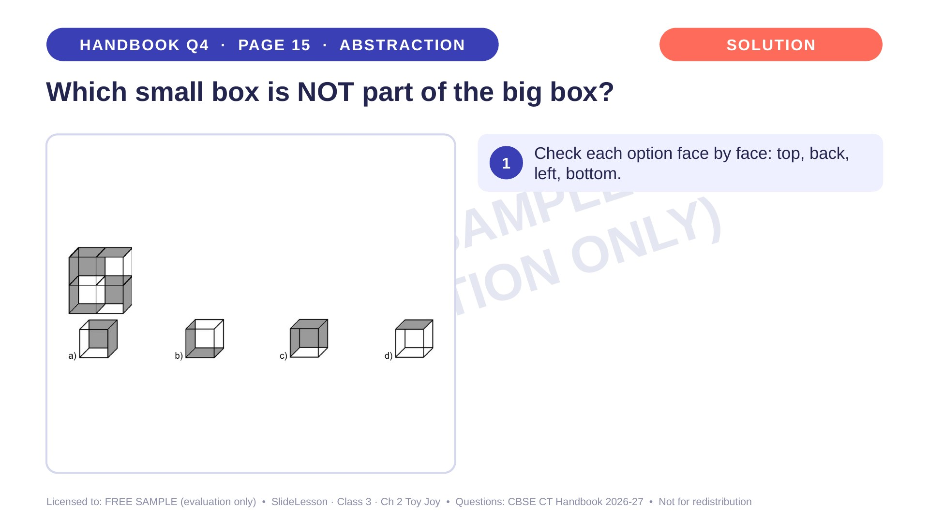
Notes:
Step 1 of 4

Slide 27
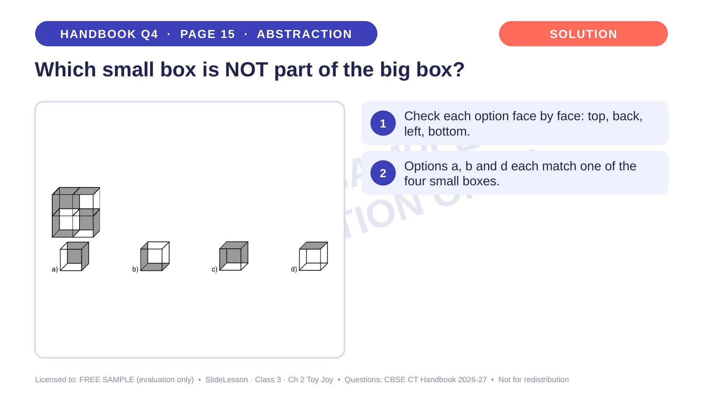
Notes:
Step 2 of 4

Slide 28
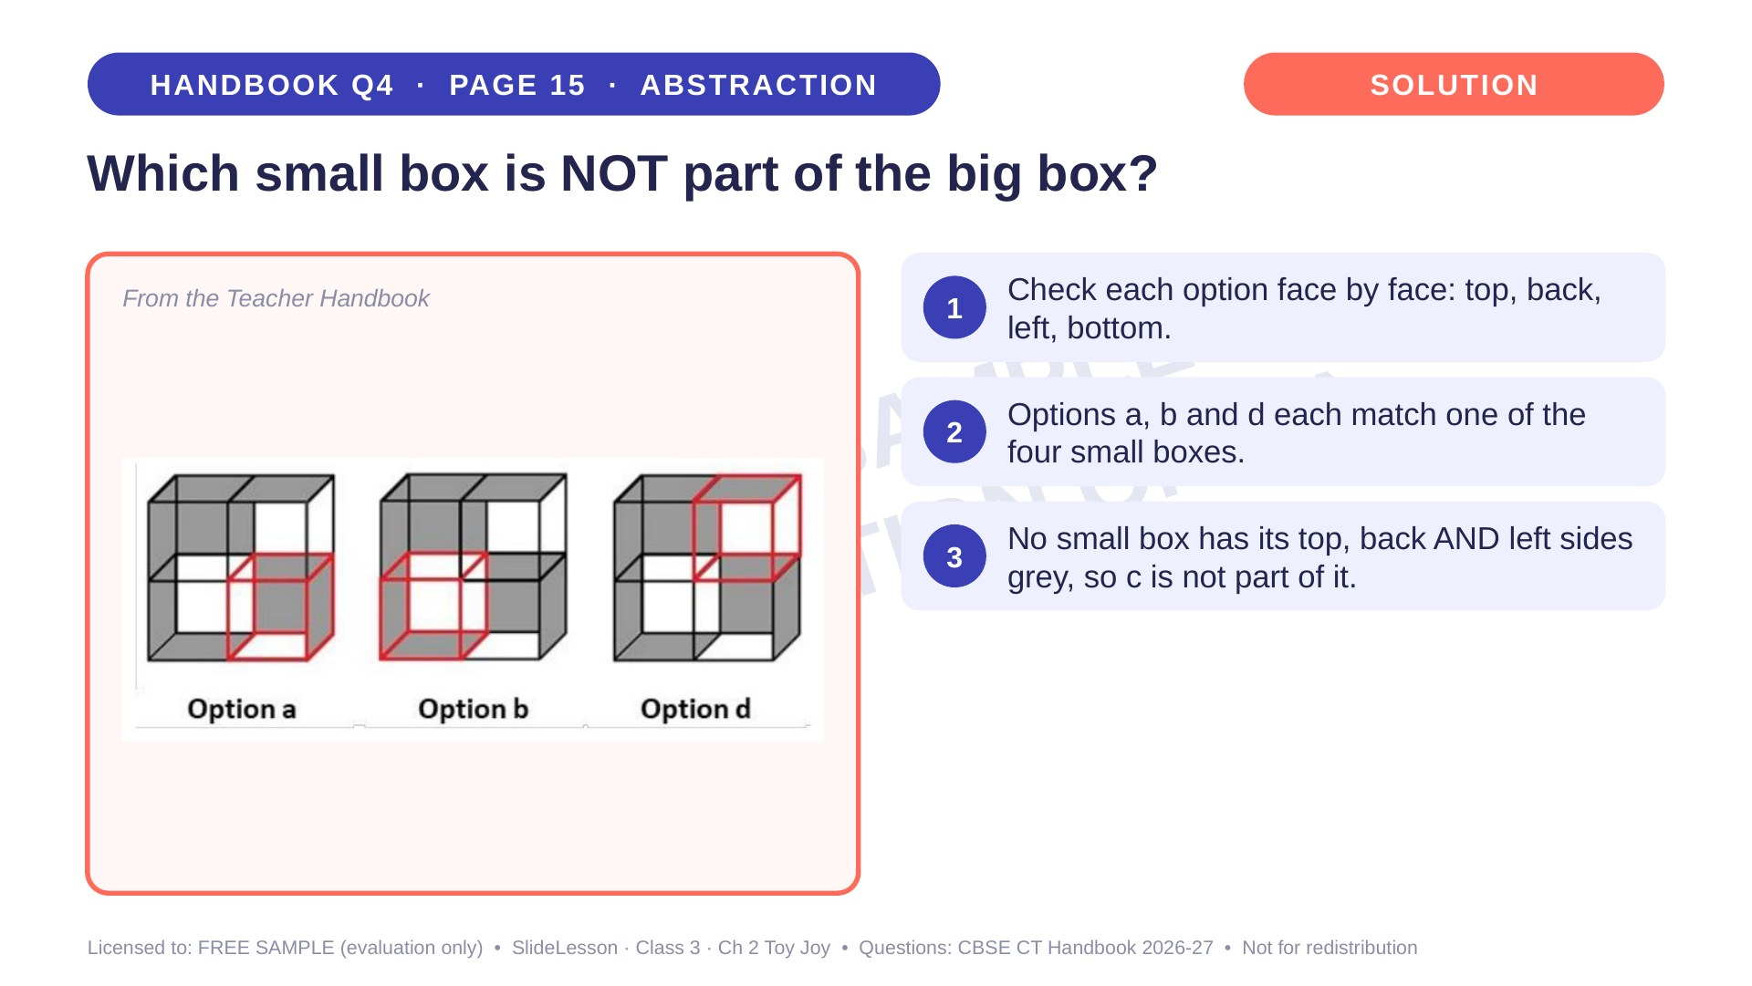
Notes:
Step 3 of 4

Slide 29
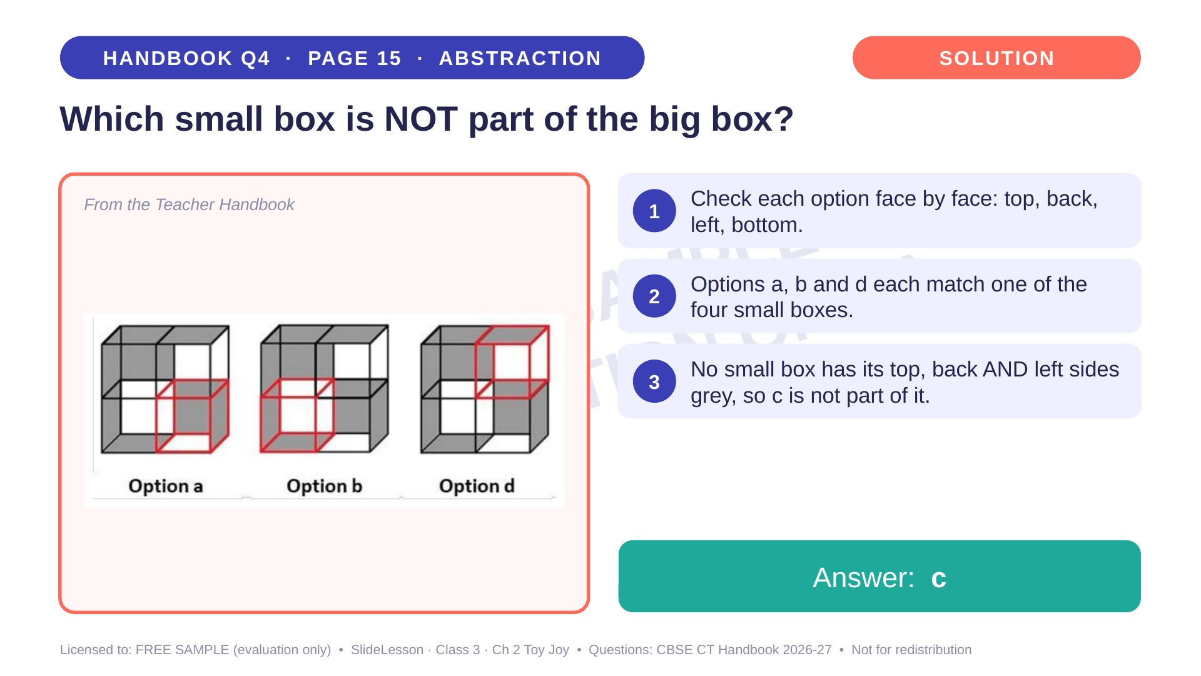
Notes:
Step 4 of 4

Slide 30
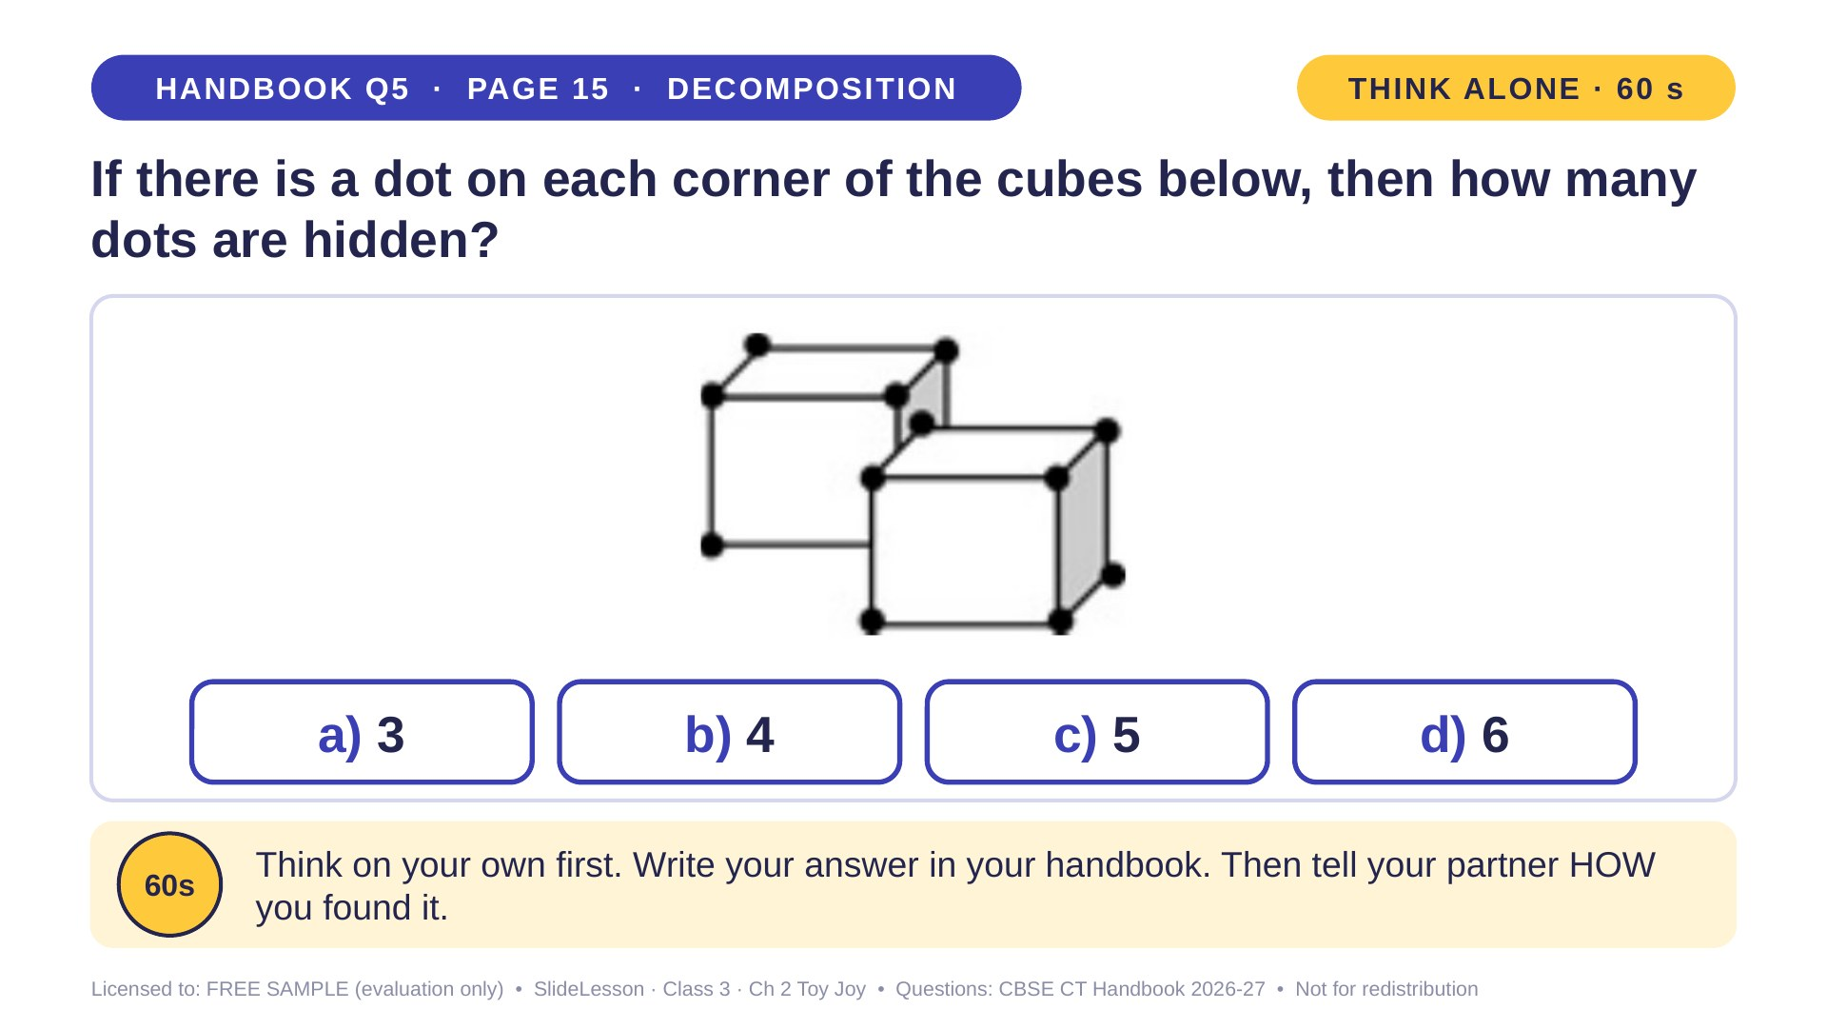
Notes:
WHILE SOLVING: children tick each visible dot as they count. COMMON MISTAKE: trying to 'see' hidden dots instead of calculating total minus visible. Praise the total-minus-seen strategy. EXTENSION: 3 cubes, 17 dots visible: how many hidden? (7)
ANSWER (do not tell yet): b) 4

Slide 31
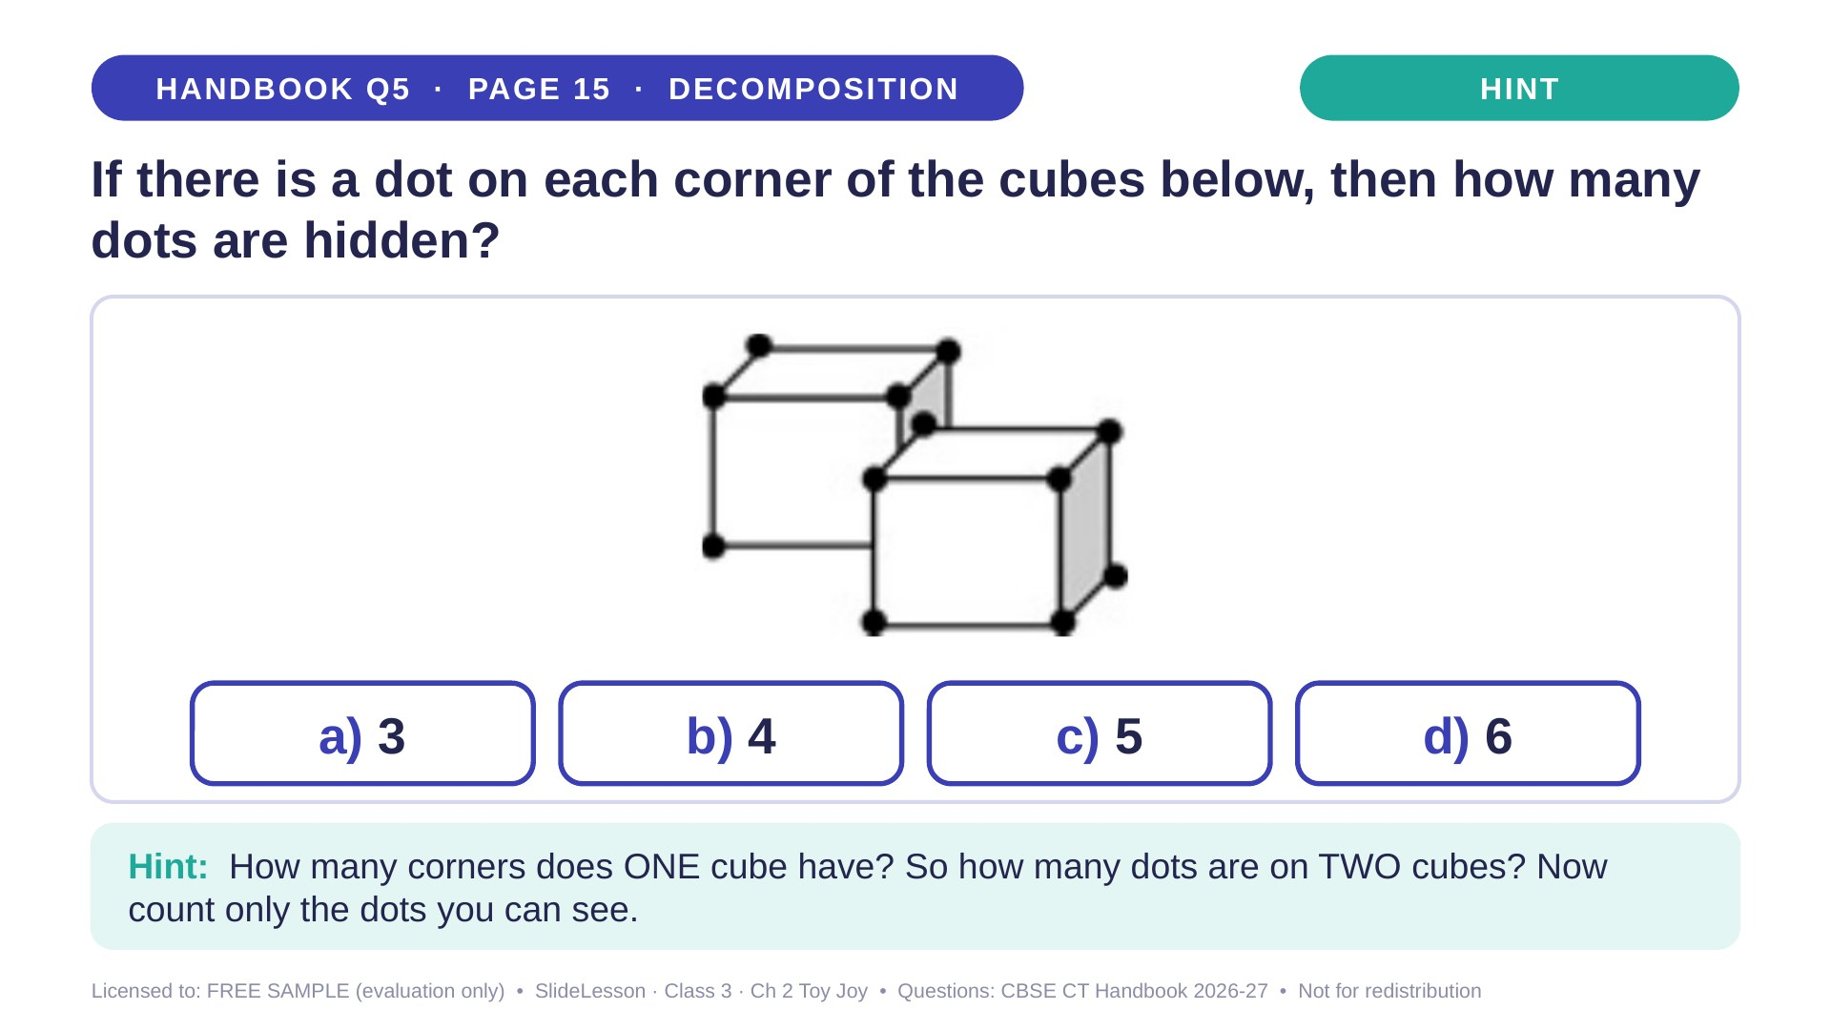
Notes:
Give the hint, then 1 more minute. Ask 2-3 children with DIFFERENT answers to explain their thinking before moving on.
WHILE SOLVING: children tick each visible dot as they count. COMMON MISTAKE: trying to 'see' hidden dots instead of calculating total minus visible. Praise the total-minus-seen strategy. EXTENSION: 3 cubes, 17 dots visible: how many hidden? (7)

Slide 32
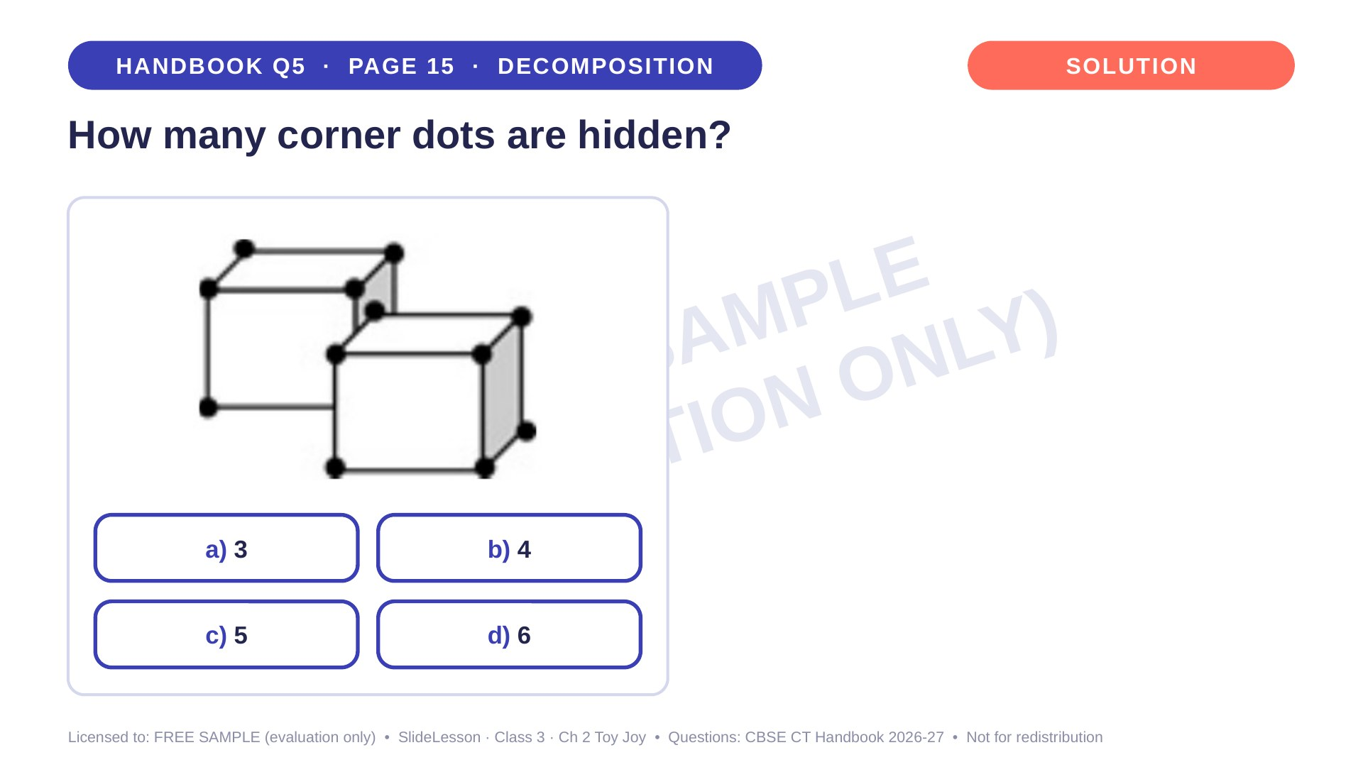
Notes:
WHILE SOLVING: children tick each visible dot as they count. COMMON MISTAKE: trying to 'see' hidden dots instead of calculating total minus visible. Praise the total-minus-seen strategy. EXTENSION: 3 cubes, 17 dots visible: how many hidden? (7)

Slide 33
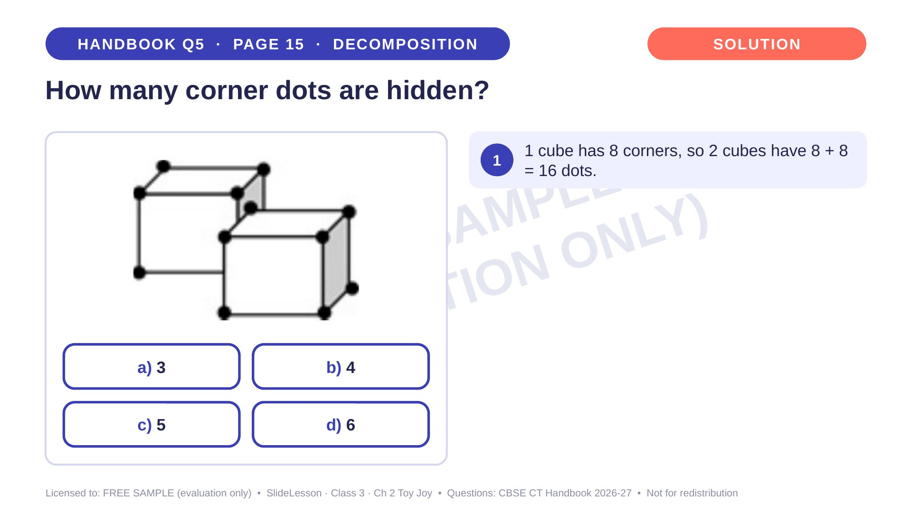
Notes:
Step 1 of 4

Slide 34
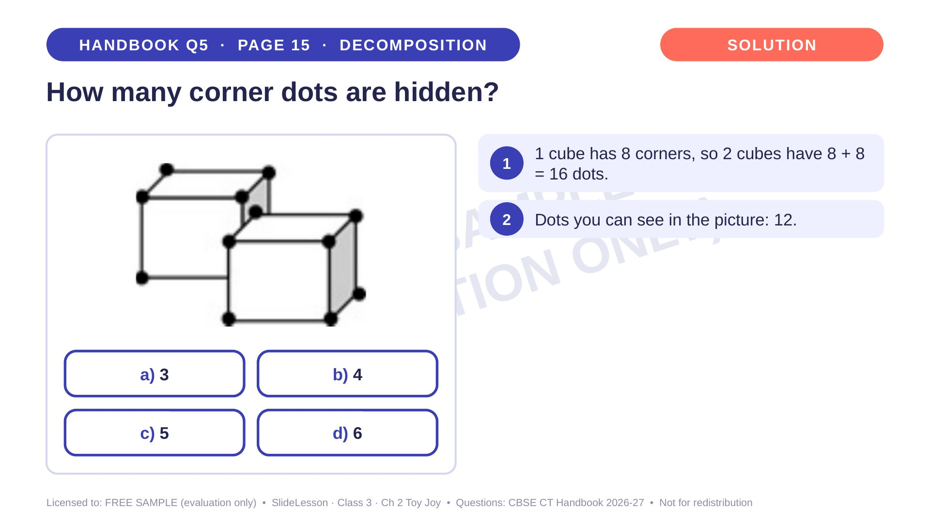
Notes:
Step 2 of 4

Slide 35
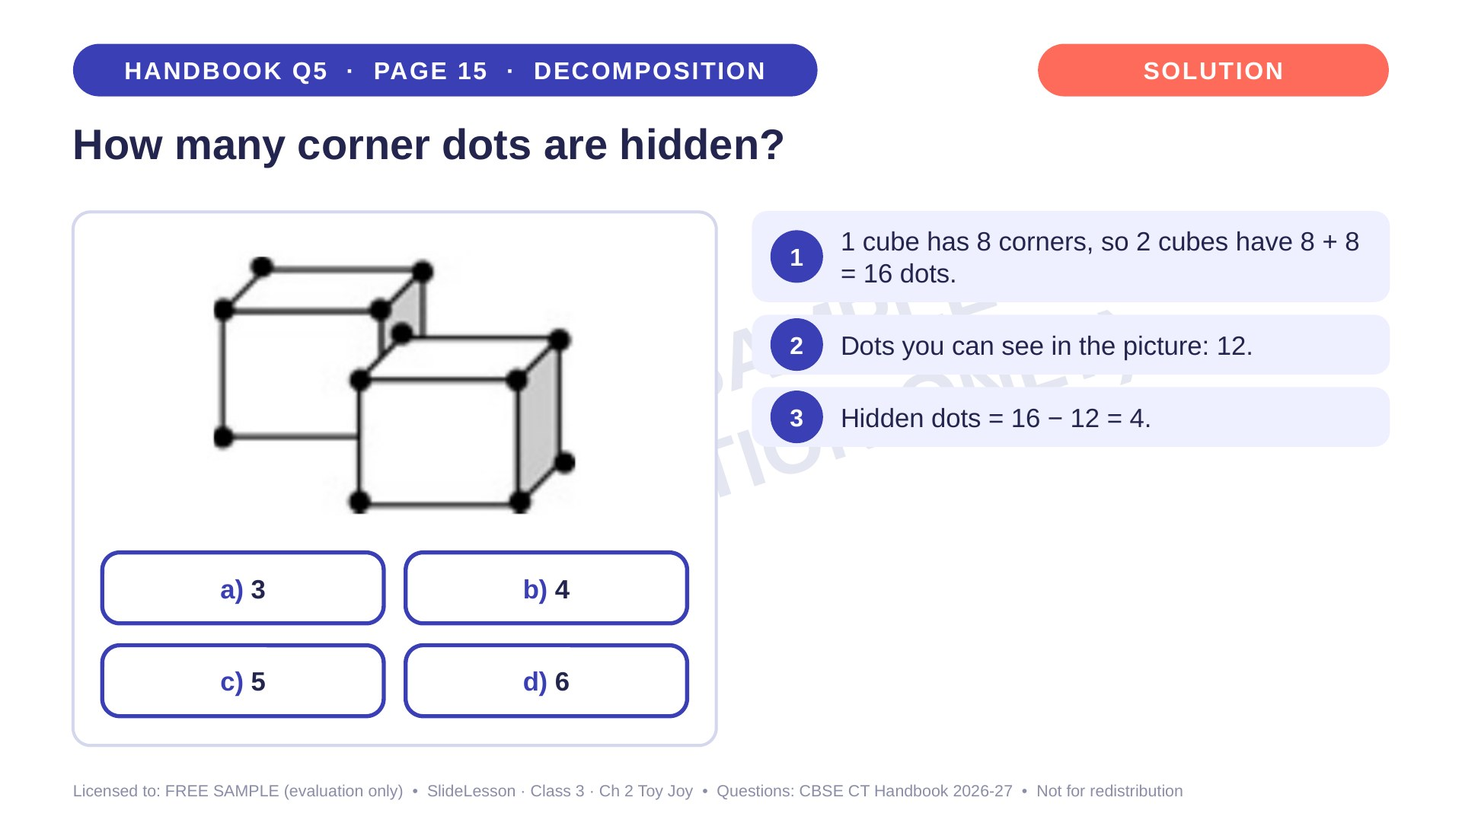
Notes:
Step 3 of 4

Slide 36
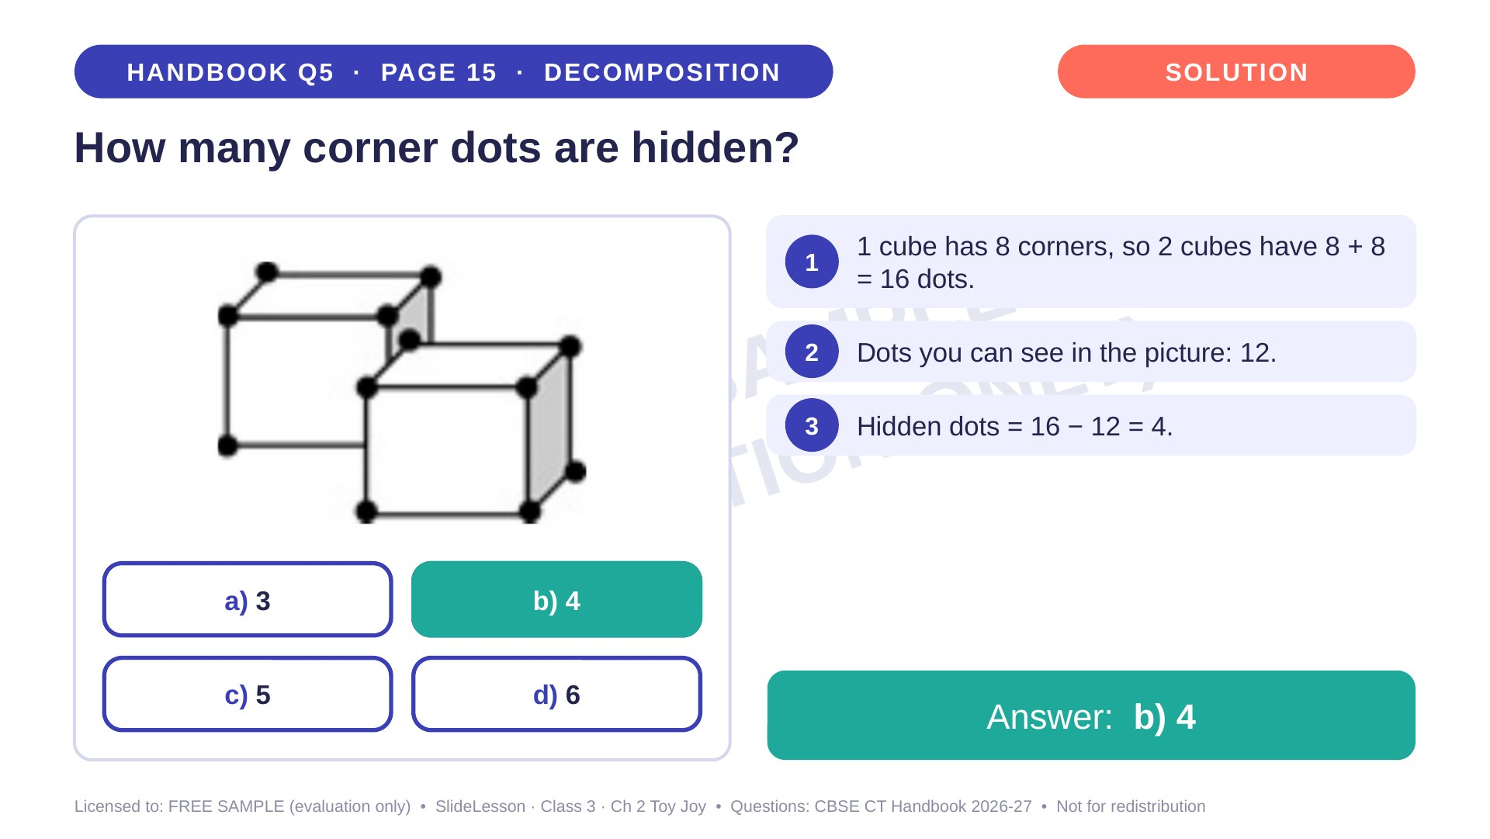
Notes:
Step 4 of 4

Slide 37
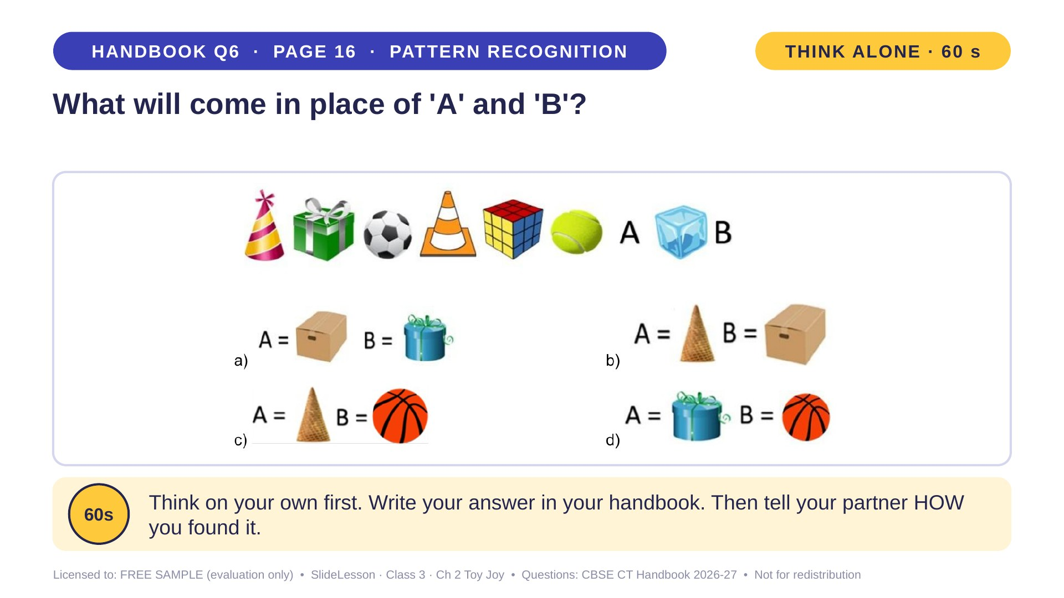
Notes:
WHILE SOLVING: write the SHAPE name under each object on the board. COMMON MISTAKE: choosing by colour or by 'party things'. EXTENSION: children make their own cone-cube-sphere pattern with classroom objects.
ANSWER (do not tell yet): c

Slide 38
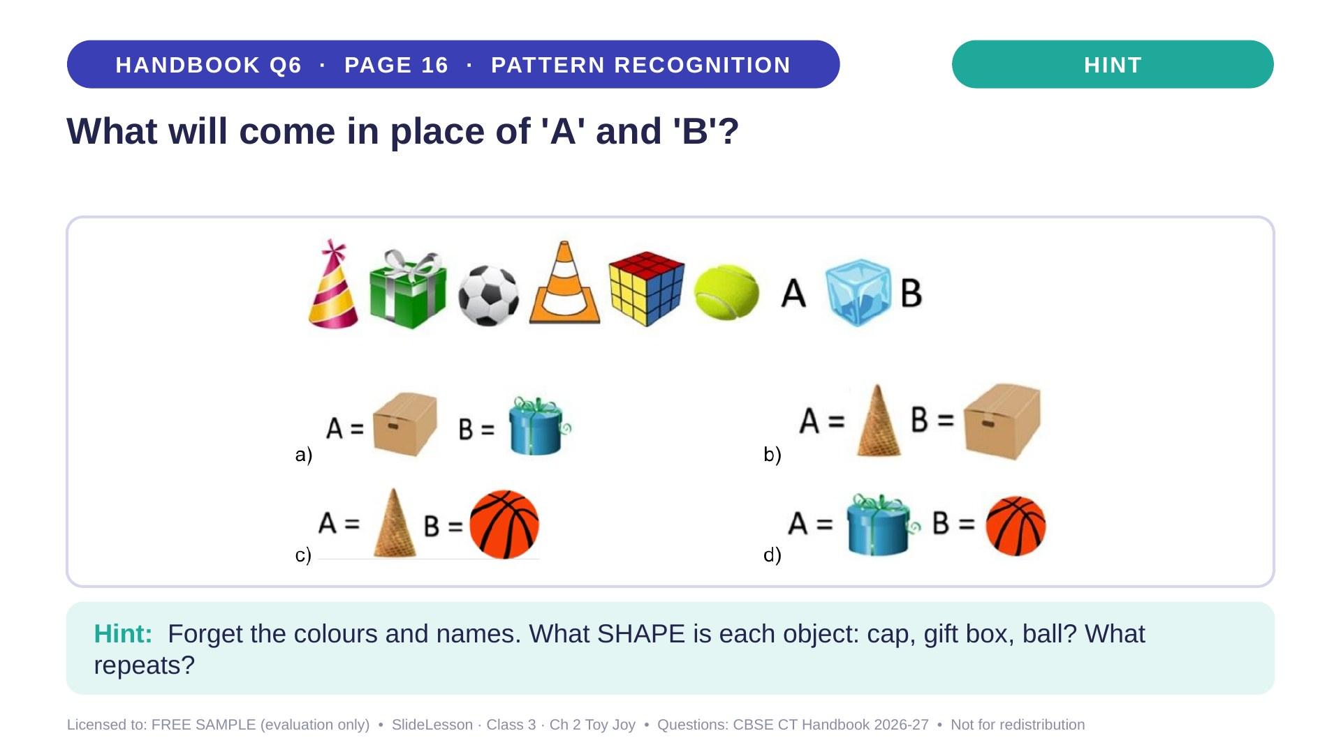
Notes:
Give the hint, then 1 more minute. Ask 2-3 children with DIFFERENT answers to explain their thinking before moving on.
WHILE SOLVING: write the SHAPE name under each object on the board. COMMON MISTAKE: choosing by colour or by 'party things'. EXTENSION: children make their own cone-cube-sphere pattern with classroom objects.

Slide 39
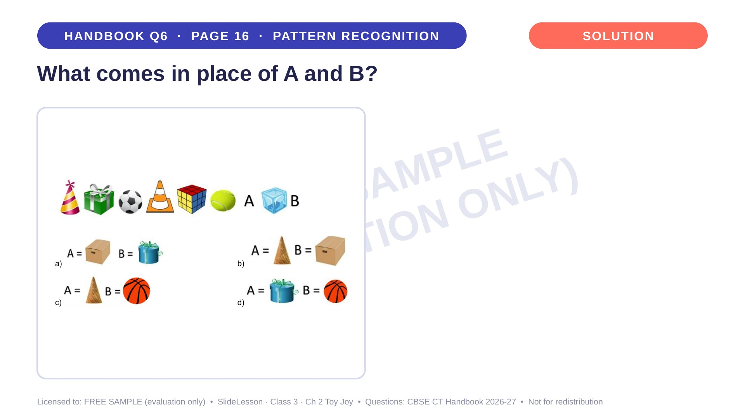
Notes:
WHILE SOLVING: write the SHAPE name under each object on the board. COMMON MISTAKE: choosing by colour or by 'party things'. EXTENSION: children make their own cone-cube-sphere pattern with classroom objects.

Slide 40
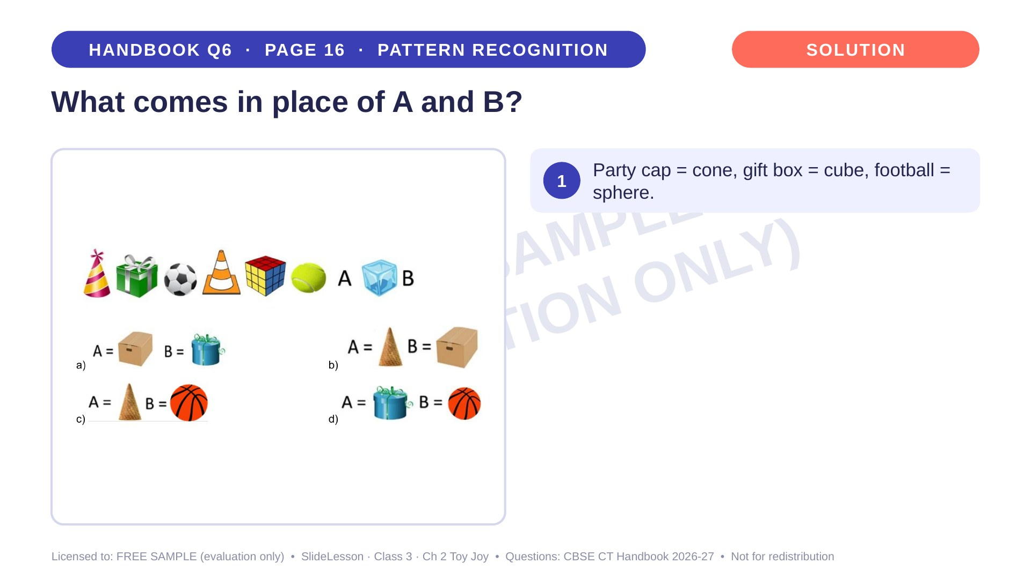
Notes:
Step 1 of 4

Slide 41
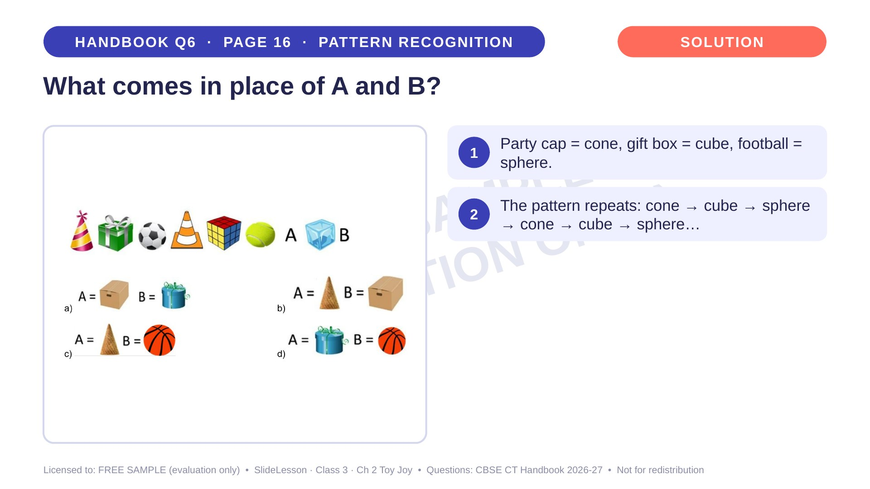
Notes:
Step 2 of 4

Slide 42
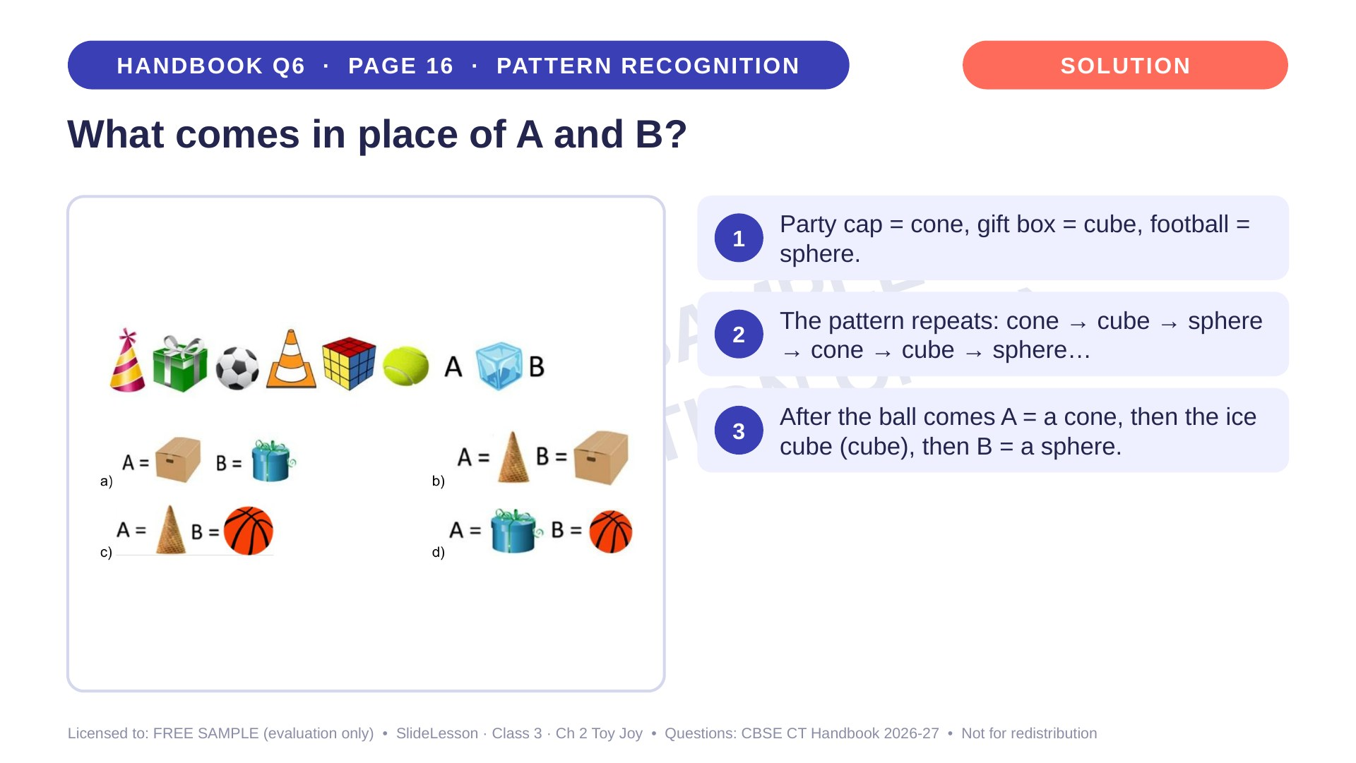
Notes:
Step 3 of 4

Slide 43
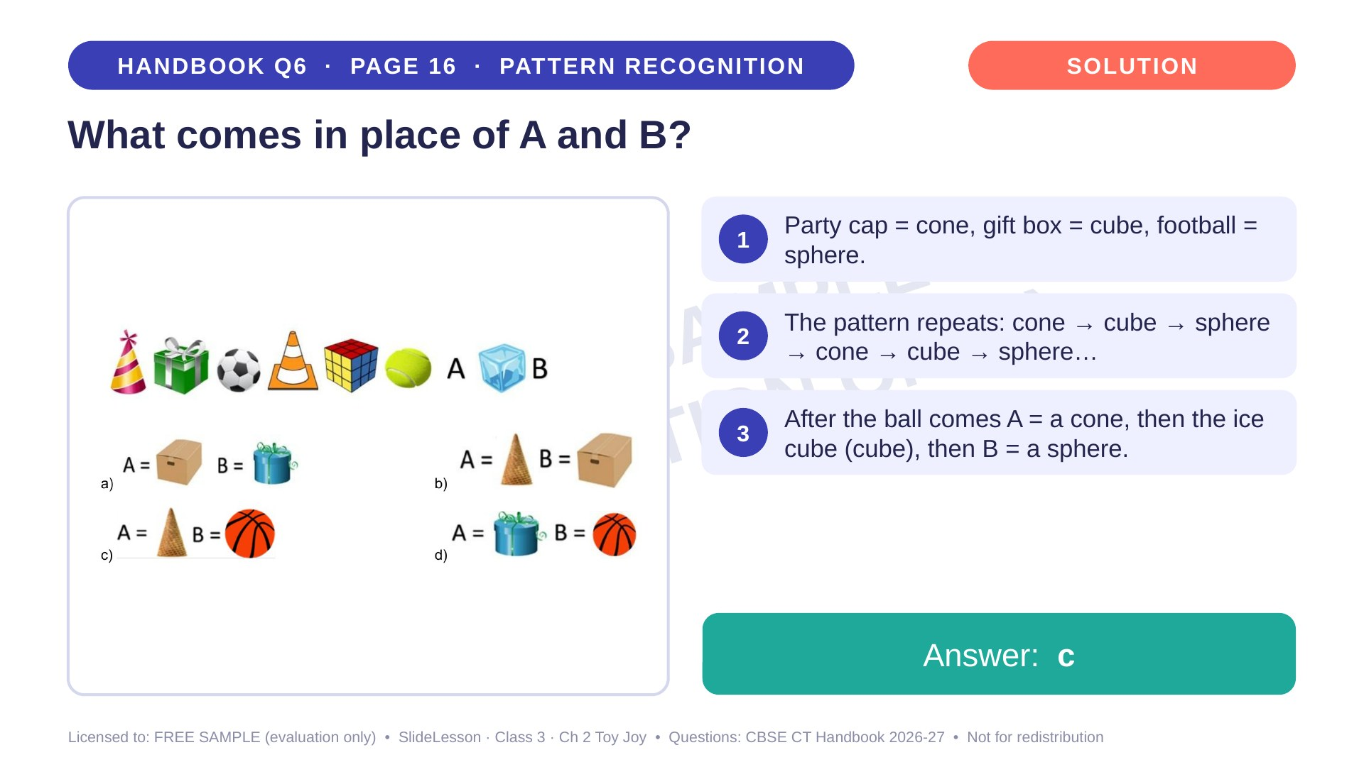
Notes:
Step 4 of 4

Slide 44
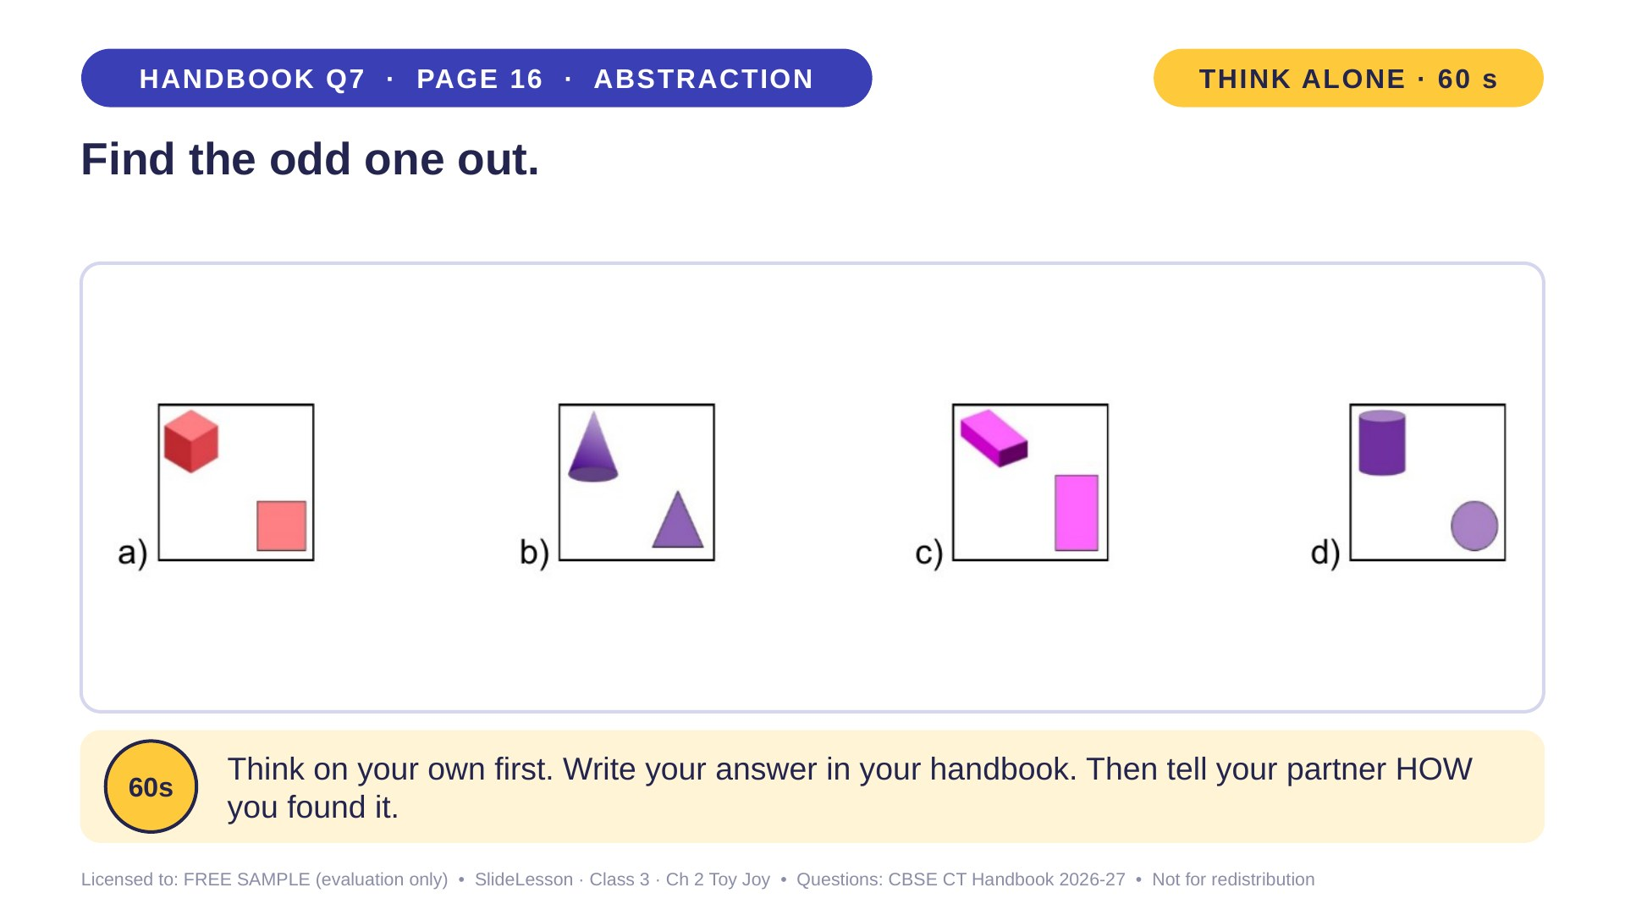
Notes:
WHILE SOLVING: ask pairs to state the rule in words before choosing. COMMON MISTAKE: choosing by colour. BEFORE: stand a cone on the table and ask what a bird sees (a circle). EXTENSION: change box b so it follows the rule.
ANSWER (do not tell yet): b

Slide 45
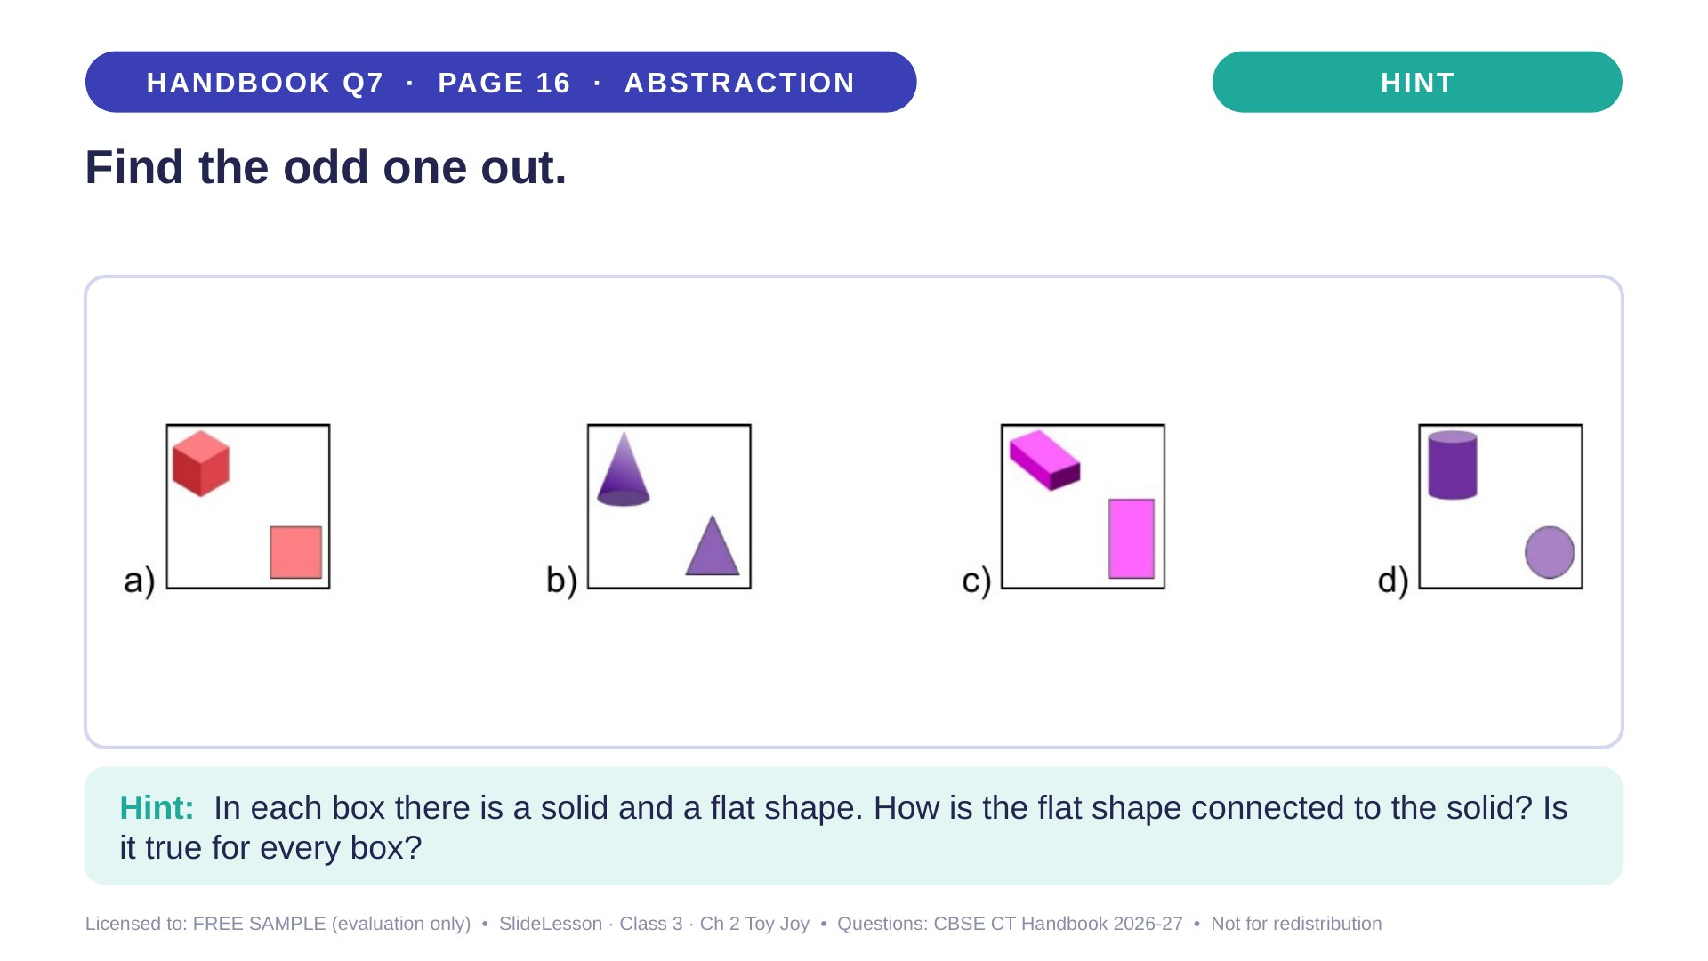
Notes:
Give the hint, then 1 more minute. Ask 2-3 children with DIFFERENT answers to explain their thinking before moving on.
WHILE SOLVING: ask pairs to state the rule in words before choosing. COMMON MISTAKE: choosing by colour. BEFORE: stand a cone on the table and ask what a bird sees (a circle). EXTENSION: change box b so it follows the rule.

Slide 46
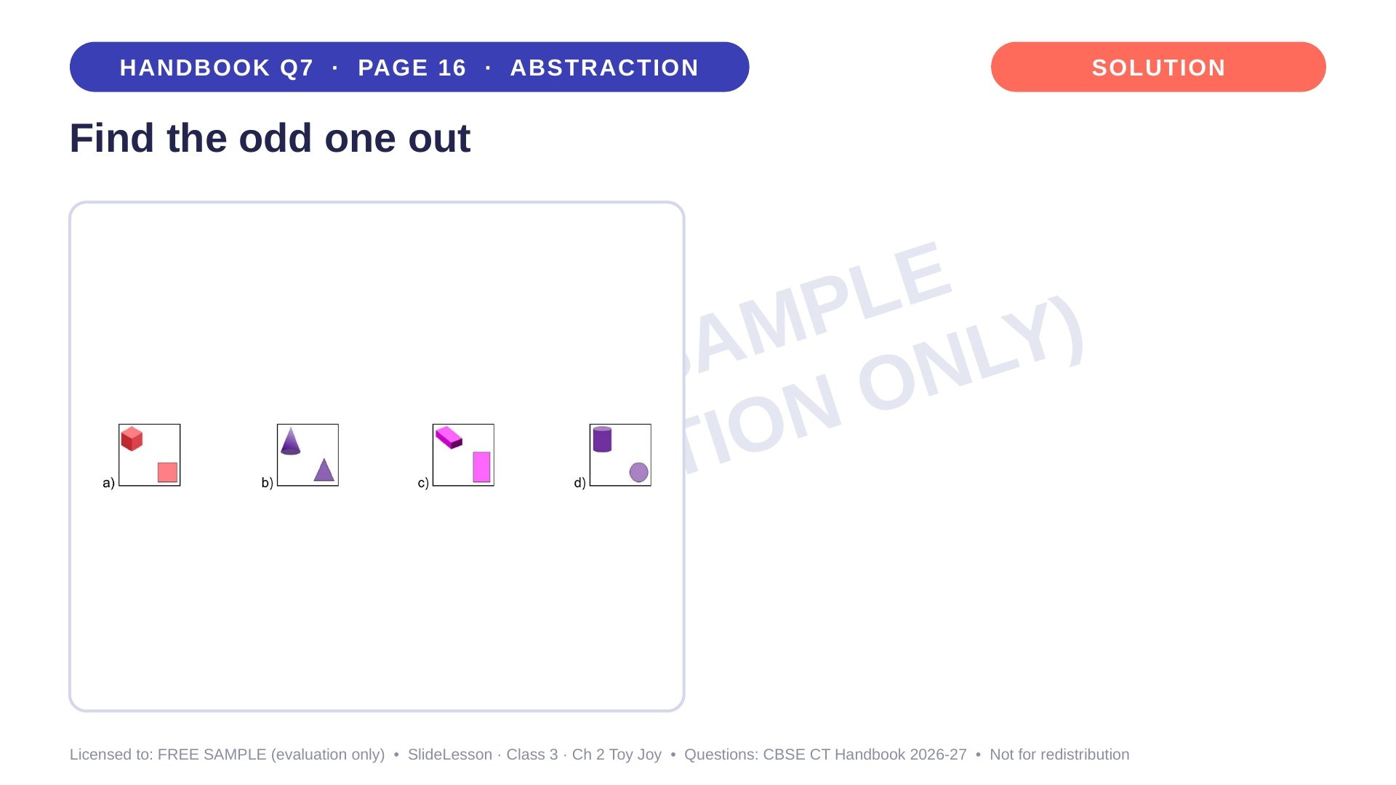
Notes:
WHILE SOLVING: ask pairs to state the rule in words before choosing. COMMON MISTAKE: choosing by colour. BEFORE: stand a cone on the table and ask what a bird sees (a circle). EXTENSION: change box b so it follows the rule.

Slide 47
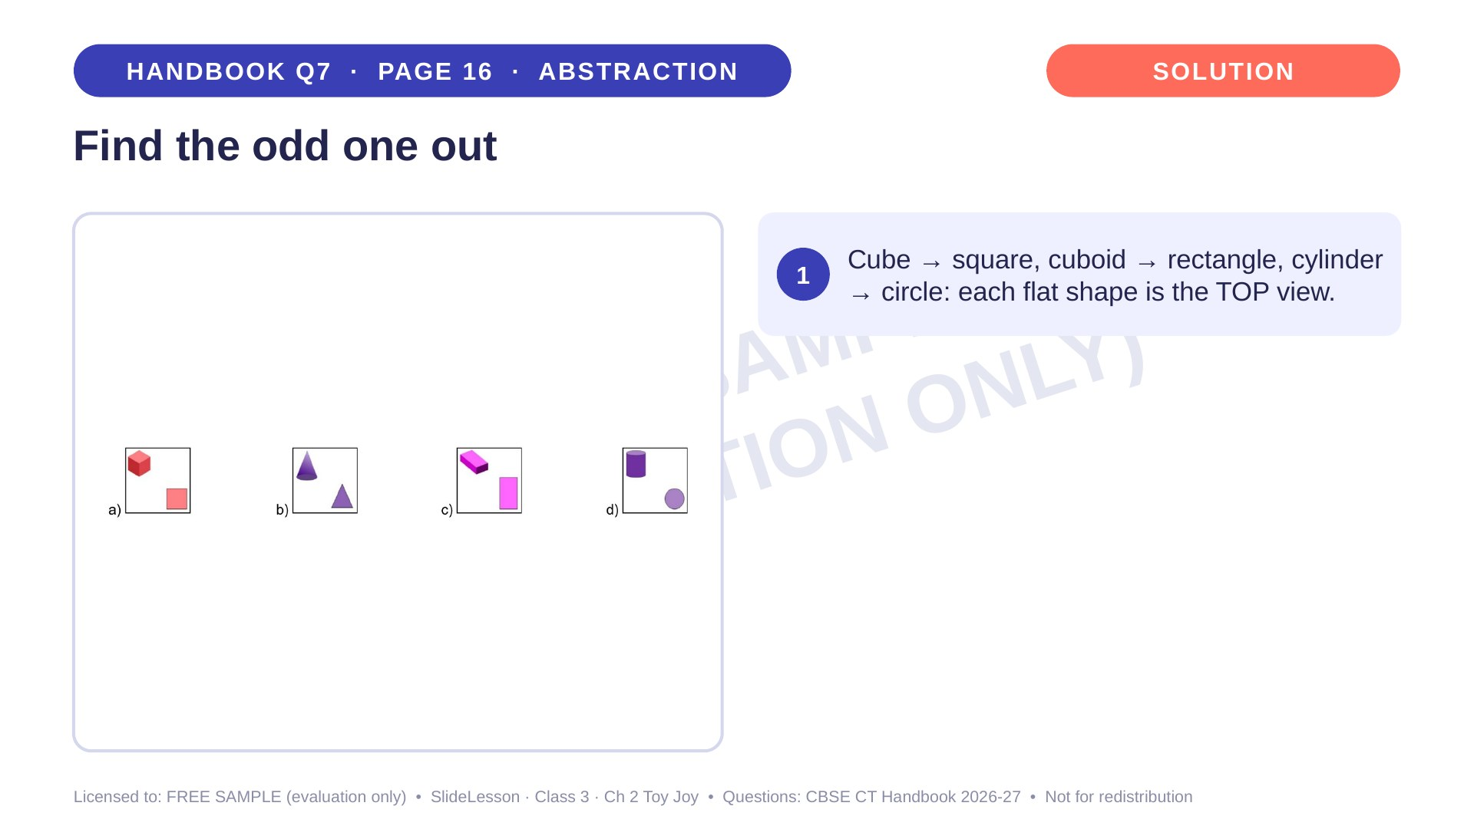
Notes:
Step 1 of 4

Slide 48
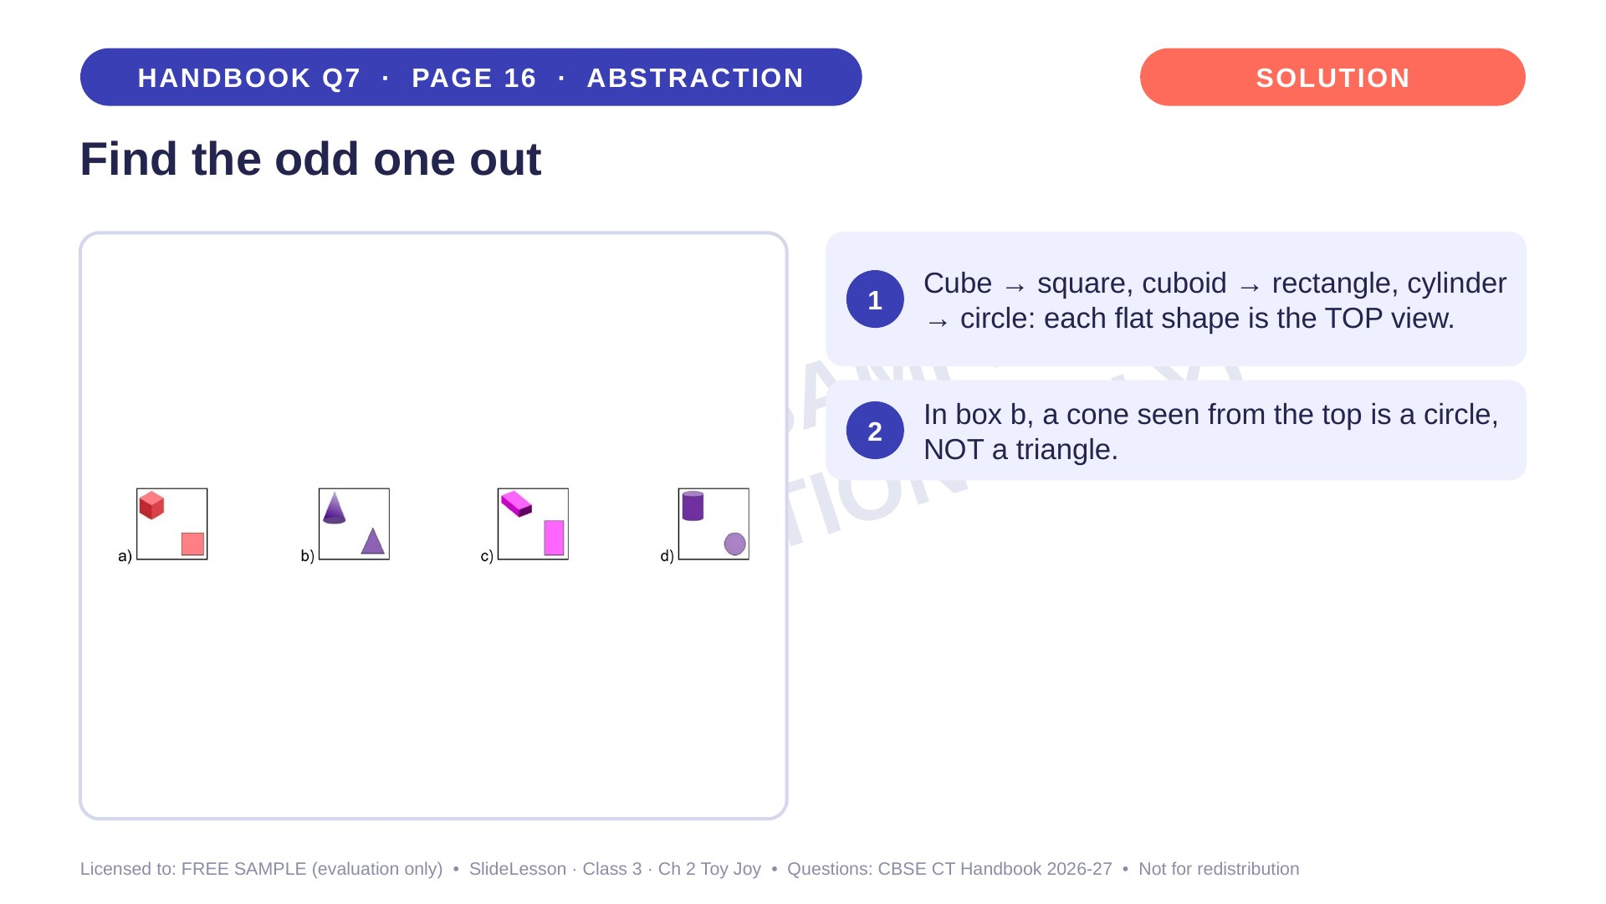
Notes:
Step 2 of 4

Slide 49
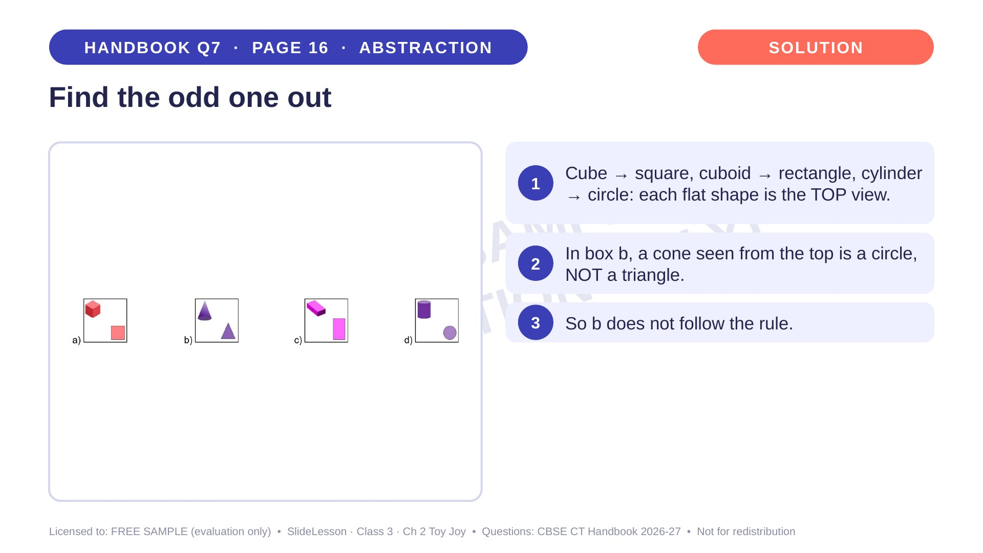
Notes:
Step 3 of 4

Slide 50
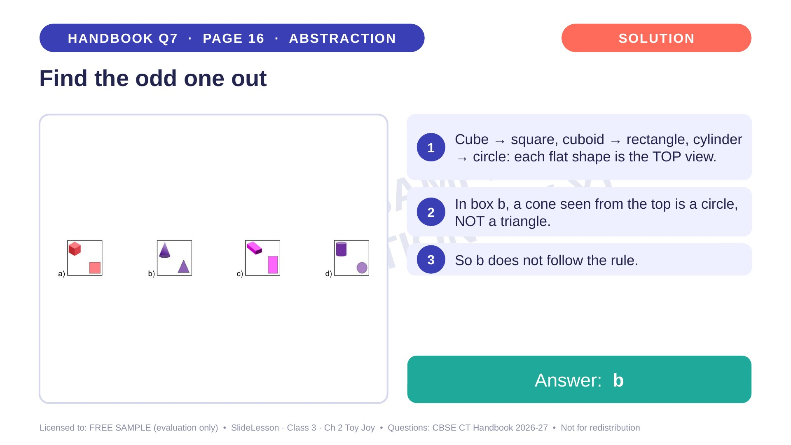
Notes:
Step 4 of 4

Slide 51

Notes:
WHILE SOLVING: ask 'Which block is nearest to you? Which is on your left?' COMMON MISTAKE: mixing up left and right. The mirror trap (b vs c) is the key discussion. BEFORE: build it with 4 blocks and let children look from the arrow side. EXTENSION: what would it look like from the opposite side?
ANSWER (do not tell yet): c

Slide 52

Notes:
Give the hint, then 1 more minute. Ask 2-3 children with DIFFERENT answers to explain their thinking before moving on.
WHILE SOLVING: ask 'Which block is nearest to you? Which is on your left?' COMMON MISTAKE: mixing up left and right. The mirror trap (b vs c) is the key discussion. BEFORE: build it with 4 blocks and let children look from the arrow side. EXTENSION: what would it look like from the opposite side?

Slide 53

Notes:
WHILE SOLVING: ask 'Which block is nearest to you? Which is on your left?' COMMON MISTAKE: mixing up left and right. The mirror trap (b vs c) is the key discussion. BEFORE: build it with 4 blocks and let children look from the arrow side. EXTENSION: what would it look like from the opposite side?

Slide 54

Notes:
Step 1 of 4

Slide 55

Notes:
Step 2 of 4

Slide 56

Notes:
Step 3 of 4

Slide 57

Notes:
Step 4 of 4

Slide 58

Notes:
WHILE SOLVING: give a printed copy and ask children to trace each edge with a pencil as they check it. COMMON MISTAKE: skipping the standing edges or counting one edge twice. EXTENSION: how many edges does this solid have altogether? (18)
ANSWER (do not tell yet): c) 4

Slide 59

Notes:
Give the hint, then 1 more minute. Ask 2-3 children with DIFFERENT answers to explain their thinking before moving on.
WHILE SOLVING: give a printed copy and ask children to trace each edge with a pencil as they check it. COMMON MISTAKE: skipping the standing edges or counting one edge twice. EXTENSION: how many edges does this solid have altogether? (18)

Slide 60

Notes:
WHILE SOLVING: give a printed copy and ask children to trace each edge with a pencil as they check it. COMMON MISTAKE: skipping the standing edges or counting one edge twice. EXTENSION: how many edges does this solid have altogether? (18)

Slide 61

Notes:
Step 1 of 4

Slide 62

Notes:
Step 2 of 4

Slide 63

Notes:
Step 3 of 4

Slide 64

Notes:
Step 4 of 4

Slide 65

Notes:
WHILE SOLVING: encourage two-step elimination (join 2, eliminate, then add the 3rd). COMMON MISTAKE: only counting blocks; the arrangement matters. BEFORE: give groups snap cubes to build the three pieces. EXTENSION: which piece would you remove to make option b?
ANSWER (do not tell yet): d

Slide 66

Notes:
Give the hint, then 1 more minute. Ask 2-3 children with DIFFERENT answers to explain their thinking before moving on.
WHILE SOLVING: encourage two-step elimination (join 2, eliminate, then add the 3rd). COMMON MISTAKE: only counting blocks; the arrangement matters. BEFORE: give groups snap cubes to build the three pieces. EXTENSION: which piece would you remove to make option b?

Slide 67

Notes:
WHILE SOLVING: encourage two-step elimination (join 2, eliminate, then add the 3rd). COMMON MISTAKE: only counting blocks; the arrangement matters. BEFORE: give groups snap cubes to build the three pieces. EXTENSION: which piece would you remove to make option b?

Slide 68

Notes:
Step 1 of 3

Slide 69

Notes:
Step 2 of 3

Slide 70

Notes:
Step 3 of 3

Slide 71

Notes:
THE THINKING SPOT. WHILE SOLVING: ask 'Which sets are even-numbered?' and 'Could set 4 be a draw?' COMMON MISTAKE: answering 'cannot be determined' because set 5 is unknown; B already has 3 sets. EXTENSION: if A had won set 4, could we know the winner?
ANSWER (do not tell yet): b) B

Slide 72

Notes:
Give the hint, then 1 more minute. Ask 2-3 children with DIFFERENT answers to explain their thinking before moving on.
THE THINKING SPOT. WHILE SOLVING: ask 'Which sets are even-numbered?' and 'Could set 4 be a draw?' COMMON MISTAKE: answering 'cannot be determined' because set 5 is unknown; B already has 3 sets. EXTENSION: if A had won set 4, could we know the winner?

Slide 73

Notes:
THE THINKING SPOT. WHILE SOLVING: ask 'Which sets are even-numbered?' and 'Could set 4 be a draw?' COMMON MISTAKE: answering 'cannot be determined' because set 5 is unknown; B already has 3 sets. EXTENSION: if A had won set 4, could we know the winner?

Slide 74

Notes:
Step 1 of 4

Slide 75

Notes:
Step 2 of 4

Slide 76

Notes:
Step 3 of 4

Slide 77

Notes:
Step 4 of 4

Slide 78


Slide 79


